Slide 2
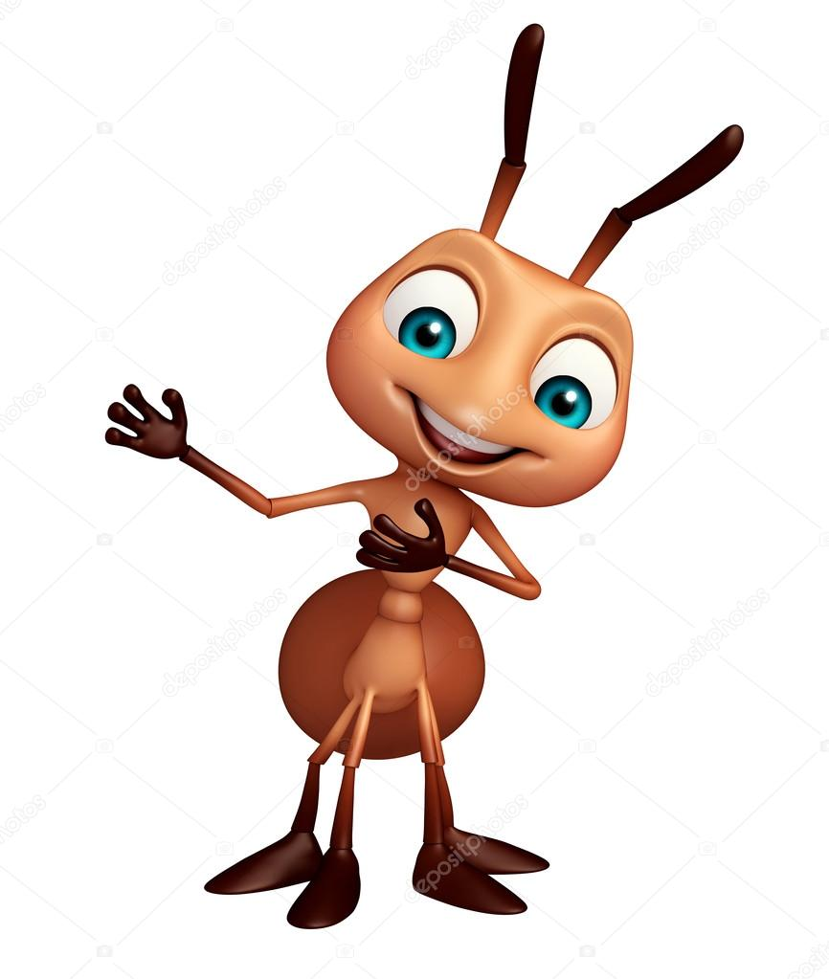
Welcome to today's class

Slide 3
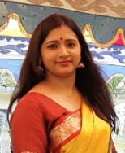
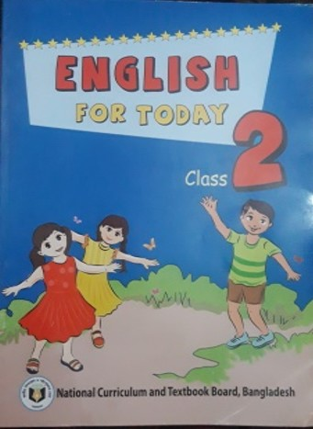
Introduction
Tonny Goswami
Assistant Teacher
Banshbaria GP School
Kamarkhand, Sirajganj
Class: Two
Subject: English
Unit: 1
Lesson: 4-6
Time: 50 minute

Slide 4
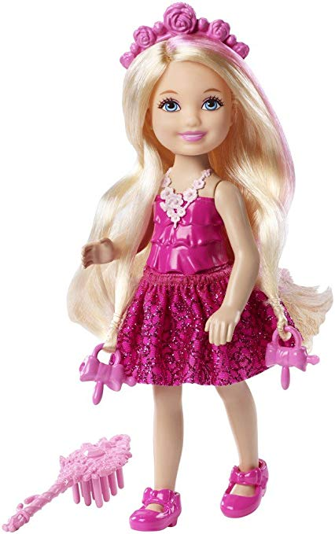
Let’s Recite a Rhyme
Discuss about the rhyme

Slide 5
Today’s Lesson
Alphabet (Aa-Ee)

Slide 6
Learning
At the end of this lesson, students will be able to
Listening
1.1.1 Become familiar with English sound by listening to common English word.
Speaking
1.1.1 Repeat after the teacher simple words and phrases with proper sound and stress.
Reading
1.2.1 Recognize and read the alphabet both small and capital (non cursive)

Slide 7
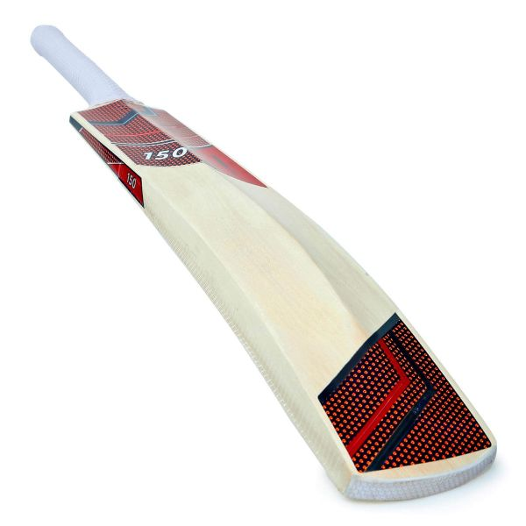
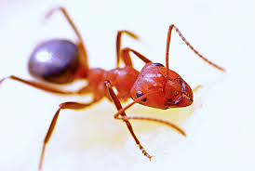
Come see the pictures below and say it out loud
What is this?
What is this?
Ant
Bat

Slide 8
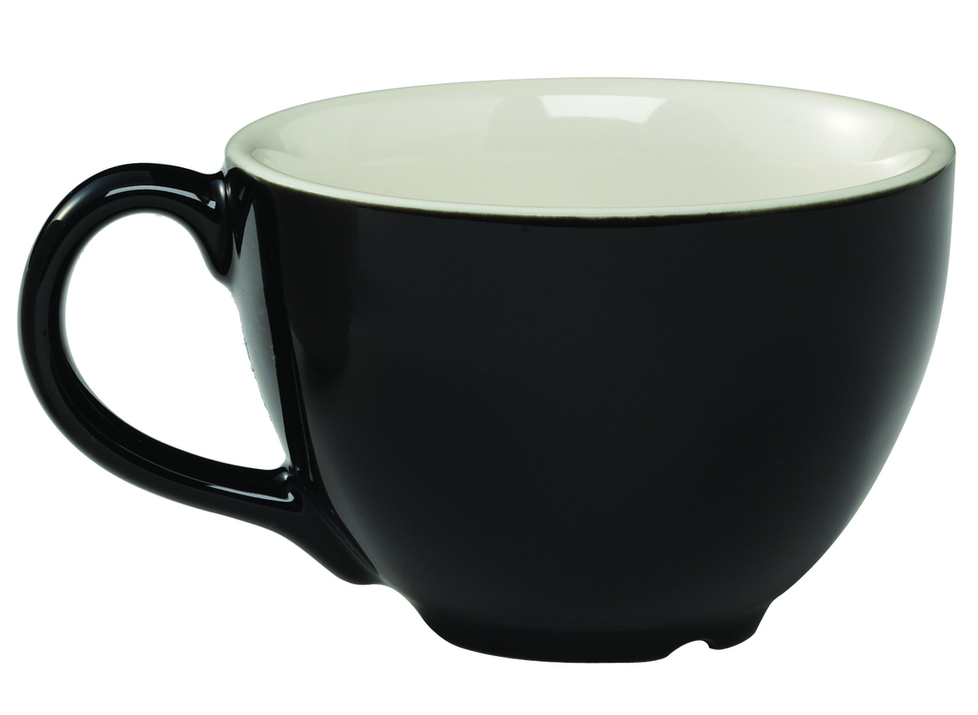
Come see the pictures below and say it out loud
What is this?
What is this?
Cup
Doll

Slide 9
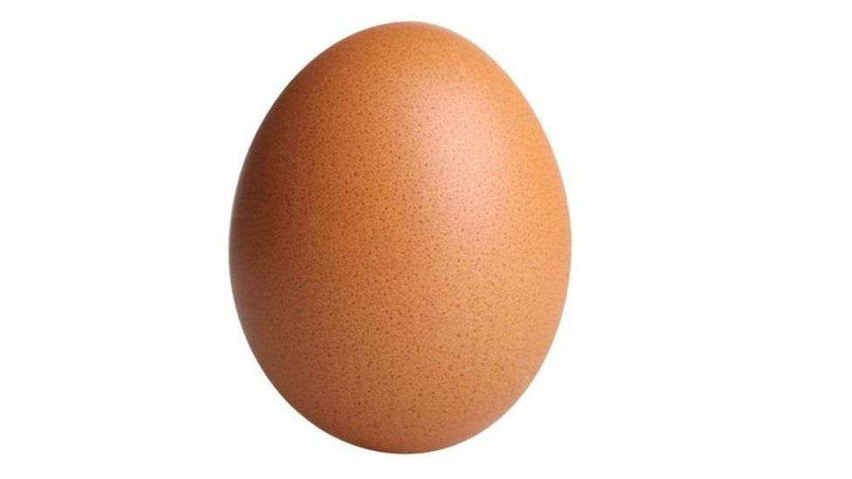
Come see the pictures below and say it out loud
What is this?
Egg

Slide 10
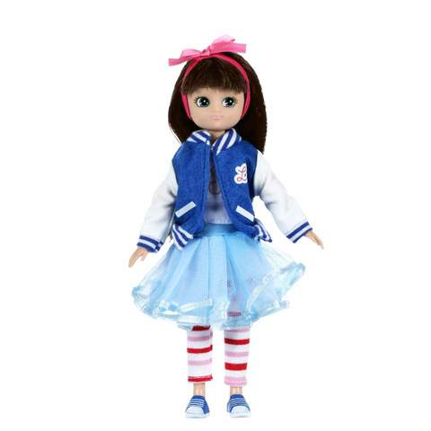
Loud reading by the teacher
A
Ant
B
Bat
C
Cup
D
Doll
E
Egg

Slide 11
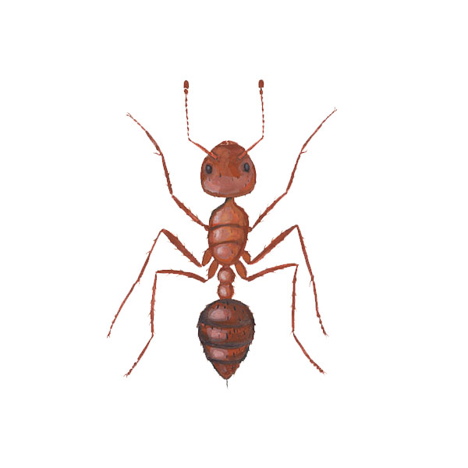
What can you see?
Ant
What is the letter name?
A
a
Small letter
Capital letter

Slide 12
What can you see?
Bat
What is the letter name?
B
b
Small letter
Capital letter

Slide 13
What can you see?
Cup
What is the letter name?
C
c
Small letter
Capital letter

Slide 14
Match the words with the letter
Aa
Bb
Cc
Cup
Ant
Bat

Slide 15
Evaluation
Fill in the blanks by small letter.
A…….. , B …….., C …….., D …….., E ……..

Slide 16
Home work
You will learn another new words with the todays learning letter.

Slide 17
Thank you

