Slide 1

WELCOME

Slide 2
Introduction of the teacher
Name: Rahim Ahmed
Post : Assistant Teacher
School Name: Mokrompur Government Primary School
Upozila: Jagannath Pur
District: Sunamganj
Division: Sylhet
Email: rahim8u@gmail.com

Slide 3

Introduction of the lesson
Class: Five
Unit: 06
Lesson: 01
Lesson Title: Eat healthy
Today’s Lesson: Activity A, B & C
Page: 22
Total Time: 40 minutes

Slide 4
Learning outcomes
By the end of the lesson the students will be able to-
Listening:
3.3.1 understand questions about objects around them.
3.4.1 understand statements made by the teacher and students
Speaking:
1.1.1 say words, phrases and sentences with proper sounds and stress.
6.2.1 talk about people, objects, events, etc.
8.1.1 take part in conversations on appropriate topics.
Reading:
1.5.1 read words, phrases and sentences in the text with proper pronounciation, stress and intonation.

Slide 5
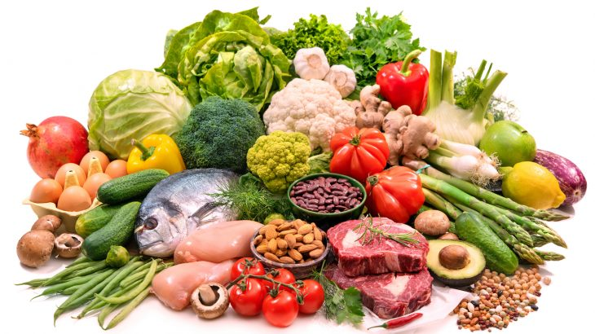
lettuce
Let’s see the pictures
egg
fish
Can you find out the egg, the fish & the lettuce in the picture?

Slide 6
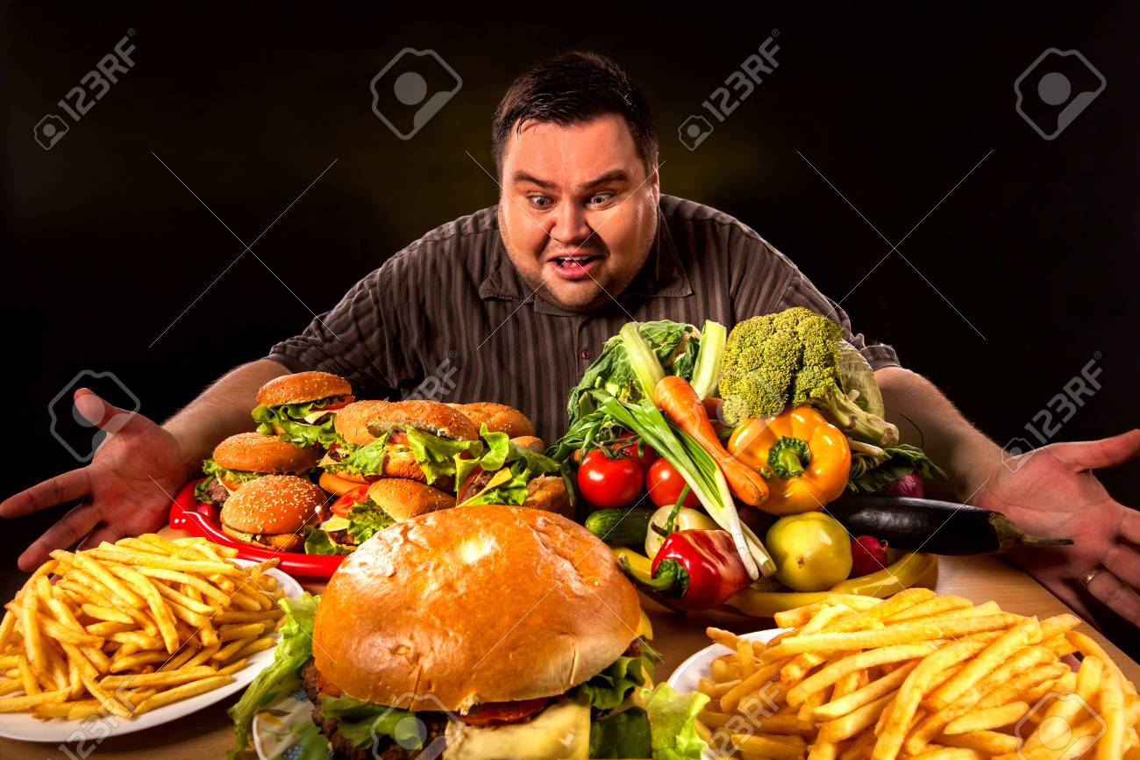
What is the man trying to do?
The man is trying to eat.

Slide 7
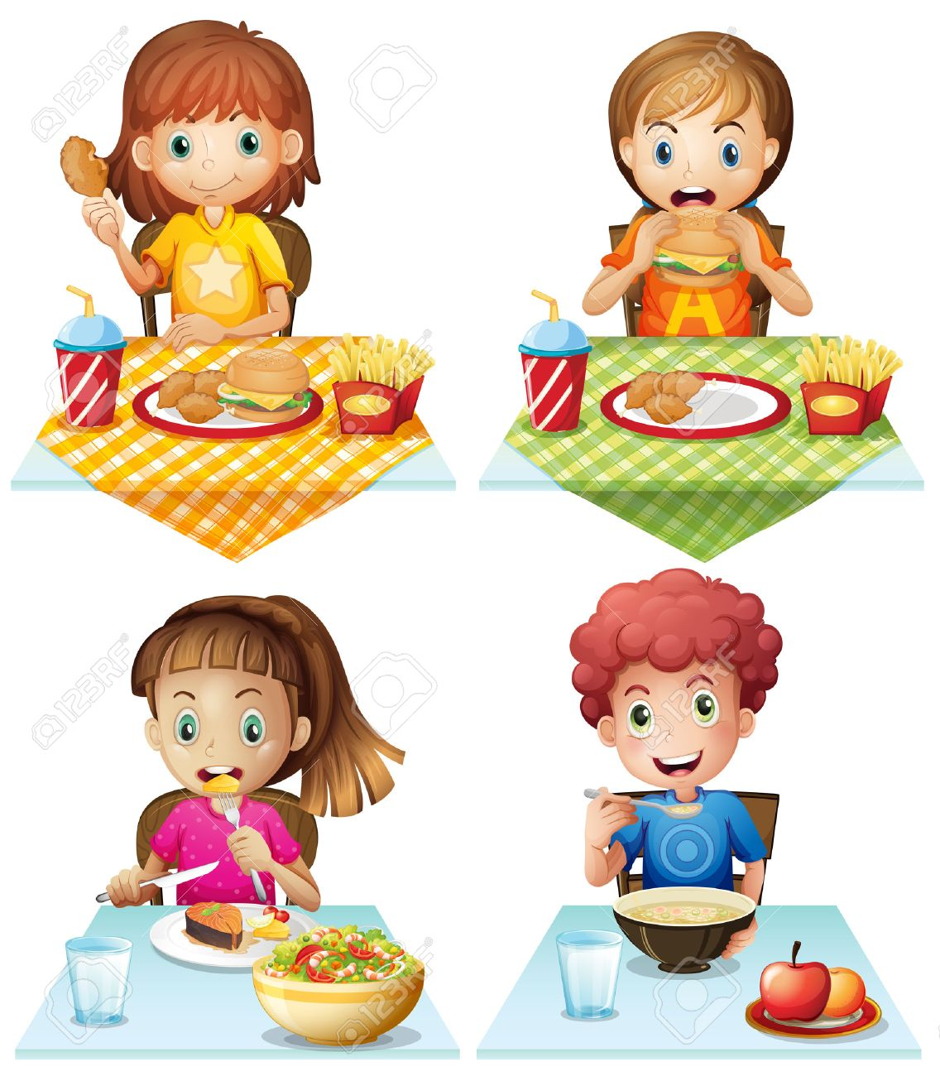
1
Who are eating healthy in the picture 1 or 2 ?
2
2

Slide 8
Today’s Lesson is
Eat Healthy

Slide 9
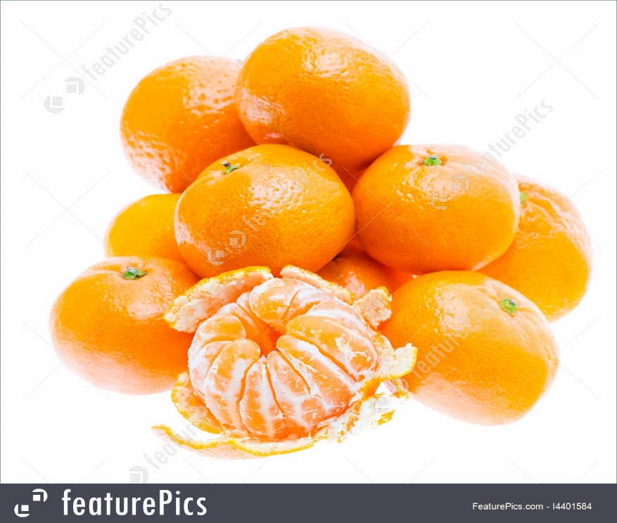
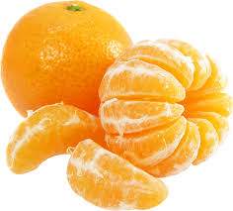
What is the name of this fruit?
Orange
Notes:
Rule: 1. Teacher will show the word chart 2. Students will chose three words and write down 3. Teacher will say any three words randomly one after one. 4. Students will cross the name if it matches with the teacher 5. The students who cross all of the three will shout “BINGO’ and will be the winner.

Slide 10
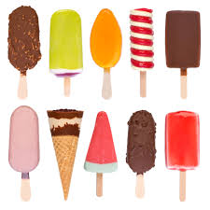
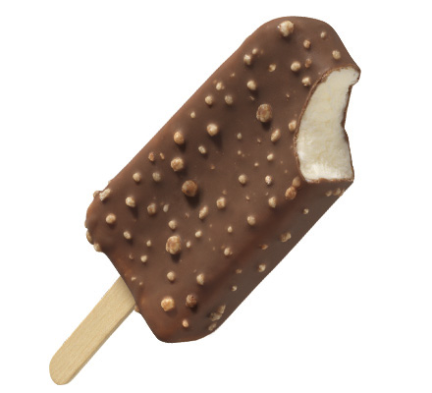
Ice-cream
This is ……………………….……….?

Slide 11
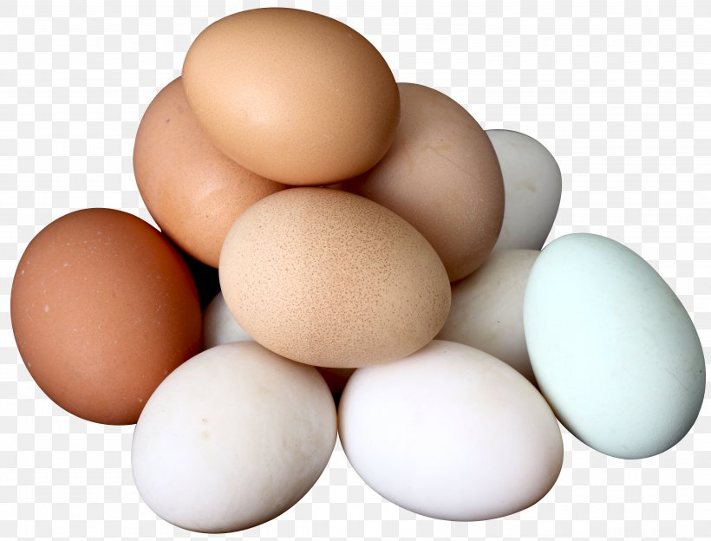
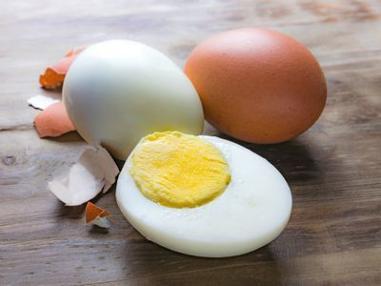
egg

Slide 12
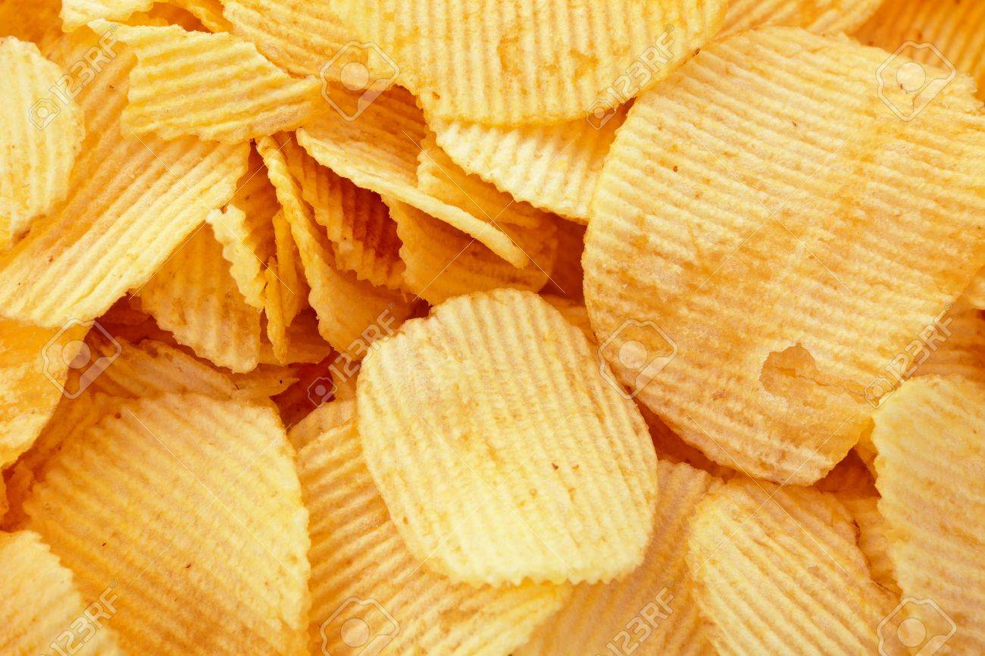
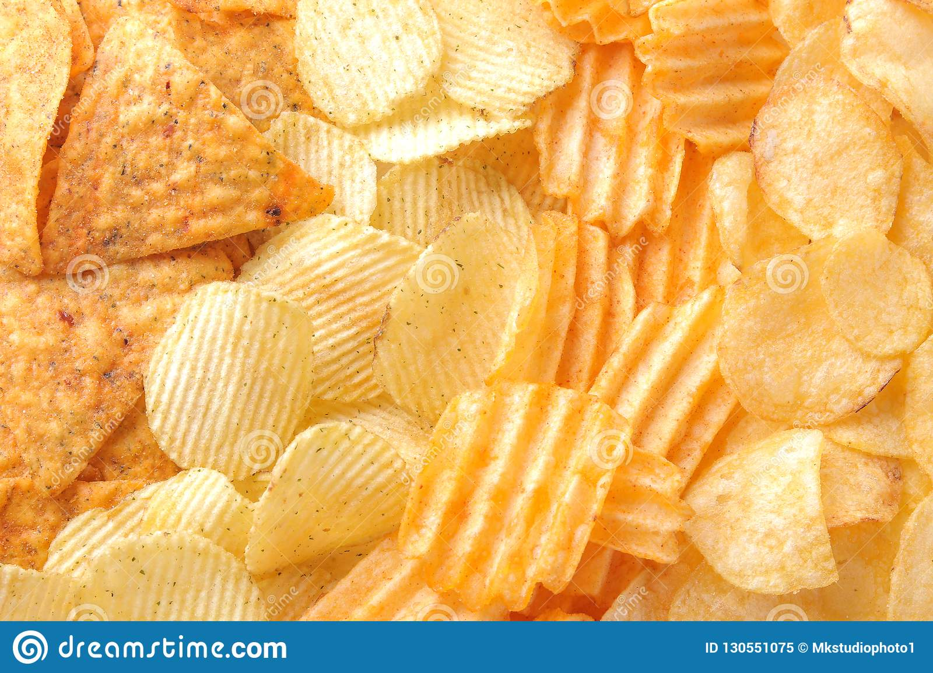
chips
Here is……….………?

Slide 13
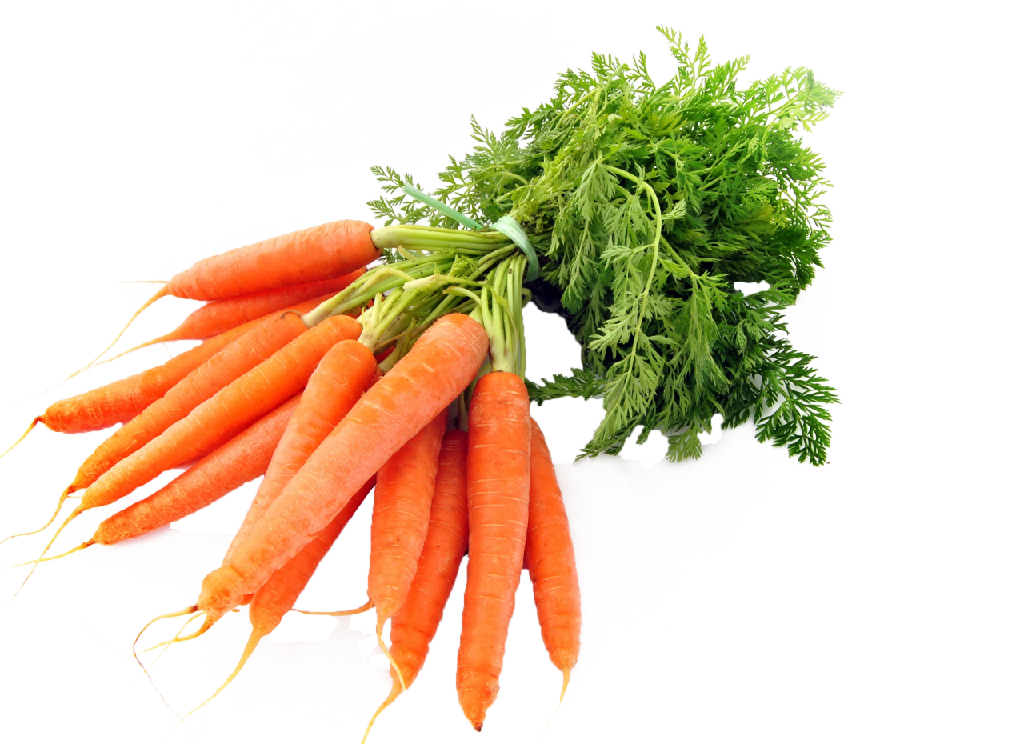
Do you like this?
carrots
Tell the name?

Slide 14
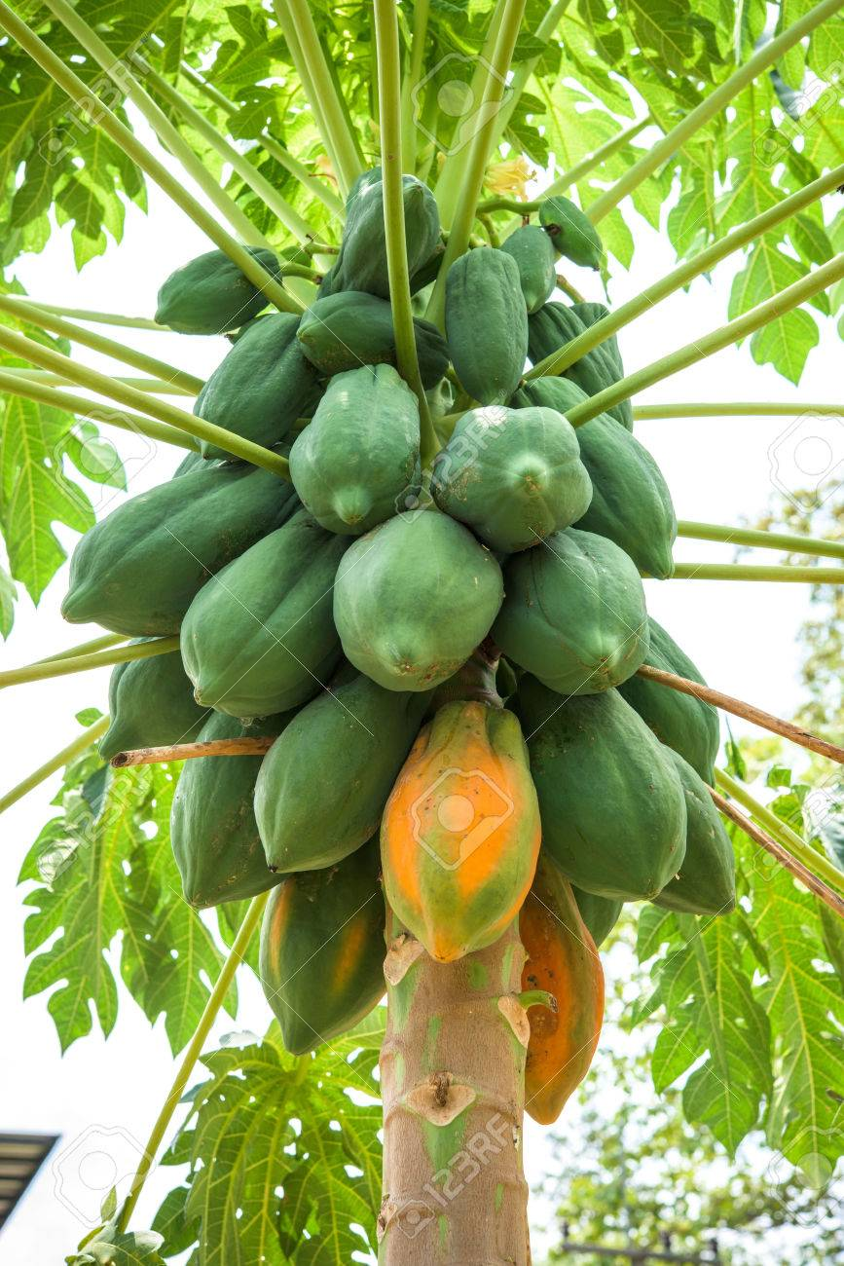
Who do/does eat this?
papaya
Name please?

Slide 15
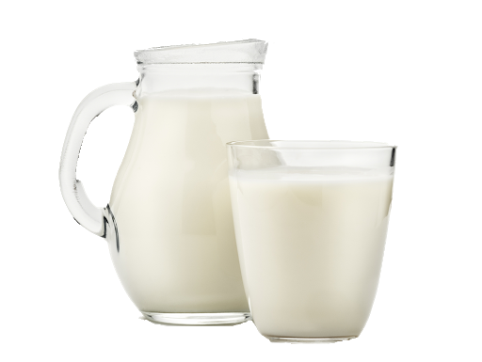
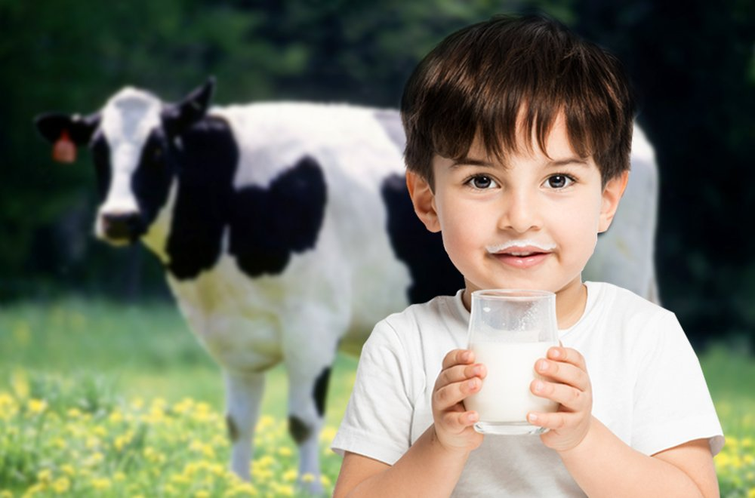
What is there in the glass?
milk

Slide 16
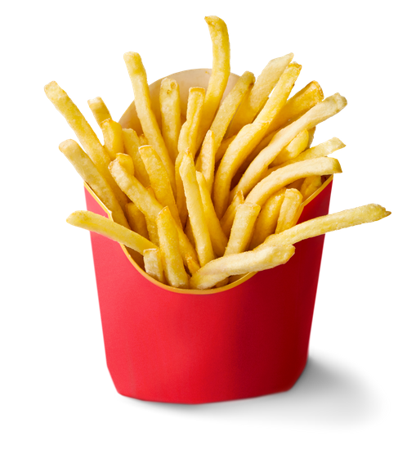
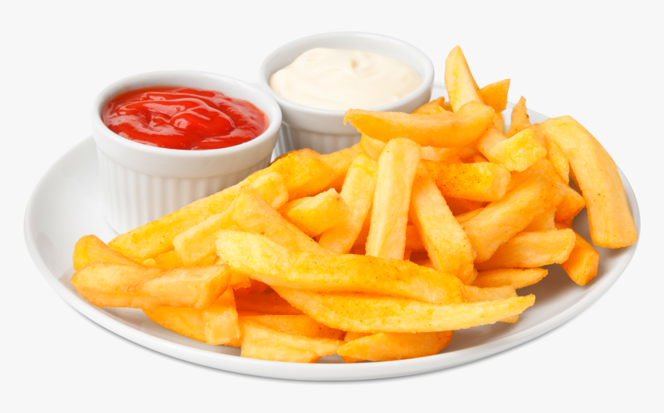
fries
This is ………………..

Slide 17
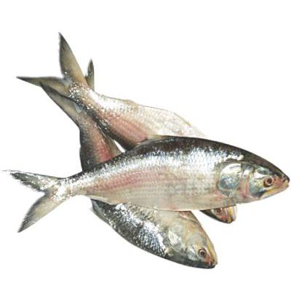
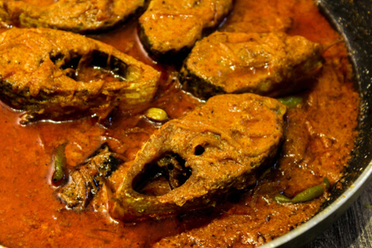
fish

Slide 18
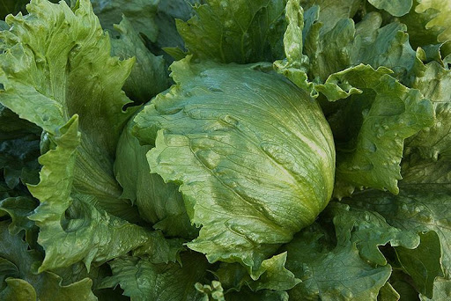
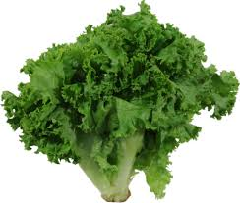
lettuce

Slide 19
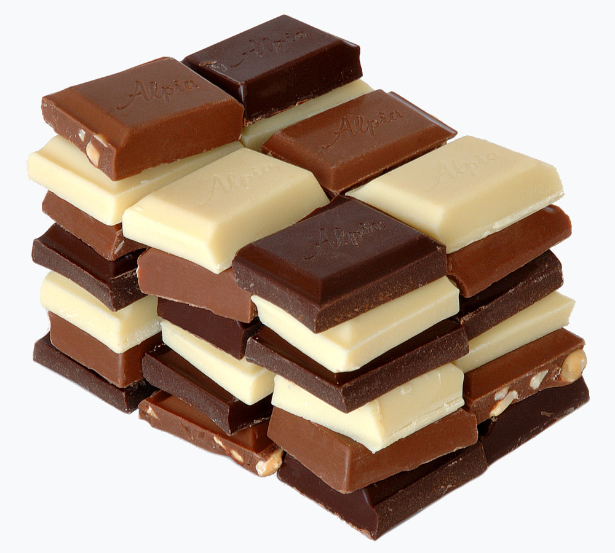
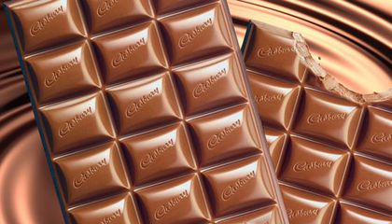
chocolate

Slide 20
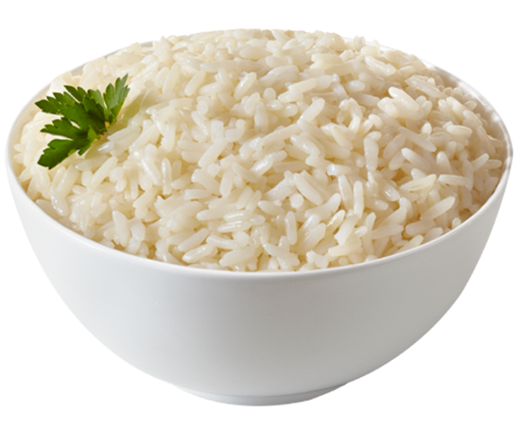
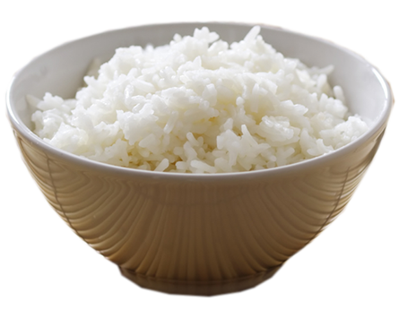
rice
rice
rice
rice

Slide 21
Open the book
Page number 22

Slide 22
A. Look, listen and say
Let’s do the activity
Say the name
of
the next pictures ?
carrots
Oranges
chips
ice-cream
milk
egg

Slide 23
Underline the foods you like and Circle the foods you think are healthy….

Slide 24
Let’s talk about food such as talking A & B.
          A: Do you like Ice-cream ?
          B: Yes, I like ice-cream. You?
          A: I like .too
          B: I also like chocolate.
          A: I don’t like it.

Slide 25
Thanks

