Slide 1
Welcome dear student.
How are you?

Slide 2
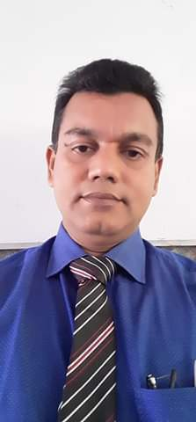
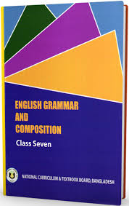
INTRODUCTION
Nurul Amin Azad
ASSISTANT TEACHER ( ENGLISH)
Jahangirpur T. Amin Govt. Pilot sHigh School
Madan, Netrakona
Mobile no. 01718431636
E-mail: nuruasif@gmail.com
Lesson
ENGLISH GRAMMAR.
Class : Seven ,Unit:3 Lesson:7
Time: 50 minutes.
Date: 22/ 02/ 2020

Slide 3
Look at the picture and try to guess what time are the speakers referring to?
I was watching TV when she called me
Yesterday, I was playing computer game.
Which tense is used in these sentences?
Past continuous tense.

Slide 4
So our today’s topic is
Past continuous tense

Slide 5
By the end of the lesson
the students will be able to :
Define past continuous tense.
Write various sentence.
Debate with others.
Fill in the gaps using the right form of verbs.

Slide 6
Definition
The past continuous tense denotes that an action was going on in the past
He was playing football.
I was going to my uncle’s house.
He was fighting for a job.

Slide 7
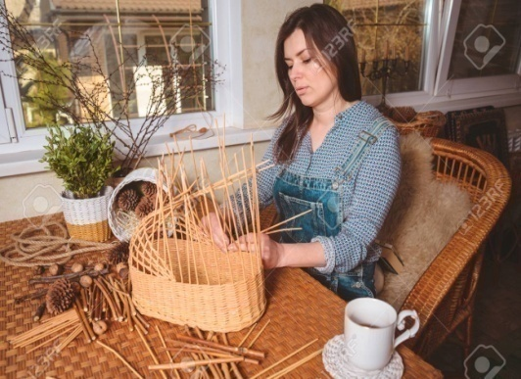
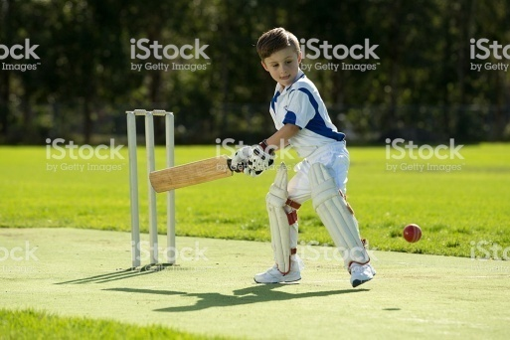
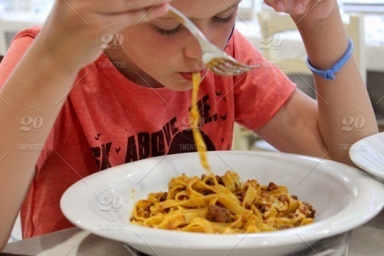
Structure
Struc: Sub+ was/were + verb+ing+obj.+ext.
Mother was making a basket.
They were playing cricket.
I was eating my dinner when you phoned.

Slide 8
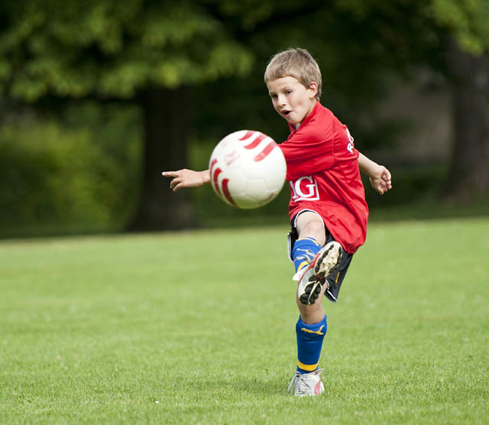
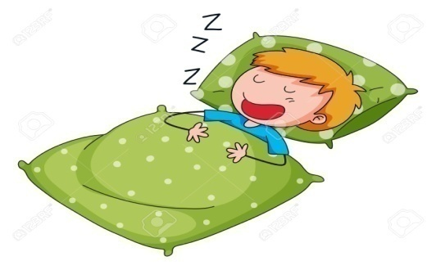
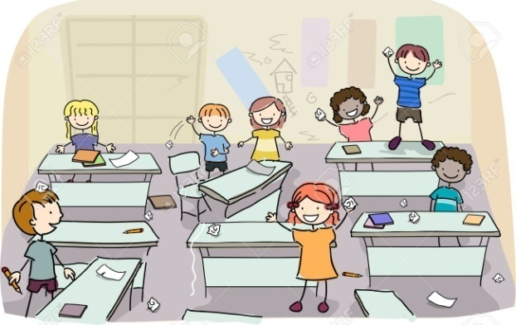
Interrogative
Struc: Was/were + sub + verb + ing. + obj + ?
Were you playing?
Was he sleeping?
Were they making a noise?

Slide 9
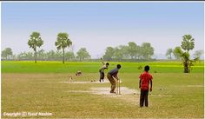
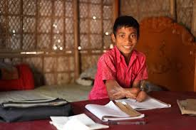
Interro-negative
Struc: Was/were + sub+ not + verb + ing + obj + ?
Was he not reading?
Were they not playing in the field?
Was not karim doing the sum?

Slide 10
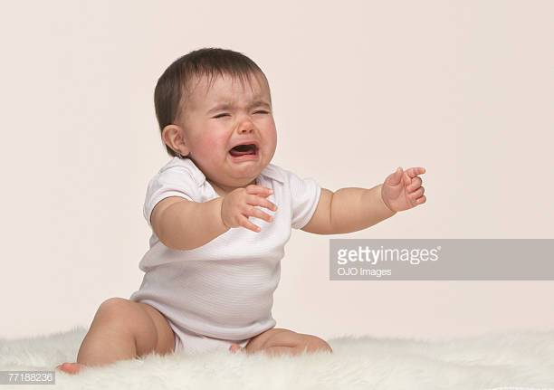
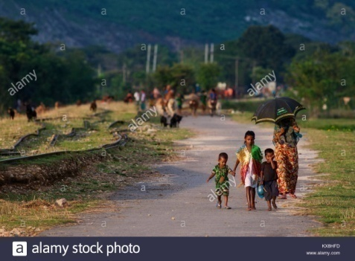
Interrogative with WH ques.
Struc: WH + was/were + sub + verb + ing + obj + ?
What were you doing when the baby was crying ?
Why was she sitting under a tree?
Where were they going in a body yesterday?

Slide 11
Group Work
Use the past continuous forms of the verbs in the following sentence.
The sun ( shine) when we went out.
When they came, I (write)
Where you (go) yesterday?
We ( have) dinner when electricity went off.
The teacher asked the students, “ why you (make) a noise in the class?”

Slide 12
Pair work.
Write all of the structures of past continuous tense
Make five sentences about the picture.

Slide 13
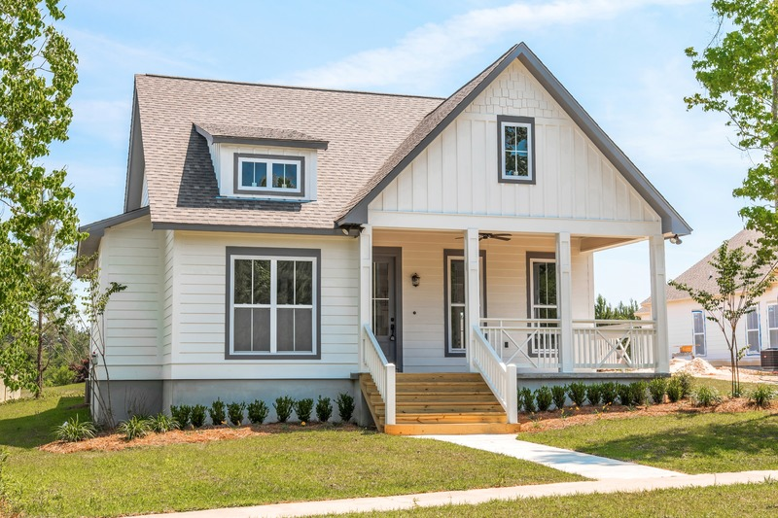
Home work
Using past continuous tense you will make ten sentences.

Slide 14
Evaluation
Use the correct form of verbs in to the blank of the following sentence.
1.It ____ heavily outside when I ____.
2. Where--------when I------you?
3. When my elder ____ my father _____.
4. Our grandma _____ with us when we _____ in our village.
5. Everybody ______ until the fire accident occurred.

Slide 15
Thanks to all

