Slide 1

WELCOME

Slide 2
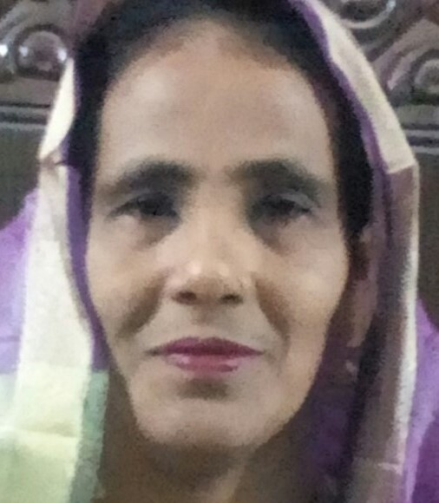
Teacher Identity:-
Name:- Rokeya Begum.
Senior teacher.
Amanotpur govt. primary school.
Begumgonj,Noakhali

Slide 3


Lesson’s identity
Class:Two
Sub:English
Lession:Unit-3
Todays Lesson:K-O
Page: 07

Slide 4
Learning outcomes:
Listening:
1.1.1 Become familiar with English sounds by listening to common
English words.
Speaking:
1.1.1 Repeat after the teacher simple words and phrases with proper
sounds and stress.
Reading
1.2.1Recognize and read the alphabet both small and capital (non-
cursive).

Slide 5
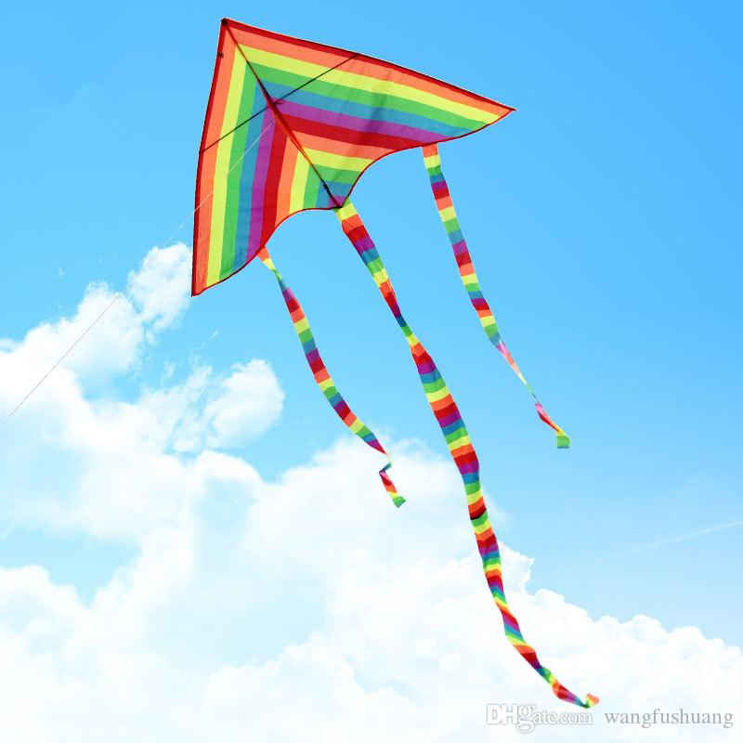

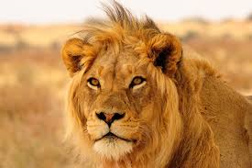
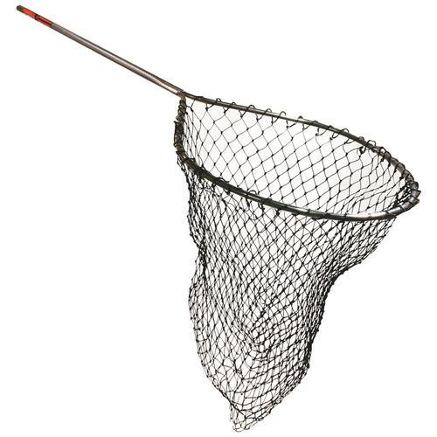
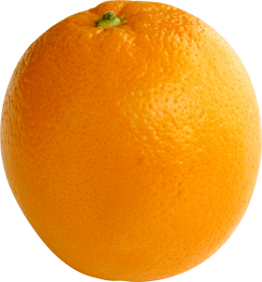
What can you see in the picture?

Slide 6
K
Kite

Slide 7
L
Lion

Slide 8
M
Mango

Slide 9
N
net

Slide 10
O
Orange

Slide 11

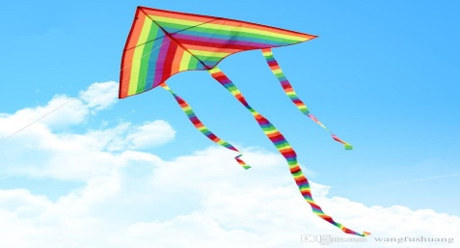

Match the words with the picture.
M
O
N
K
L

Slide 12
PAIR WORK.
Say the names and initial letters with your partner.
Kite
Lion
Net
Mango
Orange

Slide 13
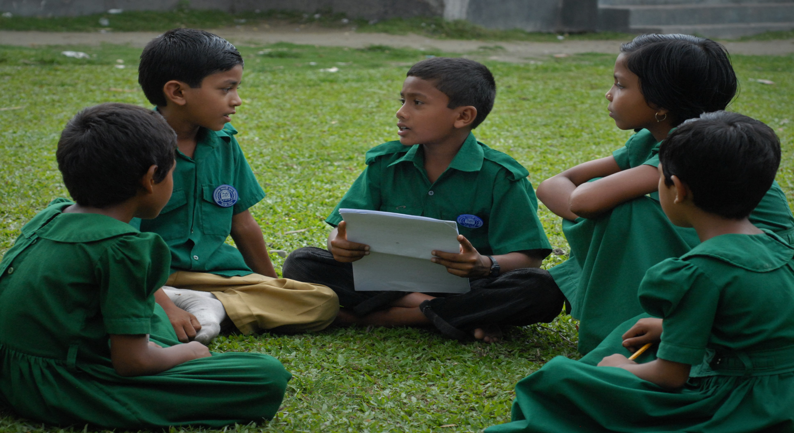
Group Work
*Make 5 sentence’s with these word:-Kite,Lion,Mango,Net,Orange.

Slide 14
Evaluation
Re-arrange the following letters and make meaningful words.
tiek
Kite
ioln
Lion
namog
Mango
raogen
Orange
ten
Net

Slide 15
Home work
write another five words by using this letters
K,l,m,n,o.

Slide 16

THANK YOU
EVERYBODY

