Slide 1

আজকের পাঠে সবাইকে স্বাগতম

Slide 2
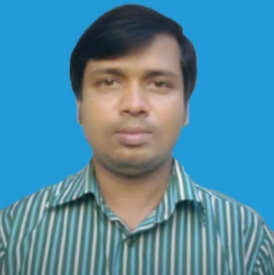

Identity
Mohammad Faisul Alam
Assistant Teacher Shambhupur Government Primary School,
Bhairab, kishoreganj.
Class : Two
Subject : English
Unit : One
Lesson : 4-6 (A)
Time : 1 hour
Date : 2/09/2019

Slide 3

Let’s watch a video clip.

Slide 4
Today’s lesson is-
Alphabet
(Aa-Ee)

Slide 5
Learning Outcomes
Listening:
1.1.1 .nBecome familiar with English sounds by listening to common English words
Speaking:
1.1.1 .Repeat after the teacher simple words and phrases with proper sounds and stress
Reading:
. 1.2.1 Recognize and read the alphabet both small and capital ( non –cursive

Slide 6
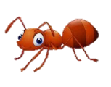
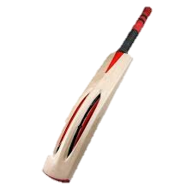
Now look at the picture and Say loudly.
What’s this ?
Ant
What’s this ?
Bat

Slide 7

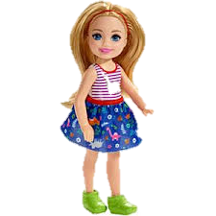
Now look at the picture and Say loudly.
What’s this ?
Cup
What’s this ?
Doll

Slide 8
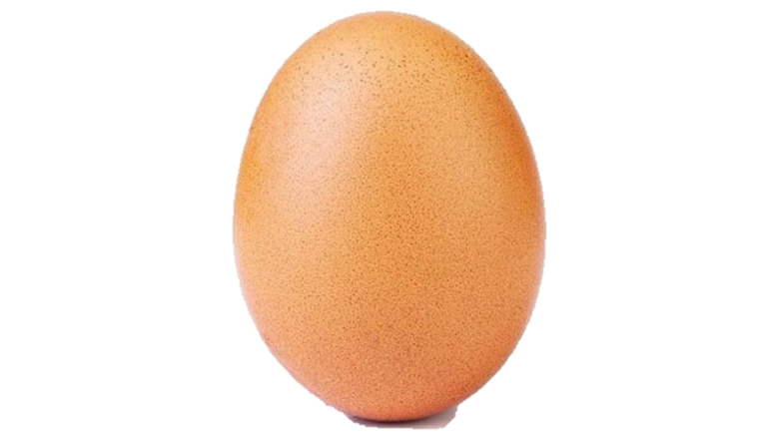
Now look at the picture and Say loudly.
What’s this ?
egg

Slide 9
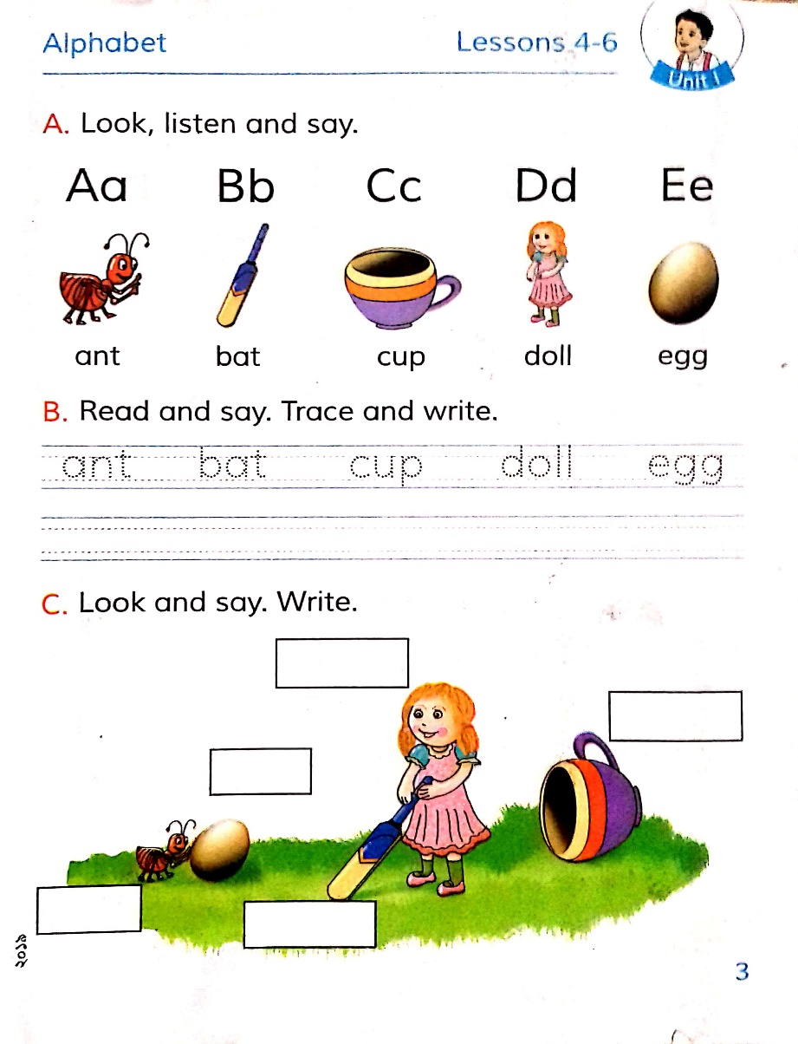
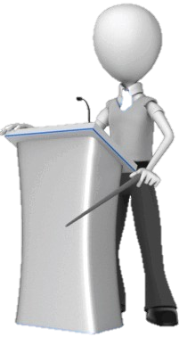
Open at page 3 of your book and look activity A.
wcw
Dear students, listen carefully and repeat after me.

Slide 10
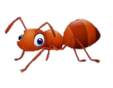
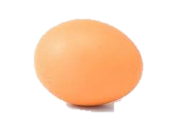
Loud reading by the teacher
A
B
bat
ant
C
cup
D
doll
E
egg

Slide 11
Look at the picture and fill in the boxes.
I W
ant
bat
cup
doll
egg

Slide 12
What can you see ?
wcw
Ant
Aa
Capital letter
Small letter

Slide 13
What can you see in the picture ?
wcw
Ant
A
b
Capital letter
Small letter

Slide 14
What can you see in the picture ?
wcw
Bat
B
b
Capital letter
Small letter

Slide 15
What can you see in the picture ?
wcw
Cup
C
c
Capital letter
Small letter

Slide 16
What can you see in the picture ?
wcw
Doll
D
d
Capital letter
Small letter

Slide 17
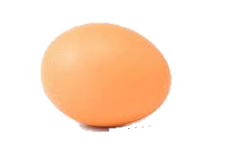
What can you see in the picture ?
wcw
Egg
E
e
Capital letter
Small letter

Slide 18
Match the words with the letter
Pair Work
Aa
cup
Bb
doll
Cc
ant
Dd
egg
Ee
bat

Slide 19
Evaluation
What’s this ?
What’s this ?
What’s this ?

Slide 20
Evaluation
Fill in the blanks by small letter.
A
,B
,C
,D
,E

Slide 21

Homework
You’ll try to learn another one word with the letters.

Slide 22
Thanks to all

