Slide 1

Welcome to all in my class.
End

Slide 2
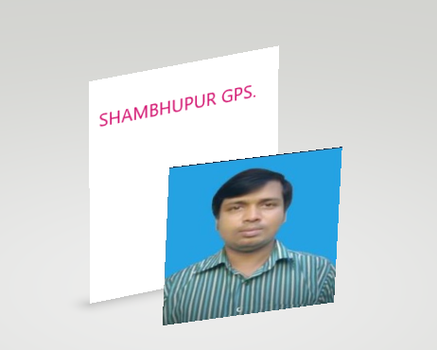
End
Teacher’s Introduction
Mohammad Faisul Alam, Assistant Teacher Shambhupur Government Primary School, Bhairab,kishoreganj.

Slide 3
End
Lesson identity
Class : Five
Subject : English for today
Unit : 1
Lesson : 1 (Hello! May I introduce myself?)
Date : 5.01.2020

Slide 4
End
Let’s sing a song together.

Slide 5
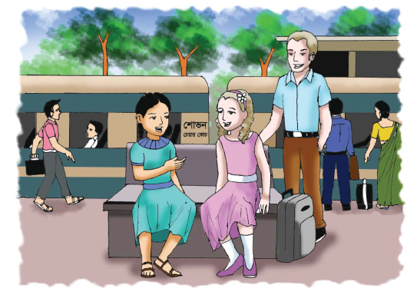
End
Look at the picture .
Think and say , what about the picture is ?
Someone is introducing with others.

Slide 6
End
Today’s lesson is –
Hello!

Slide 7
End
Learning outcomes:-
Listening-
√
1.3.1: recognize which words in sentence are stressed.
Speaking-
√
1.1.1. : say, words, phrase and sentences with proper sounds and stress.
Reading-
√
1.5.1: Read words, phrases and sentences in the text with proper pronunciation stress and intonation.

Slide 8
End
Good morning.
Let’s introduce ourselves.
I am Faisul Alam, I am your
Assistant and English teacher.

Slide 9

End
What’s this?
This is our ‘English for Today’ text book.

Slide 10
End
Let’s know some words.
Introduce , really, holiday, meeting, leaving.
Really - সত্যি
Leave - ছেড়ে যাওয়া
Meeting - দেখা হওয়া
Holiday – ছুটির দিন,
Introduce - পরিচয় করানো
Journey- ভ্রমন ,

Slide 11
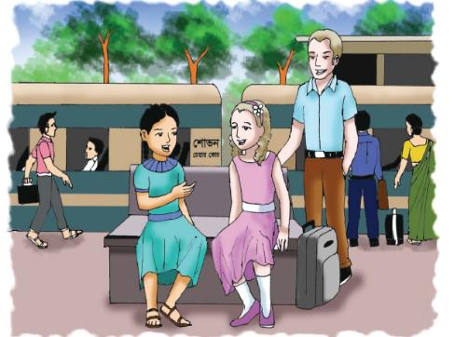
End
Everybody look at the picture and think about this.
What is the scenery of this picture ?
The scenery of this picture is at a Railway station.
Where is the people staying?
The people are staying at a station.
What is done by the people?
The people are introducing one another .

Slide 12
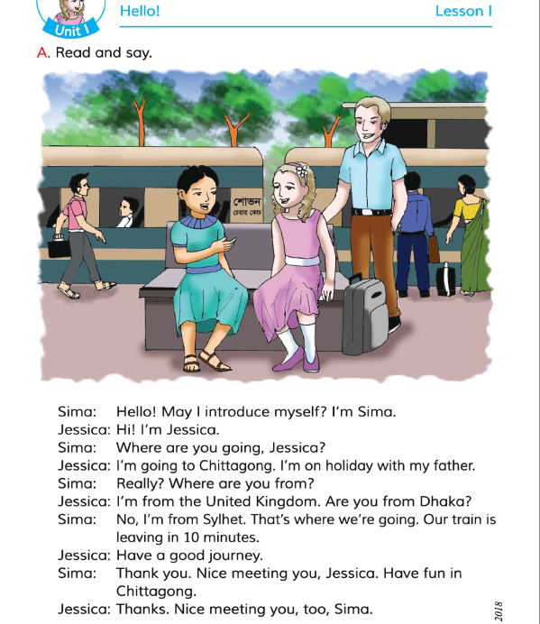
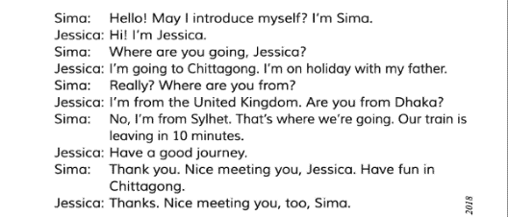
End
Everybody read the text silently.

Slide 13
End
Look and say
Where is Jessica going ?
Jessica is going to Chittagong.
Where is Sima from ?
Sima is from Sylhet.
Why is Jessica going there?
Jessica is going there to enjoy
the holiday with her father
Where is Jessica from ?
Jessica is from United Kingdom.

Slide 14
End
Look and say
Where are Sima and Jessica ?
Sima and Jessica are going to Chittagong.
Is Sima from Dhaka?
No, Sima is from Sylhet.
When is Sima’s train leaving?
Sima’s train is leaving in ten minutes.

Slide 15
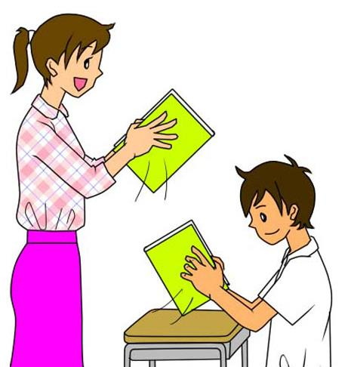
End
Come someone in front of the class and tell about yourself.
Hi ! I’m Ramim. I’m from Shibpur.
Hi ! I’m Bhubon. I’m from Shambhupur.
Bhubon ,where are you going now ?
Ramim, I am going to school now .
But where are you going now?
Bhubon, I’m also going to my school now.

Slide 16
End
Let’s know what we say in see off time
Nice meeting you,
Take care of you
See you, bye ! Bye !

Slide 17
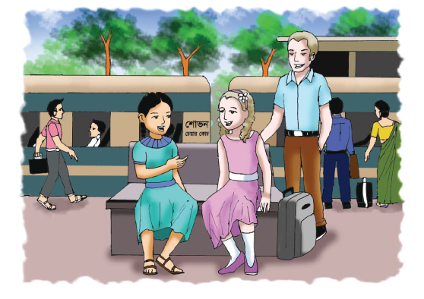
End
Look at the picture and talk about it in groups.
What are they doing ?
They are waiting at the station.

Slide 18

End
Look at the picture and talk about it in pairs.
What are they doing ?.
They are talking each other.

Slide 19
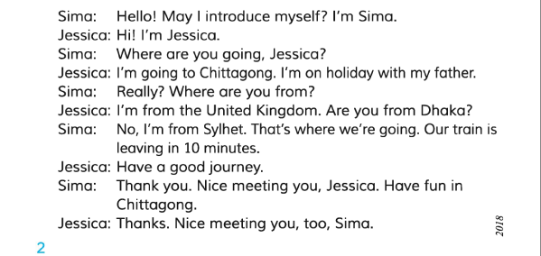
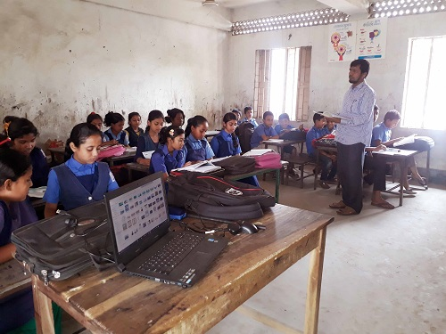
End
Let’s read the text again.

Slide 20
End
Evaluation
Write five sentences about Sima and Jessica.

Slide 21

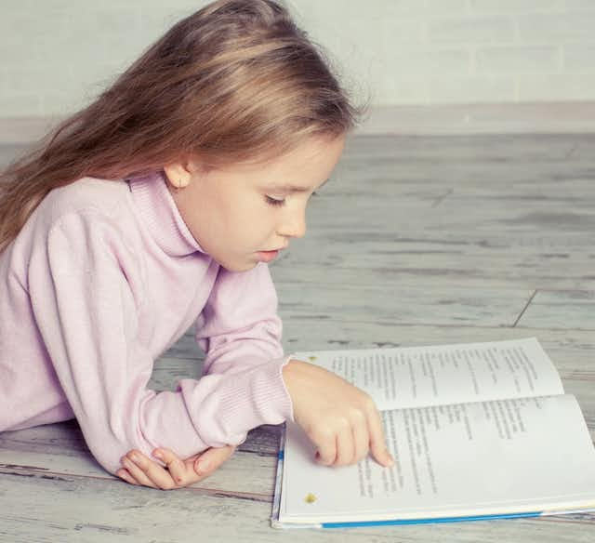
End
Hometask.
All you will study the lesson at home and make a note on the lesson for tomorrow.

Slide 22

End
Thanks to all.

