Slide 1
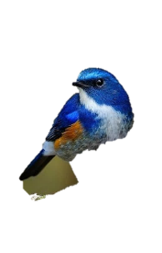



Slide 2
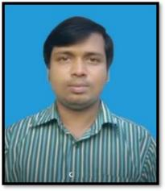

IDENTITY
MOHAMMAD FAISUL ALAM
ASSISTANT TEACHER
SHAMBHUPUR GOVT.PRIMARY SCHOOL
BHAIRAB,KISHOREGANJ.
MOBAIL: 01715512060
EMAIL: faisulalamrsa@gmail.com
SUBJECT: ENGLISH
UNIT: 35
LESSON: 1-2
TOPIC: MY TRIP.
TIME: 1 HOUR.
DATE: 25-8-19

Slide 3
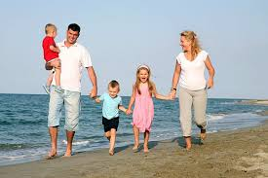
Look at the pictures and try to say about these.
This is a picture of a family. They are now on a trip.

Slide 4
Today’s lesson is-
My trip.

Slide 5
Learning outcomes:
Listening:
  3.4.1 Understand statements made by the teacher and students.
Speaking:
  1.1.1 repeat after the teacher and say words, phrases and sentences with proper sounds, stress and intonation.
  3.1.1 ask and answer wh questions.
Reading:
  1.5.1 Read words phrass and sentence in the text with proper pronunciation, stress and intonation.
  1.7.1 read short paragraphs, dialogues and simple, letters.
Writing:
  3.1.1 write words, phrases and sentences using non-cursive capital and small letters.
Let’s enjoy a song.

Slide 6
Let’s know some key words of the lesson.
পরিবার
জানা
নদী
জেলে
সুস্বাদু
Family
Know
River
Fisherman
Delicious
ভ্রমন
একত্রে
ইতিহাস
আত্মীয়
পরিদর্শন করা
Trip
Together
History
Relative
Visit

Slide 7
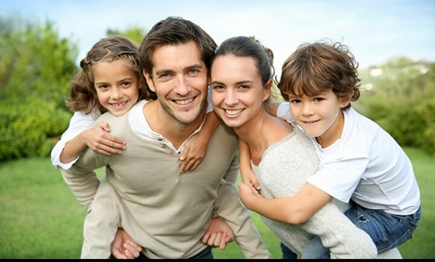
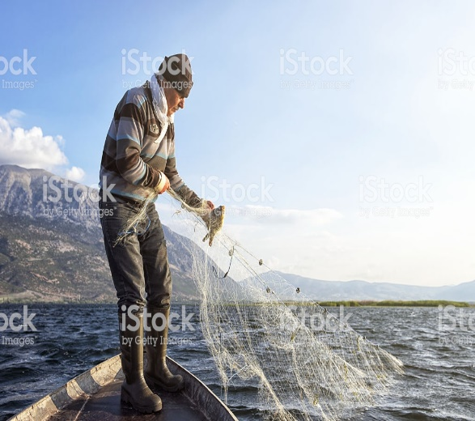
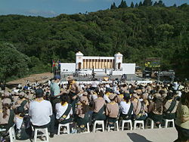
Let’s know some key words of the lesson.
পরিবার
জেলে
Family
Fisherman
একত্রে
ভ্রমন
Together
Trip

Slide 8
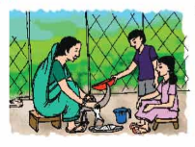
Look and say about the pictures.
A women is working with the help of a boy and a girl.

Slide 9
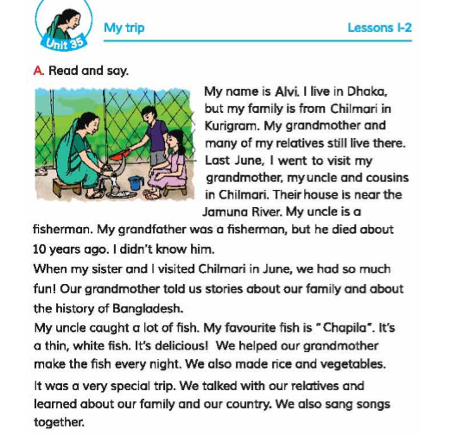
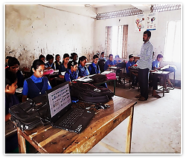
Teacher’s reading
Open your book at page 70 and repeat after me.

Slide 10
Indivisual work
Dear students, read the text silently now.

Slide 11
Pair work.
Write the sentences in your khata/Note book and ask and answer.
Where does Alvi live?
Where did Alvi go?
Who did he go with?
What did he do there?

Slide 12
Group work.
Write “True” for correct statement or “False” for incorrect statement
Alvi lives in Chilmari now.
There house is near the Maghna river.
His uncle is a fisherman.
He does not like fish.
He visited Chilmari in July.
His grandmother knows the history of Bangladesh.
Chapila is delicious fish.
False
False
True
False
False
True
True

Slide 13
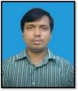
Bingo game
Family
House
All of you, write any five words on your khata.
Cousin
Favourite
River
Relative
Visit
History
Click for on/off

Slide 14

Evaluation
All of you, write three sentences about Alvi.

Slide 15

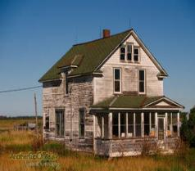
Hometask
You will write a short composition about “ Your trip”.

Slide 16
THANKS TO ALL!
NO MORE TODAY
BYE…

Slide 17
THANKS FOR PARTICIPATION

