Slide 1


Good morning to all.

Slide 2
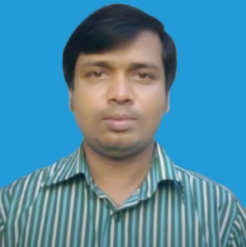

Identity
Mohammad Faisul Alam Assistant Teacher Shambhupur Government Primary School, Bhairab,kishoreganj.
Class : Five
Sub : English
Unite : 15
Lesson : 1 (Happy Birthday)
Time : 45 minutes

Slide 3
Let’s sing a song-
We shall overcome some days--

Slide 4
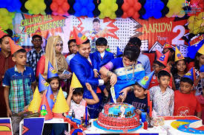
Look and say about the picture?
This is a picture of birthday.

Slide 5
Today’s lesson is-
Today Lesson is-
‘Happy Birthday’.

Slide 6
Learning outcomes-
L: 1.3.1- recognize which words in a sentence are stressed.
3.4.1- understand statements made by the teacher and students.
S: 1.1.1.- say words ,phrases and sentence with proper sounds and stressed.
R: 1.5.1- read words, phrases and sentences in the text
with proper pronunciation, stress and intonation.

Slide 7
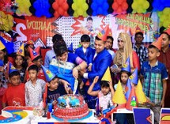
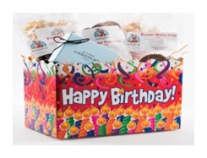
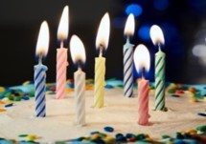
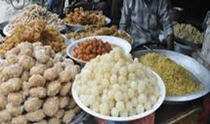
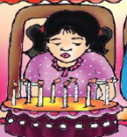
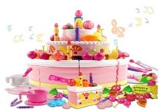
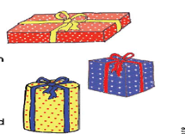
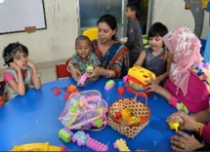
Let’s know some key words.
Celebrate
Birthday gift
Candles
Special food
Blow out
Birthday cake
Wrapped
Toys

Slide 8
Let’s know Bengali meaning of the words.
Birthday
জন্মদিন
Colourful
রঙিন
Special
বিশেষ
Gift
উপহার
Celebrate
উদযাপন করা
Enjoy
উপভোগ করা
Candle
মোমবাতি
Spend
কাটানো/ব্যয় করা
Blow out
নেভানো
Wrap
মোড়ানো

Slide 9
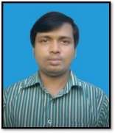
Bingo game
Birthday
Celebrate
All of you, write the words on your khata.
Blow out
Enjoy
Candle
Gift
Happy
Wrap
Click for on/off

Slide 10
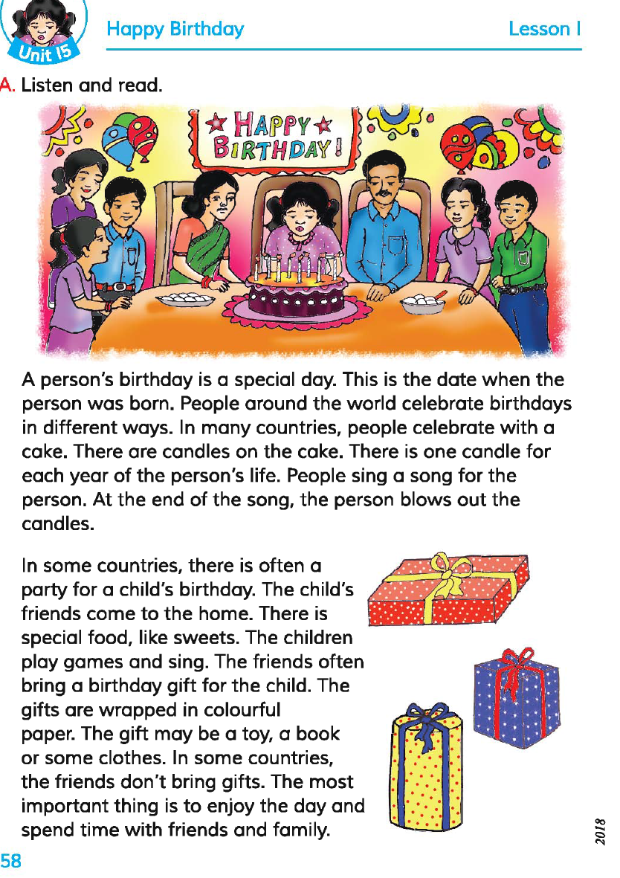
Open your book at 58 and read the text silently.

Slide 11
Group work.
Match the words of the column A witth their meaning that is mention in the text in the column B.
Column A | Column B
a) Blow out | i) Not the same
b) Enjoy | ii) Put out
c) Usually | iii) to get pleasure from something ..
d) Parents | iv) Use always
e) Children | v) Father and mother
f) wrapped | vi) Little boys and girls
g) different | vii) Some thing covered with colourful paper

Slide 12
pair work.
Write “True” for correct statement or “False” for incorrect statement
Birthday is a special day.
Birthday is only celebrated in our country.
The birthday gift may be a toy or a book.
The friends blow out the candles.
We sing a song for the person on his birthday.
Birthday is not celebrated around the world.
True
False
True
False
True
False

Slide 13
Indivisual work.
Look and say.
What can you see in the picture? Say one by one.

Slide 14
Evaluation.
Look at the picture and write.
Write five sentences about a birthday party.

Slide 15


Hometask
You will write five sentences about your birthday party at home.

Slide 16
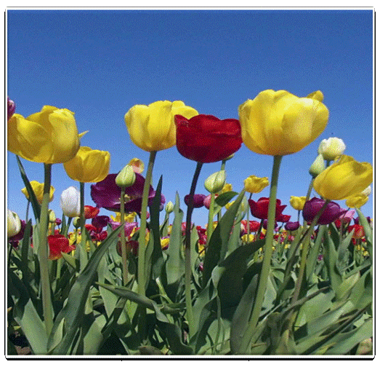
Thank you to all.

