Slide 1
Welcome, my dear students.

Slide 2
Introduction
Class: ix
Subject: English 2nd Paper
Time : 40 minutes
Title: Narration (2)
Number of Students: 40
Md. Manzur Rahman
Assistant Teacher (English)
Goonvari B.L. High School,
Fulchhari, Gaibandha.
E-mail: manzurrahman12@yahoo.com

Slide 3
Let’s see some pictures and texts.

Slide 4
The boy said to the girl, “ What do you want?.”
The boy asked the girl what she wanted.

Slide 5
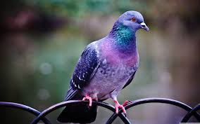
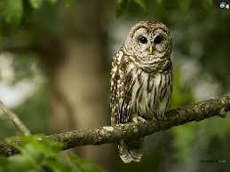
The owl said to the dove, “Don’t you have any words to praise?
The owl asked the dove if it (dove) had not any words to praise.

Slide 6
Can you say what we are going to learn today?
Changing Speech of Interrogative Sentence

Slide 7
Our Today’s Lesson is-
Changing speech
of Interrogative Sentence

Slide 8
Learning Outcomes
After the end of this lesson, we will be able to-
define interrogative sentence.
identify the structure of changing speech.
change speech from direct to indirect.

Slide 9
What is Interrogative Sentence and how can you understand it?
An interrogative sentence is a kind of sentence which is used to ask question. We can easily understand interrogative sentence by seeing a sign named Question Mark (?).
Examples:
What’s your name?
How are you?
Are you happy?
Do you learn English?

Slide 10
Changing Speech of Interrogative Sentence
Let’s know the rules of changing speech of Interrogative Sentence.

Slide 11
Key Changes
Said to asked
Comma (if the reported speech starts with auxiliary verb)
if
Comma (if starts with WH) WH

Slide 12
Let’s practise.
A bird said to another bird, “Why are you shouting?”
A bird asked another bird why it (another) was shouting.

Slide 13
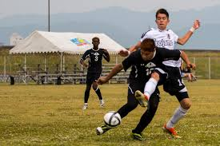
Roni said to Toni, “Are you trying to get the ball?”
Roni asked Toni if he (T) was trying to get the ball.

Slide 14
The boy said to the girl, “Do you want anything?”
The boy asked the girl if she wanted anything.

Slide 15
Individual Work
Change the following speeches.
Razu said to me, “How are you?”
I said to him, “Do you know me?
He said to me, “Is Rana your best friend?”
I said to Razu, “Will you help me?”
Razu said to me, “Why do you want help?”
1. Razu asked me how I was.
2. I asked him if he knew me.
3. He asked me if Rana was my best friend.
4. I asked Razu if he would help me.
5. Razu asked me why I wanted help.

Slide 16
Home work
Turn the following speech into indirect:
I said, “ How was the accident?”
She said to me, “Did you want to meet me?”
I said, “Do you have enough time?”
She said to me, “Are you very busy today ?”
I said to her, “Why did you make the mistake yesterday?”

Slide 17
Thank you.
See you tomorrow.

