Slide 1
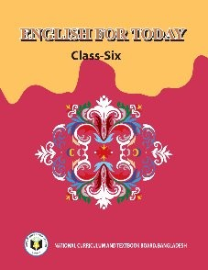
WELCOME

Slide 2
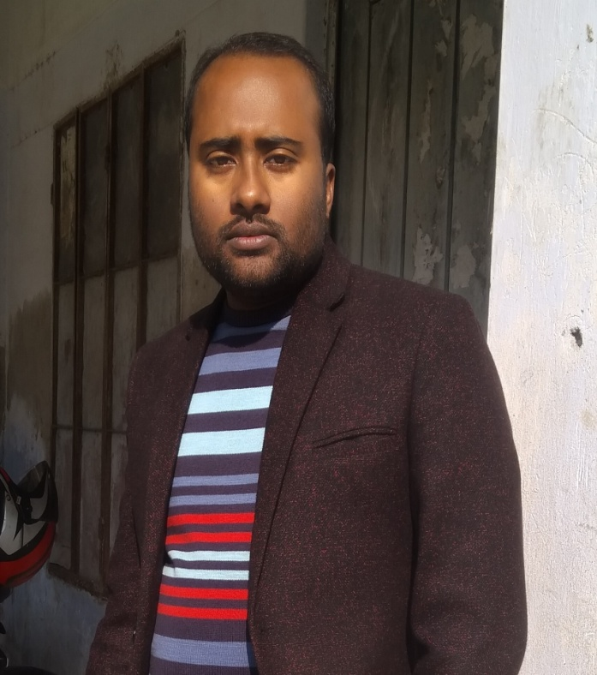
Teacher ‘s Identity
CHANDAN BISWAS
ASSISTANT TEACHER
ANDHA HIGH SCHOOL
E-mail: chandanb13@gmail.com

Slide 3
Class Identity
English-1st Paper
Class-Six
Lesson-10
Remedies: modern and traditional

Slide 4
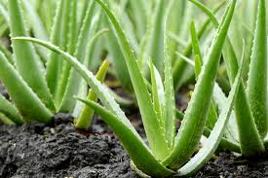
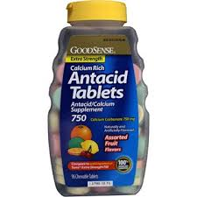
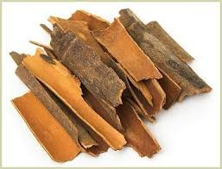
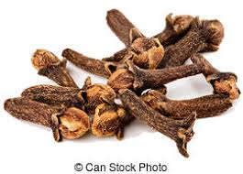
Look at the picture
Clove
Cinnamon

Slide 5
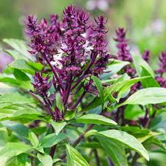
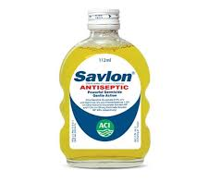
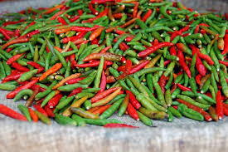
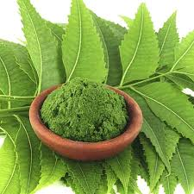
Tulsi
Savlon
Pepper
Neem

Slide 6
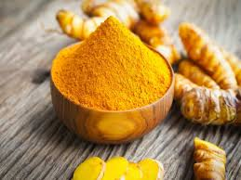
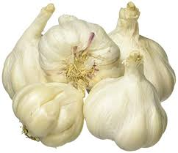
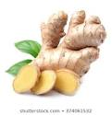
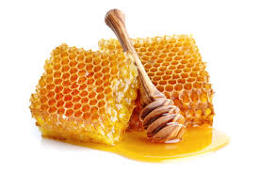
Garlic
Turmeric
Ginger
Honey

Slide 7
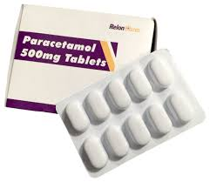
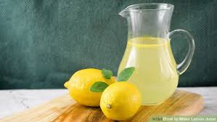
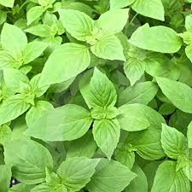
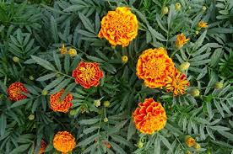
Lemon Juice
Basil leaf
Marigold

Slide 8
Learning outcomes
After completing the lesson students will be able to-
*Read and understand the texts.
*Understand and enjoy stories .
*Answer the questions.
* Write short paragraph.

Slide 9
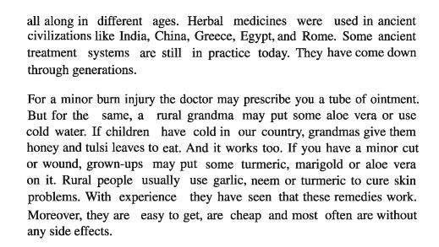

Slide 10
Discuss the following questions in pairs.
1. What are natural cures made of ?
2. Are herbal cures modern inventions ?
3. Which civilisations are known for herbal treatments ?
4. What natural remedies are used for cold ?
5. What herbal cures are used for skin problems ?

Slide 11
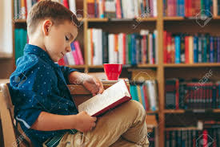
Home work
* People with a cold , a fever, or the flu often go to the doctor for help. But many people in our country also use home remedies for common illnesses.Write a short composition about some simple home remedies.

Slide 12
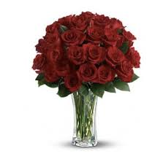
Thank you
everybody

