Slide 1
Very welcome to my class.

Slide 2
Introduction
Class: ix
Subject: English 2nd Paper
Time : 40 minutes
Title: Narration (2)
Number of Students: 40
Md. Manzur Rahman
Assistant Teacher (English)
Goonvari B.L. High School,
Fulchhari, Gaibandha.
E-mail: manzurrahman12@yahoo.com

Slide 3
Let’s see some pictures and texts.

Slide 4
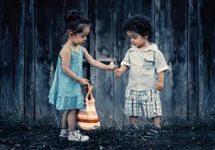
Mimi said “Mahim, take it.”
Mimi told Mahim to take it.

Slide 5
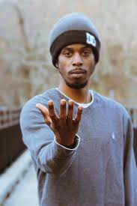
The man said, “Please, give me some money.”
The man requested to kindly give him some money.

Slide 6
Dear Students, what are we going to learn today?
Changing Speech of Imperative Sentence

Slide 7
Our Today’s Lesson is-
Changing speech
of Imperative Sentence

Slide 8
Learning Outcomes
After the end of this lesson, we will be able to-
define imperative sentence.
identify the structure of changing speech.
change speech from direct to indirect.

Slide 9
How can you identify an imperative sentence?
An imperative sentence starts with:
Verb(present form)
Do not
Never/Always
Let
Please/Kindly
Examples:
Come here.
Do not do it.
Never go there.
Always help him.
Let me go.
Please, take it.

Slide 10
Changing Speech of Imperative Sentence
Let’s know the rules of changing speech of Imperative Sentence.

Slide 11
Key Changes
“said to” can be changed by the rules below:
Reported Speech
Reporting Verb
To mean order
ordered
To mean request
requested
To mean advise
advised
To mean forbid
forbade
To mean nothing
told
“comma” is turned into “to”

Slide 12
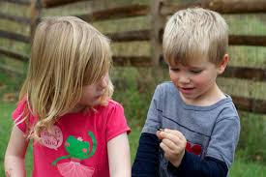
Let’s practise.
The boy said to the girl, “Look at the thing.”
The boy told the girl to look at the thing.

Slide 13
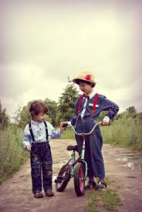
Pinku said to his friend, “Please, go there on foot.”
Pinku requested his friend to kindly go there on foot.

Slide 14
Changes of “Let made sentence”
It can be changed by the rules below:
Reported Speech
Reporting Verb
Let’s / Let us
proposed to
Let me
requested/told/forbade/advised/ordered (according to the meaning of reported speech
Let him
Let them
Let her
“comma” is turned into “that”
Let’s / Let us
Sub+should+v1
Let me/him/her/them
Sub+might+v1

Slide 15
Let’s practise.
The boy said to the girl, “Let’s play.”
The boy proposed to the girl that they should play.

Slide 16
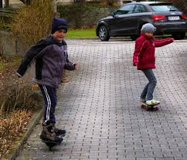
He said to me, “Let me go first.”
He told me that he might go first.

Slide 17
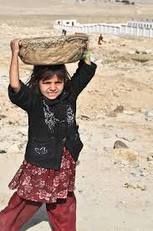
Sonia said, “Friend, help me.”
Addressing as friend, Sonia requested to help her.

Slide 18
Individual Work
Change the following speeches.
Razu said to me, “Do it now.”
I said to him, “Do not hate the poor.”
He said to me, “Always speak the truth.”
I said to Razu, “Let him make a plan.”
Razu said to me, “Let’s make a plan together.”
1. Razu ordered me to it then.
2. I forbade him to hate the poor.
3. He advised me to speak the truth always.
4. I told Razu that he might make a plan.
5. Razu proposed to me that they should make a plan together.

Slide 19
Home work
Turn the following speech into indirect:
I said, “ Let me finish the work.”
She said to me, “Never tell a lie.”
I said, “Make a cup of tea, please.”
She said to me, “Don’t forget it.”
I said “Mim, stop the music.”

Slide 20
Thank you so much.
See you.

