Slide 1
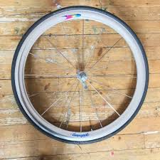

Slide 2
Md. Mofizur Rahman
Assistant teacher (computer)
Bashudebpur Siddiqua Dakhil Madrasah
Subject: English for today
Class: Eight
Unit: Nine
Lesson: 1
Learning Object: The wheel
Time: 35 minutes

Slide 3
Learning Outcomes
At the ends of this part the students will –
1.give the definition of wheel.
2.Fill in the blanks with appropriate words.
3.Sign out the key words.
4. Match the substitution table.

Slide 4
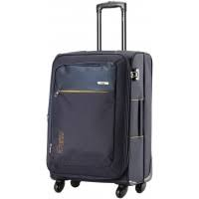
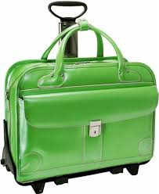
1.Look at the pictures and say which one is easier to move and why?

Slide 5
Wheel

Slide 6
Key Words
Circular= e„ËvKvi
Rotate= PµvKvi
Axis= Aÿ/Aÿ‡iLv
Propeller= PvjK cvLv/PvjK hš¿

Slide 7
Turbine= Rj, evqy ev ev‡®ú PvwjZ PvKv
Mobility= MwZkxjZv
Vehicle= hvbevnb
Civilisation= mf¨Zv
Invention= Avwe®‹vi

Slide 8
Definition
A wheel is a circular object. It can rotate around its axis and help easy movement of things across a surface.

Slide 9
Fill in the blanks with appropriate words from the box.
Difficult much circular important heavy first
Although the wheel is a very ------- invention, the history of its origin is unknown. Experts guess that the first wheel was developed from a circular object. The early man observed that a he piece of stone could be rolled easily if it was ----in shape. Similarly, a heavy tree-trunk is ----- to carry; but it can be rolled away with less effort, Even, a gigantic tree-trunk can be moved easily using other small and round trunks as rollers under it. Thus, early man took advantage of rolling objects and developed the---- wheel. Apart from its mechanical advantage, a wheel’s mobility has contributed--- to
the civilisation.

Slide 10
Solution
Although the wheel is a very first invention, the history of its origin is unknown. Experts guess that the first wheel was developed from a circular object. The early man observed that a he piece of stone could be rolled easily if it was circular in shape. Similarly, a heavy tree-trunk is difficult to carry; but it can be rolled away with less effort, Even, a gigantic tree-trunk can be moved easily using other small and round trunks as rollers under it. Thus, early man took advantage of rolling objects and developed the circular wheel. Apart from its mechanical advantage, a wheel’s mobility has contributed much to the civilisation.

Slide 11
Group work
Match the table
The wheel A plain wheel It A propeller | is has rotates | A type of wheel Around its axis. One of the simplest Machines Wheels on vehicles and machines. Helped In rapid progress of civilization.

Slide 12
Evaluation
What is a wheel?
What can a wheel do?
Say the name of three vehicle where wheel is used?

Slide 13
Write a paragraph about wheel

Slide 14
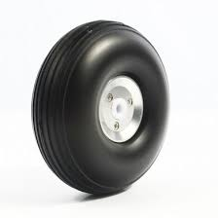
ab¨ev`

