Slide 1
WELCOME

Slide 2
Farhad Ahammad Chowdhury
Head teacher
Burishwar Govt Primary School
Nasirnagar,Brahmanbaria.

Slide 3
Class:Three
Subject:English
Unit 28
Lesson:1-2
Time: 40 minute
Date:06/02/2020

Slide 4
Learning outcome
4.3.1- Enjoy and understand simple sentence
5.1.2-Read simple stories

Slide 5
Lets sing a song

Slide 6
What does a cow eat?
Eats grass

Slide 7
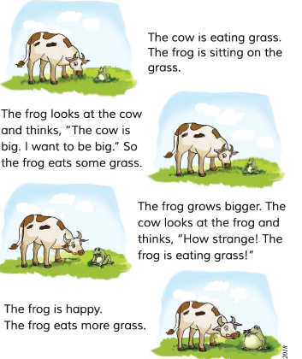

Slide 8
Which animal whants to be big?
Frog
What anial is big?
Cow

Slide 9
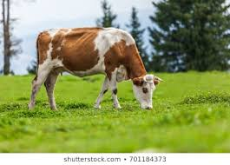
What is this?
This is a cow.
What does this cow do?
This cow eats grass.

Slide 10
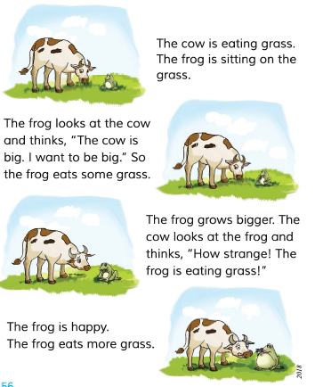
Open at page 56

Slide 11
Flower:The cow is eating grass.The frog is sittin on the grass.
Fruit:The frog looking at the cow and thinks.”The cow is big. I want to be big.” So the frog eats some grass.
Table:The frog grows bigger . The cow looks at the frog and thinks,”how strange! The frog is eating grass!”
Chair:The frog is happy.the frog eats more grass.

Slide 12
Evaluation

Slide 13
THANKS

