Slide 1
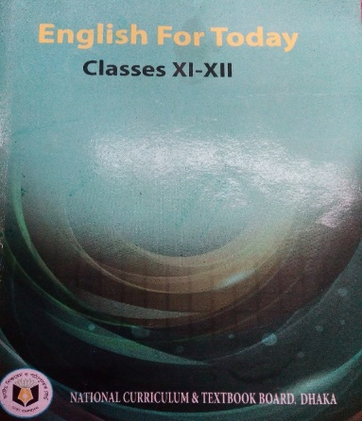
Sree Pradip Chandra Das
Lecturer in English
Ziarkandi Hafij Uddin Fazil Madrasah
Gouripur
Titas,Cumilla
IDENTITY
Class: XI-XII
Subj: English 1st Paper
Time: 45 minutes
Date: February 25, 2020

Slide 2
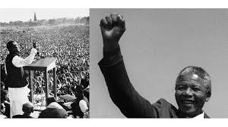

Slide 3
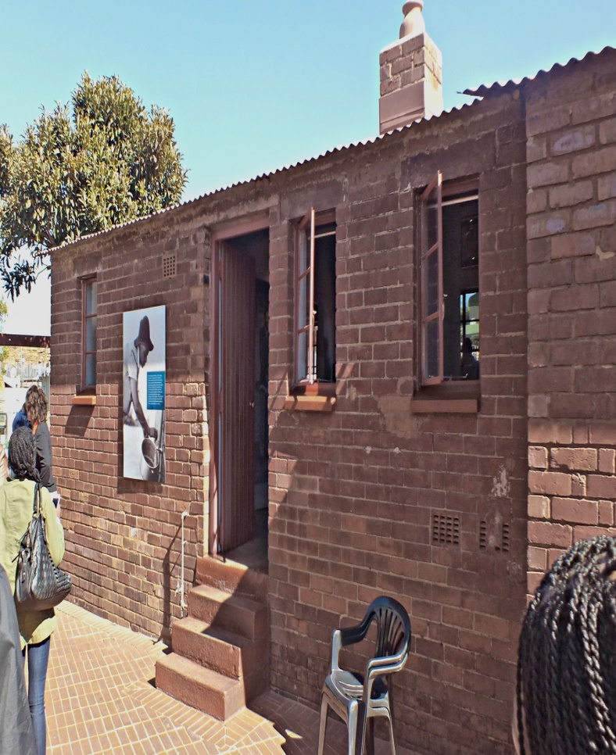
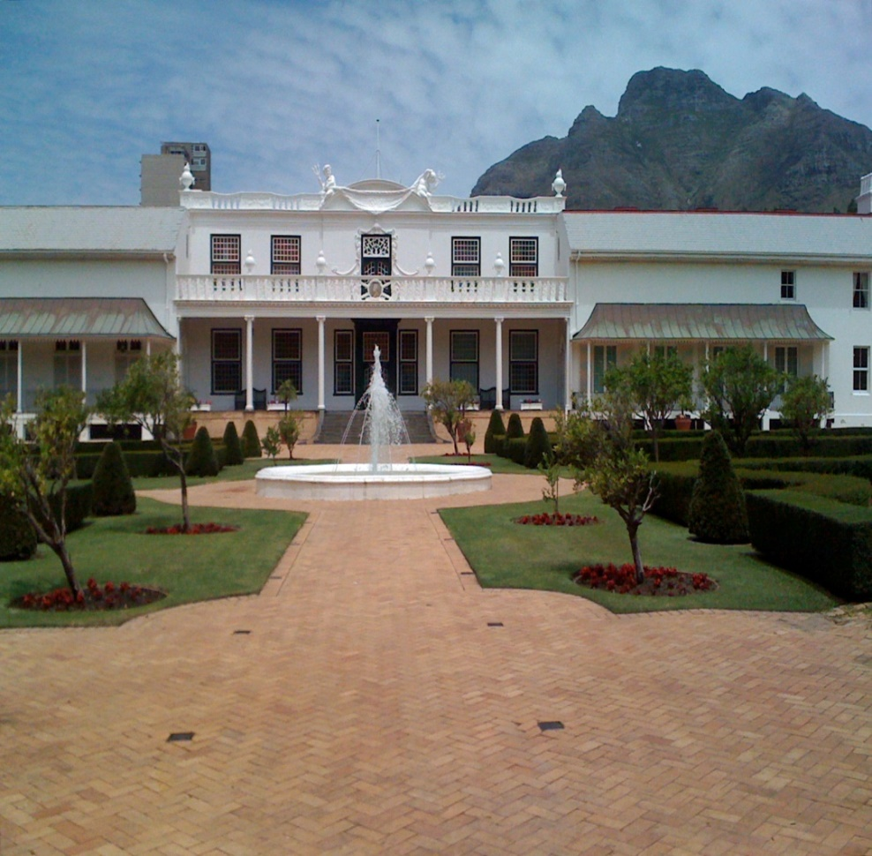
Paternal Residence of Nelson Mandela
President House of South Africa

Slide 4
Today’s Lesson
Nelson Mandela, from Apartheid Fighter to President.
Unit:One
Lesson:One

Slide 5
Learning Outcomes:
After the lesson the ss will be able to-
→ say the synonym & antonym of some new words.
→ identify several world famous personalities.
→ speak about Nelson Mandela and his contribution.
→ explain ‘a brief history of South Africa.’

Slide 7
Let’s diccuss about some words and their synonyms and antonyms
Word
Synonym
Antonym
Shackle
Chain
Freedom
Apartheid
Race hatred
Unity
Emancipation
Liberation
Imprisonment
Charisma
Magnetism
Repulsion
Chasm
fracture
bridge
Mythic
Unreal
Factual

Slide 8
A. Read the multiple choice questions below and find the answers from the following text:
i .The pharse “The moment to bridge the chasms” refers to the time to----
a) start a war
b) reduce the difference between the White and the Black
c) imprision Nelson Mendela
d) to mitigate sufferings
Ans. b) reduce the difference between the White and the Black
We have, at least, achieved our political emancipation ; “political emancipation” in the underlined statement means-----
a. political freedom b. social freedom
c. financial freedom d. cultural freedom
Ans. a) political freedom
What does the term ‘race discrimnation’ stand for ?
a. competetion among the nations b. war among the communities
c. demoralization of people d. differences on the basis of caste , creed and color
Ans. d) differences on the basis of caste, creed and color
iv. The word ‘chasm’ means
a. hatred b. cleft
c. border d. jeslousy
Ans. a) heatred
v. The apartheid leader as described in the text got noble prize in ---- .
a. 1993 b. 1995
c. 1997 d. 1999
Ans. a) 1993

Slide 9
Nelson Mandela guided South Africa from the shackles of apartheid to a multi-racial democracy, as an icon of peace and reconciliation who came to embody the struggle for justice around the world. Imprisoned for nearly three decades for his fight against white minority rule. Mandela never lost his resolve to fight for his people’s emancipation. He was to bring down apartheid while avoiding a civil war . His prestige and helped him win the support of the world.
“I hate race discrimination most intensely and in all its manifestations. I have fought it all during my life; I will fight it now , and will do so until the end of my days,’’ Mandela said in acceptance speech on becoming South Africa’s first black president in 1994. “…The time for the healing of the wounds has come. The moment to bridge the chasms that divide us has come.”
“We have , at last, achieved our political emancipation.”
In 1993 Mandela was awarded the Nobel Peace Prize, and honor he shared with F.W. de Klerk, the white African leader who had freed him from prison three years earlier and negotiated the end of apartheid.
Mandela went on to play a prominent role on the world stage as an advocate of human dignity in the face of challenges ranging from political repression to AIDS.

Slide 10
B. Read the questions below and answer them from your understanding of the comprehension above.
a) Who was Nelson Mandela ?
b)What was the impact of racial problem in South African society?
c) What is apartheid ? Do you support it? why/why not?
d) What is Nelson Mandela famous for ?
e) Why was Mandela awarded Nobel Peace Prize?

Slide 11
Evaluation
Based on your reading of the passage make short notes in each of the boxes in the flow chart showing the difference stages of Nelson Mandela..No.1 has been done for you.)
1
2
3
4
5
6
Fought against apartheid

Slide 12
Q.Make a list of five events happening in Mandel’s struggling life.

Slide 13
Home Work
Summarize the text in your own language.

Slide 14
Thank you Very Much

