Slide 1
WELCOME

Slide 2
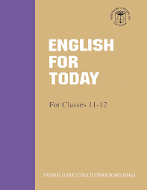
Md . Saifuddin khan
Lecturer in English
Hazi Goyes Uddin Mohila Fajil Madrasah ,
Bhangura , Pabna.
Mobile :01710449379
Email: skhan84bd@gmail.com.
English 1st Paper
Alim 1st Year
Time: 45 Minute

Slide 3
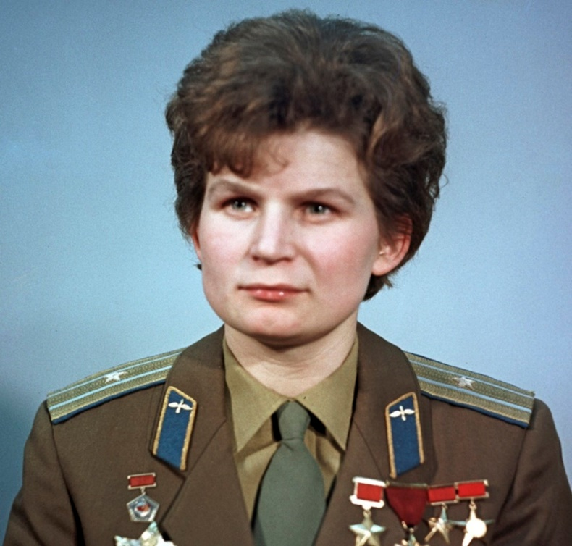
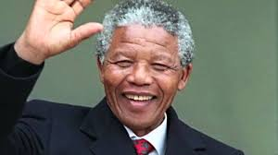
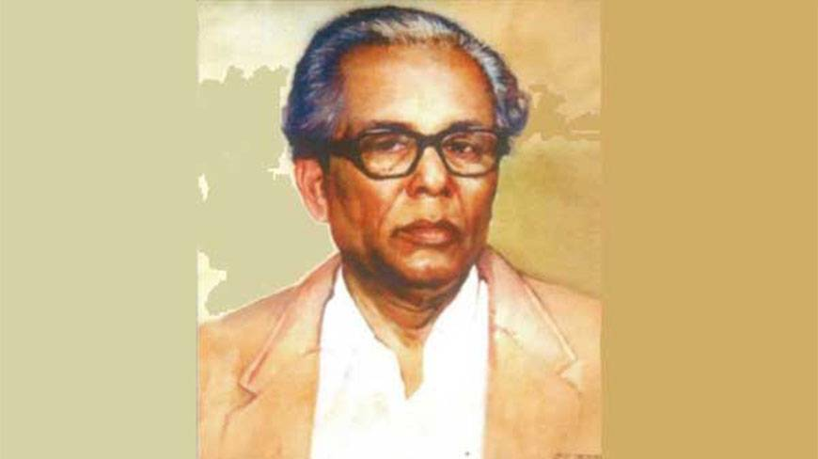
Let us see the following pictures
Identify the South African Leader among the three persons.

Slide 4
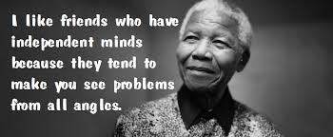
Our today’s topic is
Unit : 1
Lesson :2
Time:45 minutes
Nelson Mandela , from Apartheid Fighter to President .

Slide 5
Learning outcomes
After reading the text, students will be able to
tell the meaning of some new words .
write about Mandela’s fight against “Race Discrimination”.
tell about the African people’s achievement of political emancipation.

Slide 6
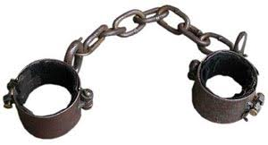
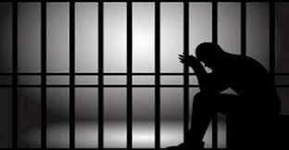
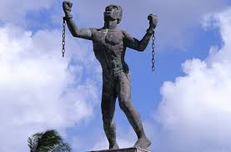
Key words
Meaning
Shackle(n)
Chain
Jailed
Imprisoned(adj)
Liberatoin
Emancipation(n)

Slide 7
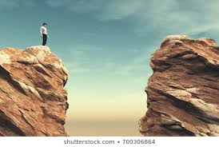
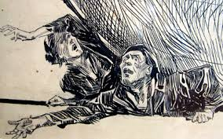
Key words
Meaning
Chasm(n)
Crack
Mythic(adj)
Illusory
Repression
Oppression(n)

Slide 8
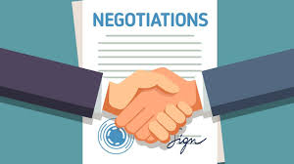
Key words
Meaning
Reconciliation(n)
Reunion
Discussion
Negotiation(n)
Peace(n)
Tranquality

Slide 9
Silent Reading
JOHANNESBURG(Reuters) Nelson Mandela guided South Africa from the shackles of apartheid to a multi-racial democracy, as an icon of peach and reconciliation who came to embody the struggle for justice around the world. Imprisoned for nearly three decades for his fight against white minority rule, Mandela never lost his resolve to fight for his people’s emancipation. ………………………………………………………………………………………………………………………………………………………………………………………………………………………………………………………………………………………………………………………………………………………………………………………………………………………………………………
Friends adored Mandela and fondly called him “Madiba,” the clan name by which he was known. People lauded his humanity , kindness and dignity.

Slide 10
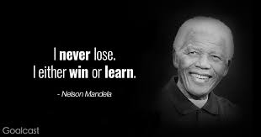
Nelson Mandela guided South Africa from the shackles of apartheid to a multi-racial democracy , as an icon of peace and reconciliation who came to embody the struggle for justice around the world.

Slide 11
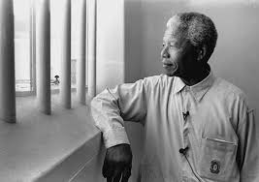
Imprisoned for nearly three decades for his fight against m white minority rule,
Mandela never lost his resolve to fight for his people’s emancipation.

Slide 12
Single Work
1.What does apartheid refer to in the first paragraph?
(a) apart (b) distance (c) discrimination (d) disable.
2. The word healing means ?
(a) curing (b) heating (c) believe (d) ailing.
3.Mandela is an icon of peace and…………
(a) War (b) reconciliation(c) fight (d) conflict.
4.Mandela was rewarded the Nobel Peace Prize in
(a)1988 (b) 1982 (c) 1990 (d) 1993
5.The clan name of Mandela is
(a) Sahiba (b) Madiba (c) sona miah (d) decork

Slide 13
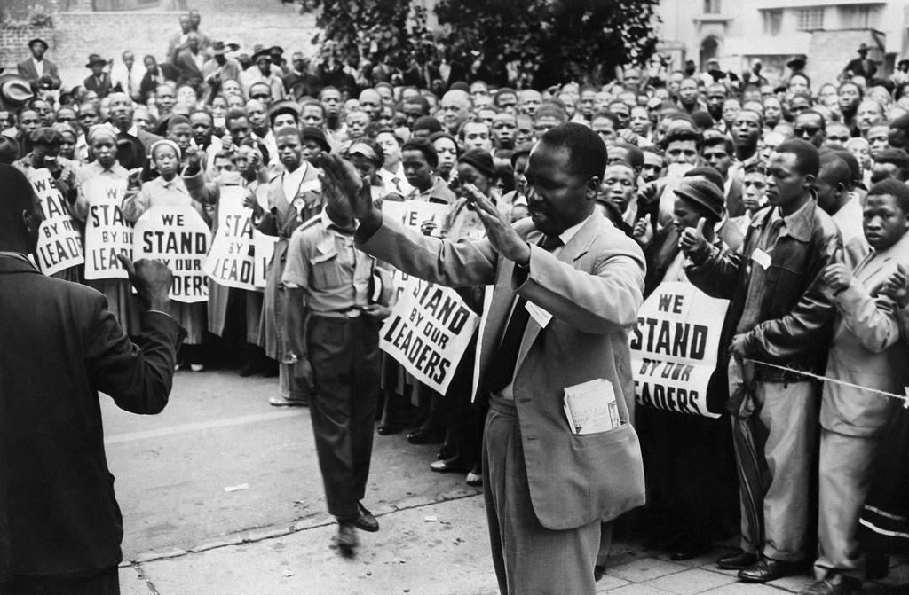
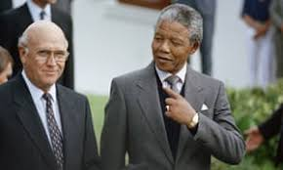
Observe the following pictures

Slide 14
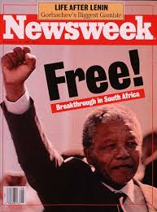
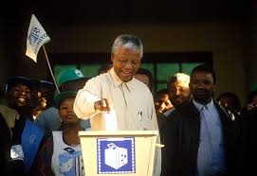

Slide 16
Pair Work
1.Why can Nelson Mandela be called “an icon of peace and reconciliation”?
2.“The time for the healing of the wounds has come.The moment to bridge the chasms that divide us has come?” what did Mandela mean by these lines?

Slide 17
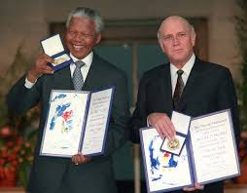

Slide 18
Group work
1.How long Was Mandela imprisoned ?
2.What do you know about F.W.de . Klerk ?

Slide 19
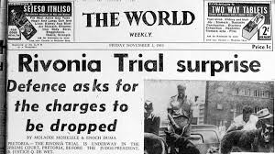
Charged with capital offences in the 1963 Rivonia Trail , his statement from the dock was his political testimony .

Slide 20
Evaluation
Based on your reading of the passage, make a flow chart showing the incidents of Nelson Mandela. (One is done for you.)
1.Fight against white minority rule
2
3
4
5
6

Slide 21
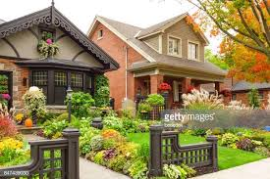
Home
Task
Wrtie a summary of the passage.

Slide 22
Thank you

