Slide 2
Welcome to My Class

Slide 3
Let me introduce myself
ABDUL LATIF
Lecturer in English
Alauddin Siddique College
Auliabad, Kalihati
Tangail.

Slide 4
Lesson Introduction
Class: XI
Unit: Ten
Lesson:01

Slide 5
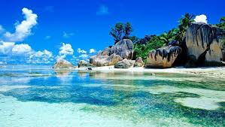
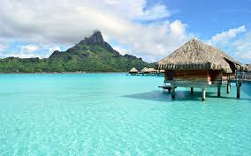
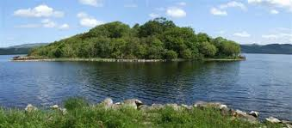
Let’s see some pictures

Slide 6
Let me declare the Lesson
“The Lake Isle of Innisfree”
by W.B. Yeats

Slide 7
Learning outcomes
The students will be able to tell the meaning of some words.
They will be able to explain the island described in the poem.

Slide 8
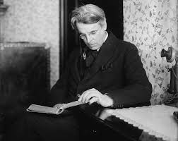
Awarded novel prize
Was born in
In 1923
13 June 1865
YEATS
Breathed his last in 1939

Slide 9
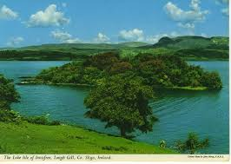
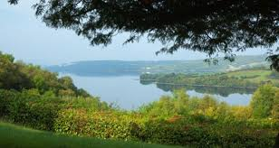
I will arise and go now, and go to Innisfree

Slide 10
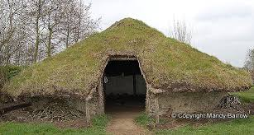
And a small cabin build there,of clay and wattles made

Slide 11
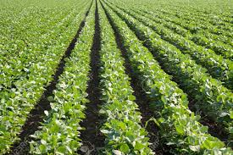
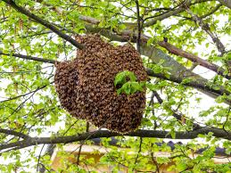
Nine bean rows will I have there, a hive for the honey bee

Slide 12
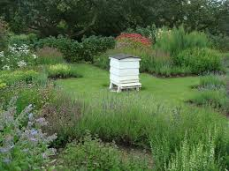
And live alone in the bee loud glade

Slide 13
Lets watch a video clip

Slide 14
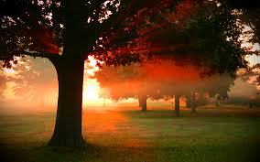
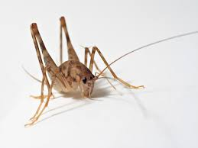
And I shall have some peace there, for peace comes dropping slow
Dropping from the veils of the morning to where the cricket sings;

Slide 15
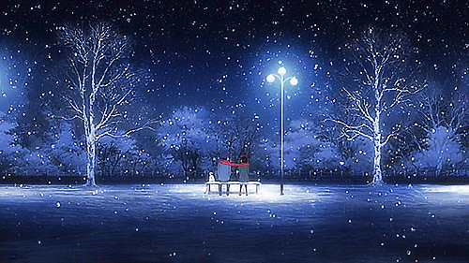
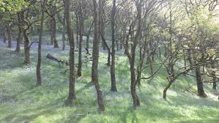
There midnight's all a glimmer, and noon a purple glow,

Slide 16
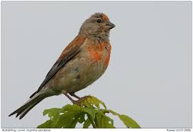
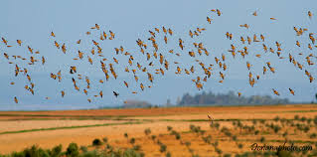
And evening full of the linnet's wings

Slide 17
I will arise and go now, for always night and day
I hear lake water lapping with low sounds by the shore

Slide 18
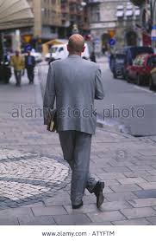
While I stand on the roadway, or on the pavements grey,
I hear it in the deep heart’s core.

Slide 19
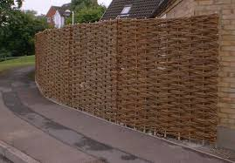
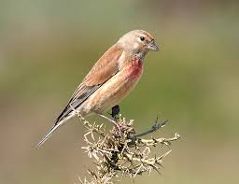
Let’s learn a few words
Wattle
a wooden fence
a thin cloth worn by women to cover their face.
Veil
an unsteady light.
Glimmer
Linnet
small song bird.

Slide 20
Group
Work
Discuss about the island stated in the poem.

Slide 21
Home
Work
Write the summary of the poem

