Slide 1
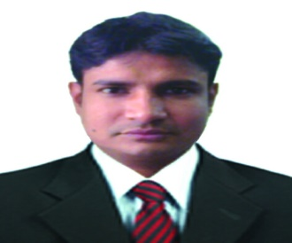
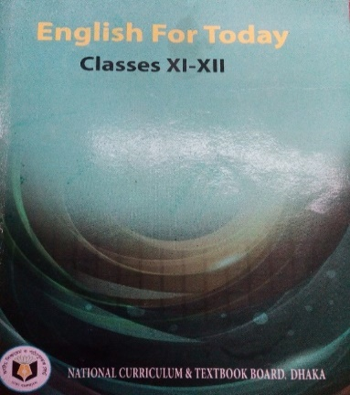
Sree Pradip Chandra Das
Lecturer in English
Ziarkandi Hafij Uddin Fazil Madrasah
Gouripur
Titas,Cumilla
IDENTITY
Class: XI-XII
Subj: English 1st Paper
Time: 45 minutes
Date: February 27, 2020
Class: XI-XII
Subj: English 1st Paper
Time: 45 minutes
Date: February 27, 2020

Slide 2
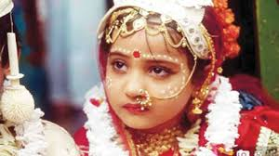
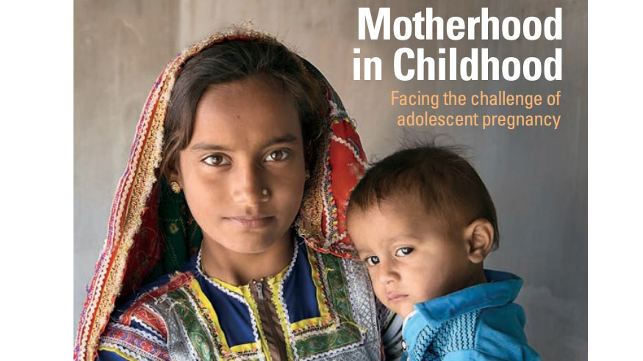
Look at the picture and think about this

Slide 3
Can you guess what may be the topic today?
Adolescence(Unit-Five)
The Story of Shilpy(Lesson-Four)

Slide 4
Learning Outcomes:
After the lesson the ss will be able to-
→ say the synonym & antonym of some new words.
→ say about the bad sides of early marriage .
→ say about the precautions of taking child.
→ describe the sufferings of early married girls

Slide 5
Let’s diccuss about some words and their synonyms and antonyms
Word
Synonym
Antonym
counselling
suggestion
rebuke
empowerment
authorization
denial
exclusion
elimination
inclusion
hemorrhage
Profusely bleeding
morbidity
sickness
freshness
mortality
Death rate
Birth rate

Slide 6
A. Read the multiple choice questions below and find the answers from the text in next two slides:
i .The word “decline” refers to----
a) rise
b) reduce
c) increase
d) intensify
Ans. b) reduce
The term “offspring” is used to imply-----
a. children b. parents
c. siblings d. adolescents
Ans. a) children
‘pressurize’ stands for ?
a. to push b. restrain
c. motivate to do something d. obligate to do something
Ans. d) obligate to do something
iv. The word ‘adolescent’ in line three means
a. teenage b. infant
c. adult d. boyhood
Ans. a) teenage
v. Shilpi is in ---- .
a. adolescence b. girlhood
c. childhood d. motherhood
Ans. a) adolescence

Slide 7
Shilpi was only 15 years old when she married Rashid in 2008. Marrying off daughters at an early age is a standard practice for many families living in rural Bangladesh. After her wedding, Shilpi joined a local empowerment group that provides adolescent girls with the tools needed to gradually change cultural practices, particularly those pertaining to early marriage and pregnancy. The group's activities include discussions on how to most effectively change behavior related to reproductive health as well as one-on-one counseling. It also offers peer-to-peer support and life skills training that help adolescents say no to early marriage .
The empowerment group is one of more than 10,000 groups supported by some local Non Government Organizations (NGOs) working all over Bangladesh. These NGOs work through Canada ‘s Adolescent Reproductive Health Project which also aims to increase access to quality health services for adolescents. During one of the group sessions, Shilpi came to understand the potentially harmful effects of early marriage and pregnancy. While maternal mortality in Bangladesh has declined by nearly 40 percent since 2001, the rate remains high with 194 maternal deaths per 100,000, live births in 2010-dropping from 322 in 2001 with a projected decrease to 143 by 2015. Girls who get pregnant are at risk of serious health complications. These include dangerous hemorrhage and fistula, a painful internal injury caused by obstructed childbirth that commonly leads to serious maternal morbidities and social exclusion.

Slide 8
When Shilpi heard about those risks, she invited her husband, Rashid, to discuss pregnancy with a counsellor. After hearing about the risks, Rashid agreed to delay having children for five years despite pressures from his parents and neighbours to produce an offspring. Together, the couple met with a female health care provider, who informed them about the various family planning options available. Shilpi’s mother-in-law and neighbours continued to pressurize the newlyweds. Deeply rooted cultural practices and traditions caused a rift between Shilpi and Rashid and their extended family, some of whose members insulted and criticized the couple. Unable to convince their close relatives of the risks, Shilpi and Rashid returned to the counsellor. They took the help of a parent peer who has been trained to speak to other parents about adolescent issues. Shilpi’s mother-in-law and neighbors eventually came to understand the harmful effects of early pregnancy on mother and child. Today, the village no longer pressurizes the couple; their parents and neighbours now support them and speak out against early marriage and pregnancy.

Slide 9
B. Read the questions below and answer them from your understanding of the comprehension in the previous slides.
a) Was Shilpi’s marriage early ?
b)What is the worst impact of early marriage of girls?
c) Where did shilpi join after weeding ? Why did she join there?
d) Do you support early marriage? Why/why not?
e) What role can you play against early marriage?

Slide 10
Evaluation
Based on your reading of the passage make short notes in each of the boxes in the flow chart showing the activities Shilpi did after marriage..No.1 has been done for you.)
1
2
3
4
5
6
Joined a local empowerment group

Slide 11
Q.Make a list of five events happening in Shilpi’s life.

Slide 12
Home Work
Summarize the text in your own language.

Slide 13
Thank you Very Much

