Slide 1
WELLCOME

Slide 2
Name Tittle Khalilur Rahman Assistant teacher Momtajbegum Assistant teacher Abdur Rahman Assistant teacher Syeeda Farhana Assistant teacher Sharmin Akter Assistant teacher
Teachers Identity:

Slide 3
Introduction of the lesson
CLASS:TWO
Unit: 29
LESSON : (4---6)
Lesson title: The Golden Goose
Today lesson: A
Time : 35 minute

Slide 4
Learning outcomes:
By the end of the lesson student will be able to---
L.4.2.I : enjoy simple stories.
S.1.1.1 :reapet after the simple words and phrases with proper sound stress.
R.1.4.1: read words with phrases with the help of visual clues and simple sentence.

Slide 5
Warm up activitics

Slide 6
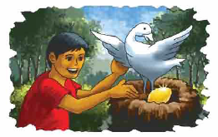
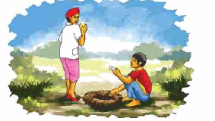
What you see about the picture ?
What are they doing?

Slide 7
Declaration of the lesion
``The Golden Goose’’

Slide 8
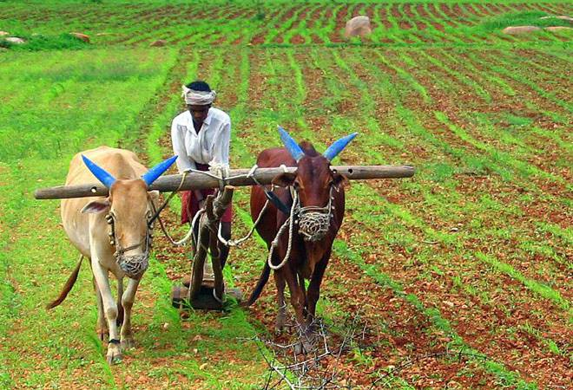
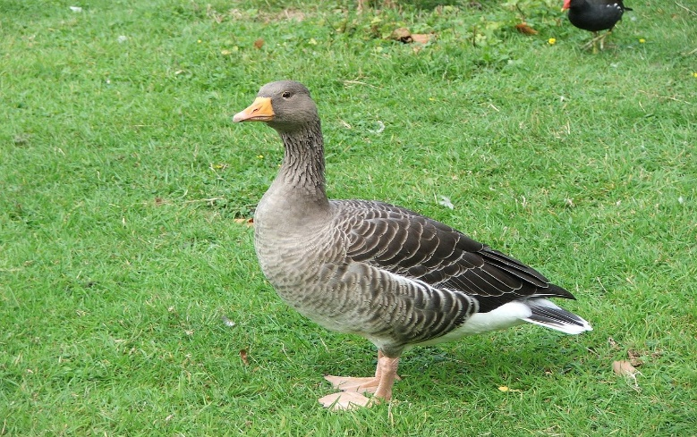
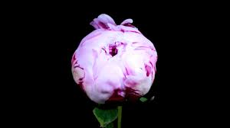
New words
কৃষক
Farmer
রাজহাঁস
Goose
Goden
সোনা

Slide 9
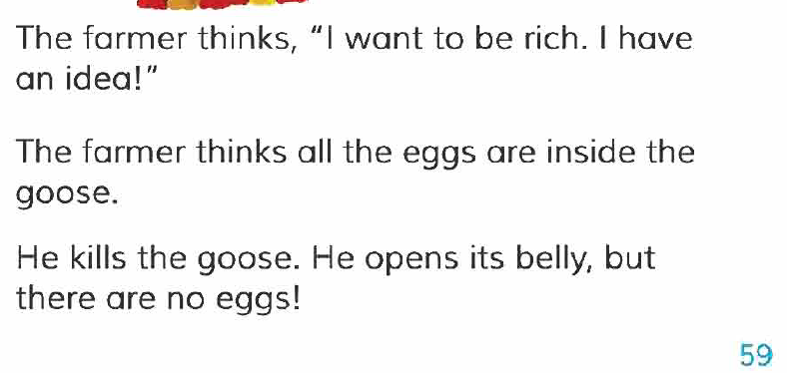
Teachers Reading
Page no at 59

Slide 10
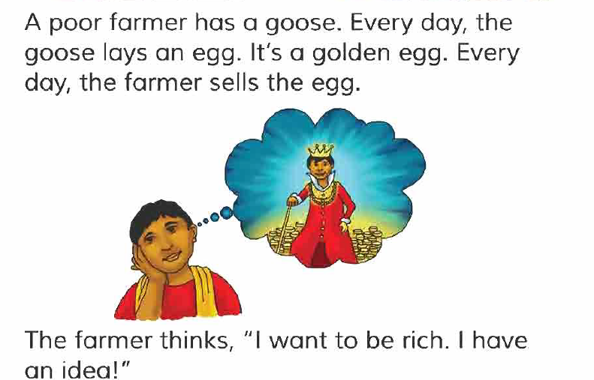
Students Reading

Slide 11
Chain drill
Read Text

Slide 12
Indevisual Work
Say True or false
The farmer is rich.
The farmer sells the egg evryday.

Slide 13
Group Work
Write word meaning and make sentence.
Farmer
Egg

Slide 14
TASK
Write 3 sentence about the golden goose.

Slide 15
Home Work
Write a small strory.

Slide 16
Thanks
Goodbye

