Slide 1
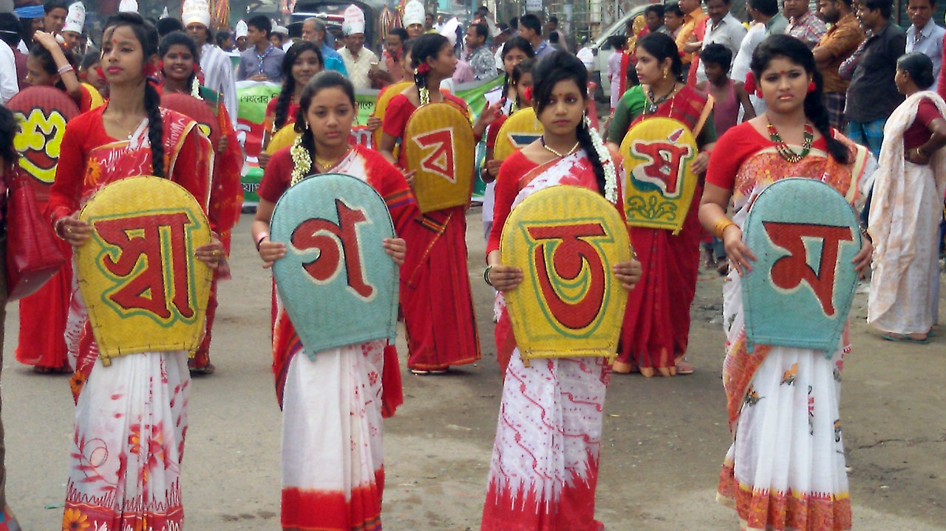
WELCOME

Slide 2
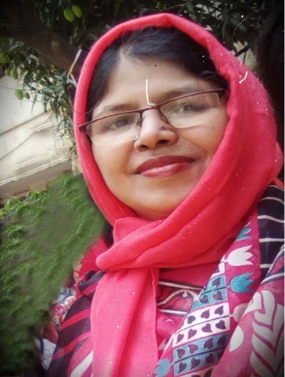
IDENTITY OF TEACHER
ASMA HUQ
Asst. teacher,English.
Motijheel Govt. Girls’ High School,Dhaka.

Slide 3
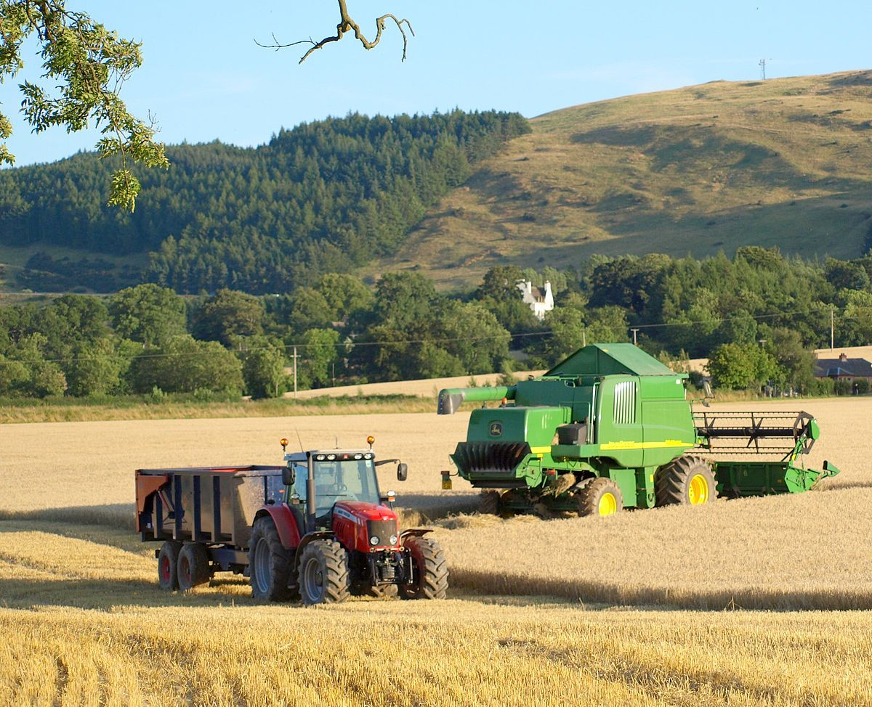
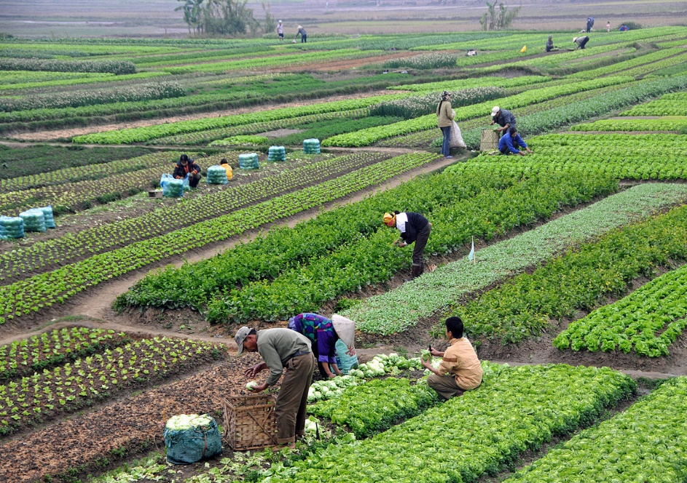
SEE THE PICTURES:
.

Slide 4
INTRODUCTION OF THE LESSON:
SUBJECT : ENGLISH FIRST PAPER
UNIT : 12 LESSON : 02
TITLE : MY ROOT
CLASSES : NINE & TEN

Slide 5
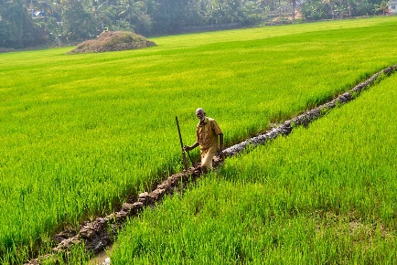
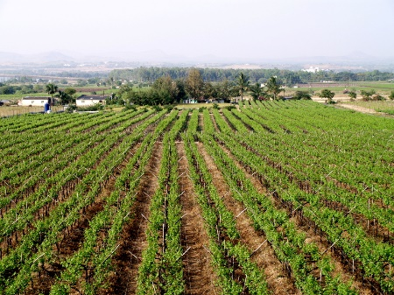
VOCABULERY:
Advanced – developed
Agriculture – farming
Bureaucrat -- govt.officer, civil servant
Fame – reputation
Farm -- granary

Slide 6
Loud reading of the text:
Moinul Islam is a qualified farmer in Naogaon.Mr.Islam was very brilliant as a student.He took his higher education from Bangladesh Agricultural University in Bangladesh .He then came back home and started advanced farming. He has two other brothers who are graduates in different disciplines. The speciality of the Islam family is that they all are living in their village and all are renowned in their own fields.------------------------They not only stuck to their own roots, they have been torch bearers for others to be respectful of their roots.

Slide 7
Individual work:
Read the text at page 156 silently.

Slide 8
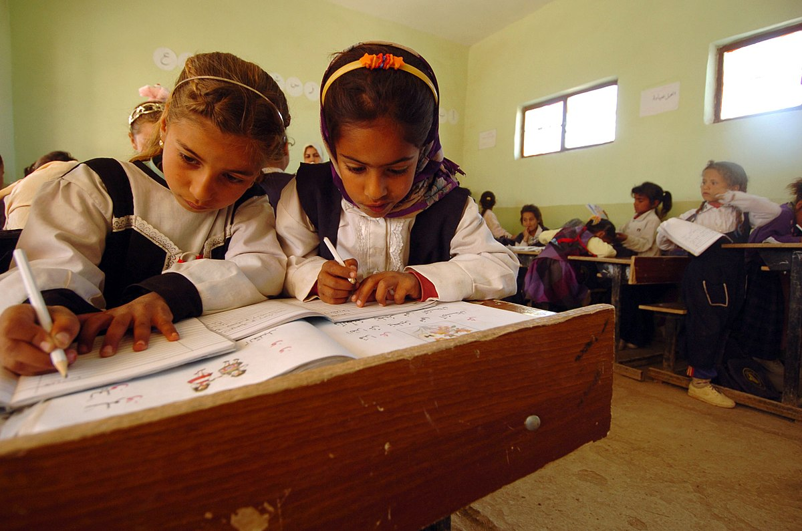
PAIR WORK:
Answer the questions:
(a) Inspite of taking higher education why
does Mr. Mainul want to live in his village?
(b) Why couldn’t city life attract him?

Slide 9
Group work:
Fill in each gap with
suitable word.
Mainul Islam is certainly a person of great (a) ---. Being highly educated he feels no (b) --- to be an ideal farmer. Rather he takes Pride in his(c) ---.
Answer :
(a) heart (b) shame (c) profession

Slide 10
EVALUATION:
Choose the best answer.
1. What is the meaning of the phrase
‘sons of soil’?
(a)Attraction to the soil (b)made of soil
(c)Avoiding of soil.
2. --- is better than any other job.
(a)Poultry (b) Fishing (c)Self-employment
Answer:
1.(a) 2.(c)

Slide 11
HOME WORK
Write a letter to your friend
describing the importance
of Farming in the economy of
our country.

Slide 12
THANK YOU

