Slide 1
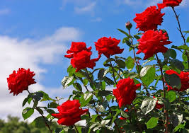
WELCOME
HOW ARE YOU ?

Slide 2
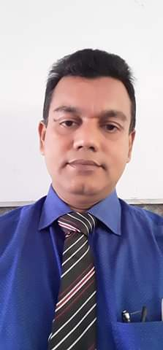
Introduction
Name: Nurul Amin Azad Assistant teacher: (English) Jahangirpur T,Amin Govt.
Pilot High School Madan,Netrakona
CLASS: Eight
SUBJECT: ENGLISH SECOND PAPER
UNIT: Three
LESSON: Seven
TOPIC : Gerund

Slide 3
Reading book is a very good habit
Exercise is good for health.
Here reading is formed from the word read by adding ing and used as the subject of a verb and wroks of a noun.
Do you know, here reading (read + ing) what kinds of verb or parts of speech ?
It’s called a Gerund.

Slide 4
Our today’s
Lesson is
Gerund

Slide 5
LESSON OUTCONES
By the end of the lesson students will be able to
learn what Gerund is.
Learn the difference between Participle and Gerund.
Learn the uses of Gerund & Infinitive instead.
Use appropriate gerundial form of verbs.

Slide 6
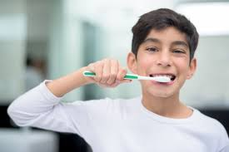
Definition of Gerund
A Gerund is that form of the verb which ends in –ing, and has the force of a Noun and a Verb.
The Gerund has the force of a Noun and a Verb: it is a Verbal Noun.
Functions of Gerund :
a) As the subject of a verb :
Eating uncooked food is not good.
Brushing your teeth is important.

Slide 7
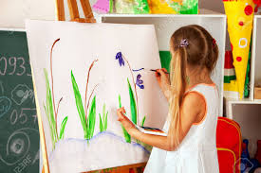
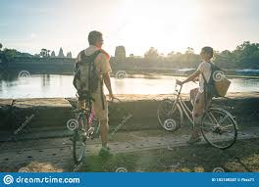
Functions of Gerund :
b) As the object of a verb :
Stop driving.
She learns painting.
c) As the object of preposition:
They are fond of cycling
I am planing of going to picnic.

Slide 8
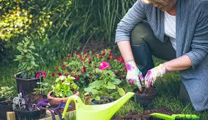
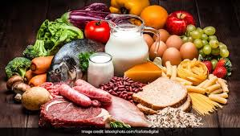
Functions of Gerund :
d) As a complement :
Speaking is believing.
Mina’s hobby is gardening.
e) As a part of compound noun :
We need healthy eating food.
I am used to waiting for buses.

Slide 9
Individual Work
Open your English Grammar book page no. 130
Read the passage carefully :
Ask and answer with your partner :
How many verbs with+ ing are there in the passage ? Find out them.
Do all the verbs having ‘ing’ work as gerunds or participles ? If not identify and show them separately.

Slide 10
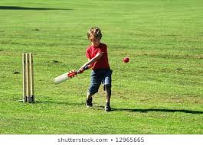
Pair Works
Replace infinitives of the following sentences by gerund.
i. To speak the truth is a great virtue.
I like to play cricket
His aim to be a teacher
To swim is good for health.
He started to write the letter..
To plant trees is everybody’s duty.
To give is better than to receive.

Slide 11
Group Works
Complete the following sentences by using appropriate gerundial form of verbs :
You cannot learn any language without (a)……….... it. (b) ……….. is the first skill you should practise. The second one is (c) ………. . The third one is (d) ……….. while the fourth skill is (e) ……….. Unless you practise the skills, you cannot succeed in (f) ……….. any foreign language.
Answer : (a) practising, (b) listening, (c) speaking, (d) reading, (e) writing, (f) learning,

Slide 12
HOME WORK
Use gerunds in the following sentences
I like to read poetry.
To walk is a good exercise.
To talk like this is foolish.
She loves to sing a song.
I am tired to wait.
He is afraid to hurt your feelings.

