Slide 1
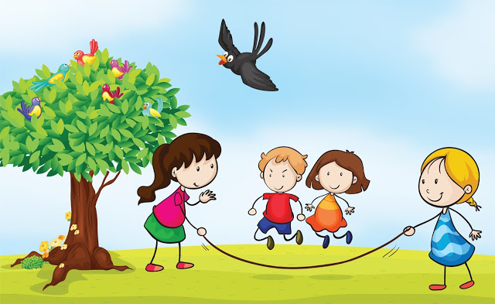
Most Welcome

Slide 2
Identity
Nahid akhtar parvin
Assistant Teacher
Jagodishpur Govt. Primary school
Taragonj,rangpur.
English
Class:- v
Unit: 17
Lesson: 5-6
Page:68
Date: 03/02/2020

Slide 3
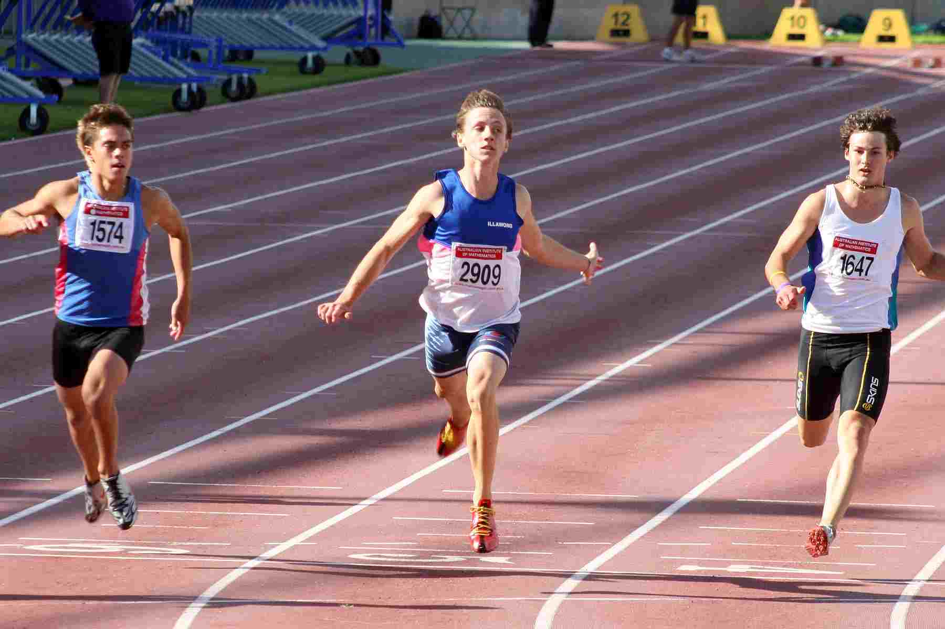
What can you see in this picture?

Slide 4
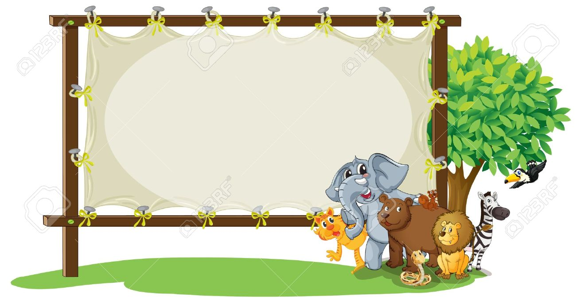
Our todays lesson is
Sport

Slide 5
students will be able to-
1.5.1 read words, phrases and sentences in the text with proper pronunciation, stress and intonation.
8.1.1 make sentences using words and phrases
given in the textbook.

Slide 6
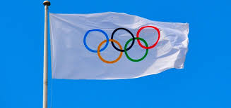
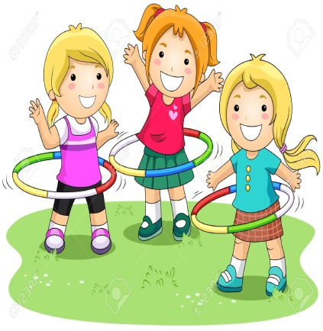
Olympic game
The biggest sports name.
There are more than 30 games in the Olympic.

Slide 7
World
Earth
The Olympic game is the biggest sport in the world.

Slide 8
Competetion
A contest among many person.
There have been 31 competitions since then.

Slide 9
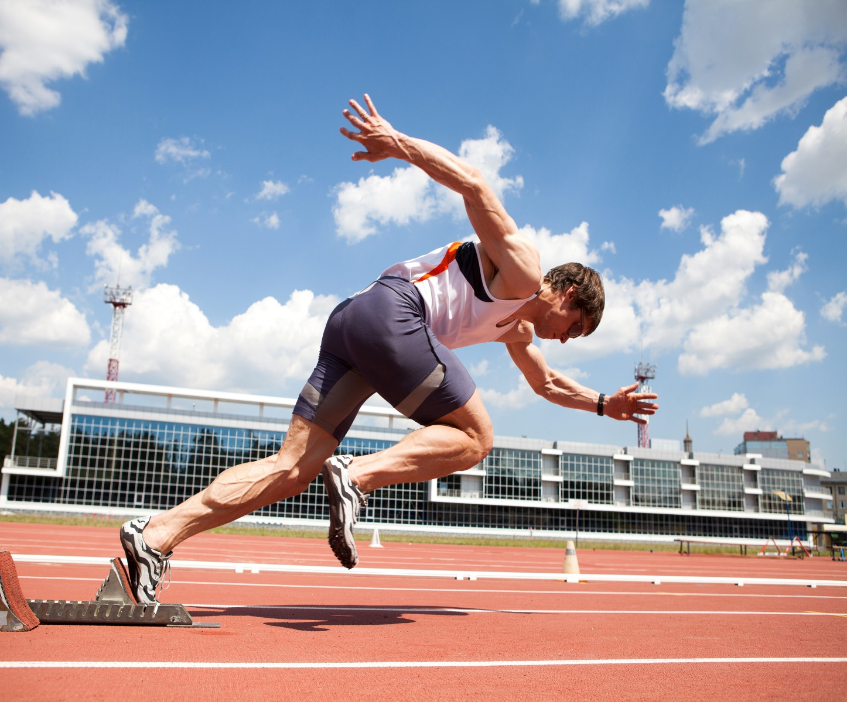
Athlet
Sportsman
About 13000 athletes compete in the Olympics.

Slide 10
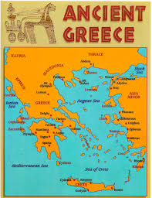
Greece
It’s a country name.
The first Olympic games held in Greece.

Slide 11
Teachers reading
Open at page 68
Make2 groups and read one after anoter.

Slide 12
Group -1
I.W
Missing letter write on the board:
Athlet
Competetion
Earth

Slide 13
group -2
Read the text silently and find out the answer
1.How often are the Olympic held?
2.When did the modern Olympic begin ?
3.How many countries compete in the Olympic?

Slide 14
Make WH questions:
Lets do pair work
1.TheOlympics are held every four years.
How often are the Olympic held ?
2.The modern Olympics Games began in 1896.
When did the modern Olympic Games begin ?
3.The first Olympic Games were held in Greece.
Where was the first Olympics held ?

Slide 15
Cheeking learning
Match with their meaning :
a person who compete in sports.
Compete
a countries , a city that arrange a special events.
Athlate
Host
to take part in a contest.

Slide 16
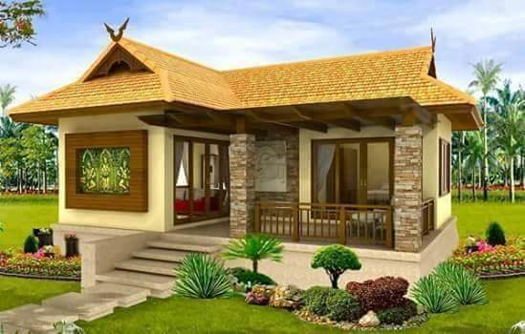
Home work
You will write five sentences about your favorite sport.

Slide 17
One day one word
খেলাধুলা
games
The first Olympic games held in Greece.

Slide 18
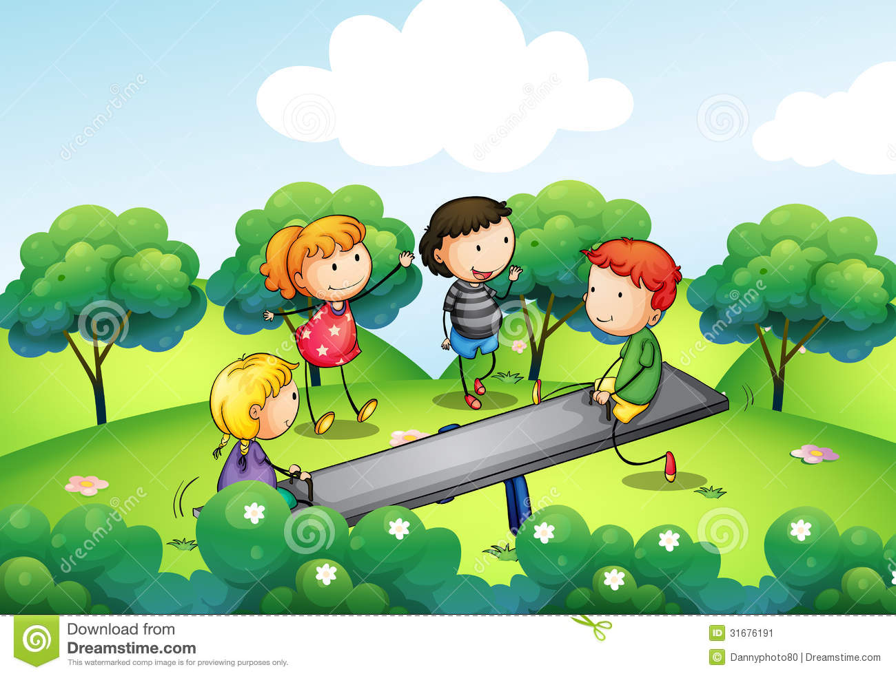
Bye.
See you

