Slide 1
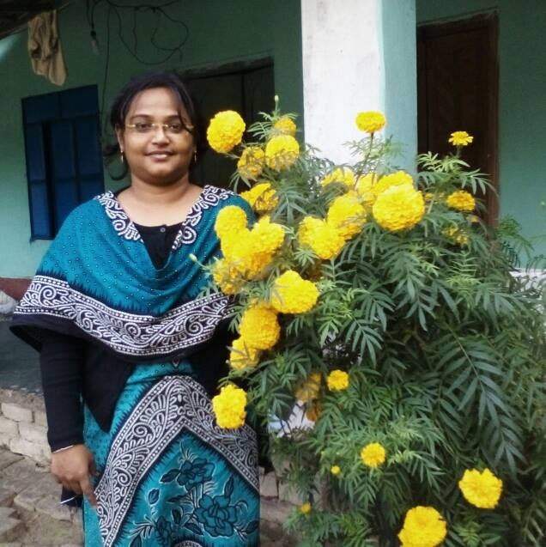
Teacher’s Identity
Name: Labony Saha
Asistant Teacher
Madhyapur Govt.PrimarySchool Avoynagar,Jashore.

Slide 2
Safe Learning Environment
By wathching Video clip

Slide 3
Today’s Lesson
Class- Three
Subject-English
Unit-37,Lesson:1-3
Lesson name-What food should we eat?

Slide 4
Learning Outcomes
They will be able to-
1.Enjoy and understand simple passage.
2.Talk about the objects.
3.Write simple sentenses by answering a set of questions.

Slide 5
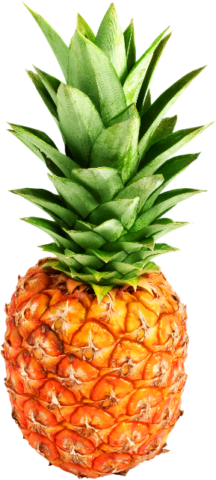
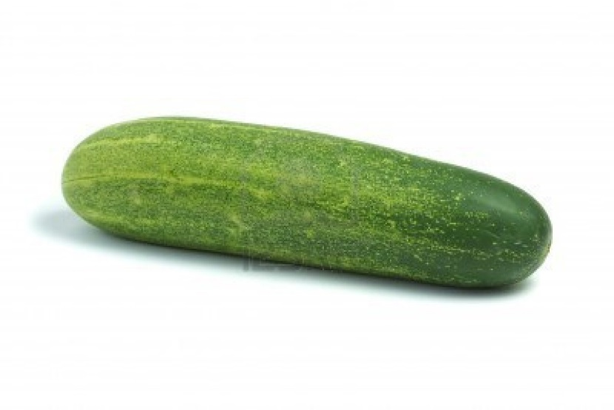
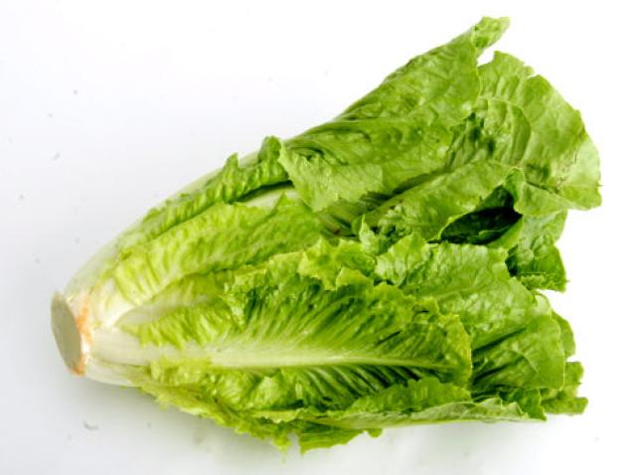
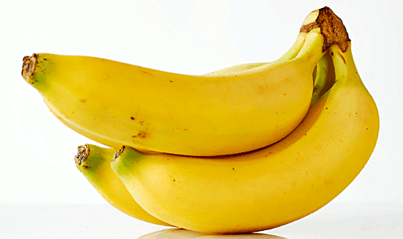
Cucumber
Healthy Food
pineapple
Lettuce
Banana

Slide 6
Lettuce is a vegetable
Lettuce

Slide 7
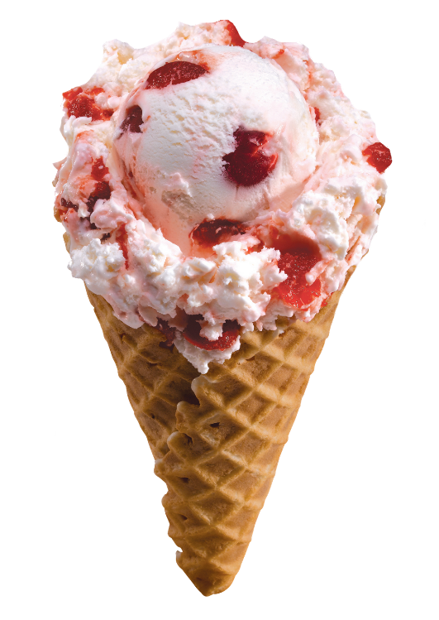
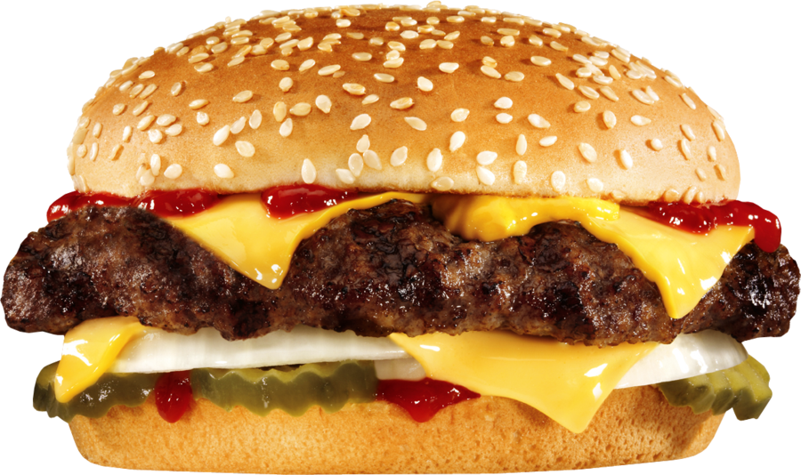
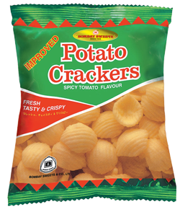
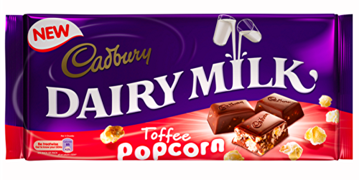
Unhealthy Food
Burger
Ice-cream
Chips
Chocolate

Slide 8
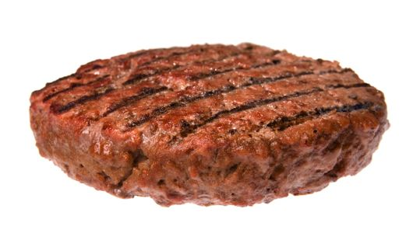
Meat
Burger
Burgers are meat, but they aren’t healthy

Slide 9
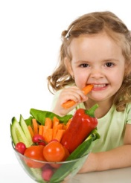
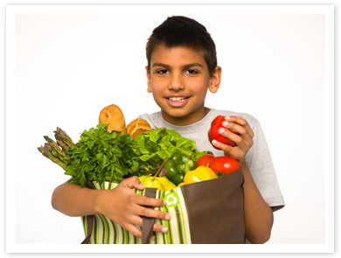
Healthy food makes us healthy

Slide 10
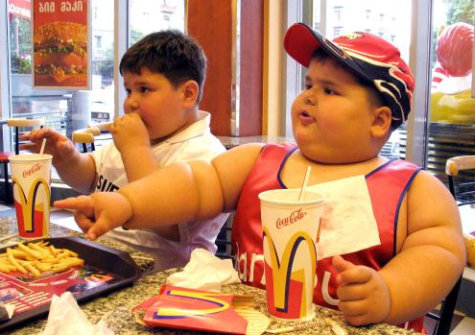
Unhealthy foods make us unhealthy

Slide 11
New Words
Healthy-Fit Eat-Have
Unhealthy-unfit vegetables-Food items
Sentence making
Healthy-Healthy foods are pineapples and papayas.
Unhealthy- Unhealthy foods are ice-cream and chocolates.
Vegetables-Carrots,lettuce and tomatoes are vegetables.
Fruits-Banana and papayas are fruits.

Slide 12
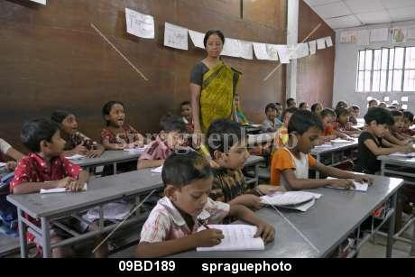
tT
Teacher’s and students loud Reading
Open your book at page 74 and repeat after me

Slide 13
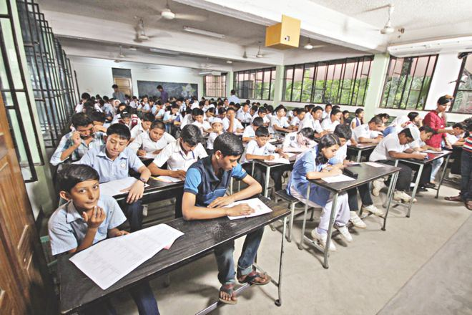
Silent Reading

Slide 14
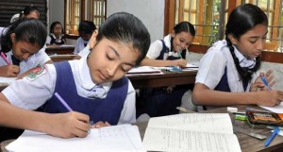
Pair Work
Make a list of healthy foods and unhealthy foods in your exercise book

Slide 15
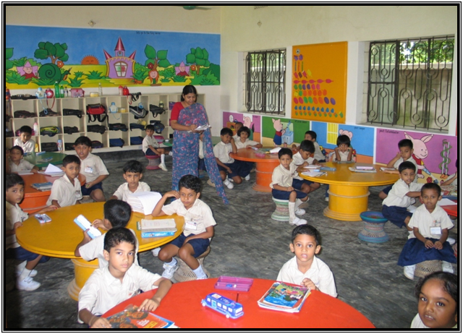
Group Name-Lettuce
Fill in the gaps
healthy
Group Work
1.We should eat……….food
2.We shouldn’t eat too much………….food.
3.Unhealthy foods are.……… ., …………..
unhealthy
Ice-cream
Chocolate

Slide 16
Make 2 simple sentences about unhealthy food

Slide 17
Choose the correct answer
1.Which food is healthy?
(a) Pineapple (b) Ice-cream
(c) Chocolate (d) Chips
2.Which food is unhealthy?
(a) Chocolate (b) Papaye
(C) Carrot (d) Tomato
$$√$$
$$√$$

Slide 18
See You next class

