Slide 2
Presented by:
Laily Akter
Assistant Teacher
Fulgaon Govt: Primary School
Laksam, Cumilla.
Today’s Lesson:
Class:5, Subject: English.
Unit:9 (Occupations)
(A long time ago, …….... Raju didn’t mind.)
Lesson: 1-2
Time: 40 minutes

Slide 3
Let’s watch a video.
https://www.youtube.com/watch?v=0GGzdXmvF5Y&t=7shttps://www.youtube.com/watch?v=0GGzdXmvF5Y&t=7s
What do you see in the video?
Firefighters put out fires.

Slide 4
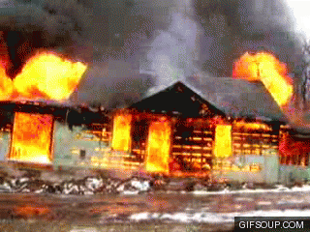
What do you see in the picture?
A fire in a house.

Slide 5
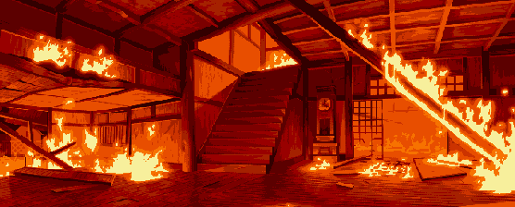
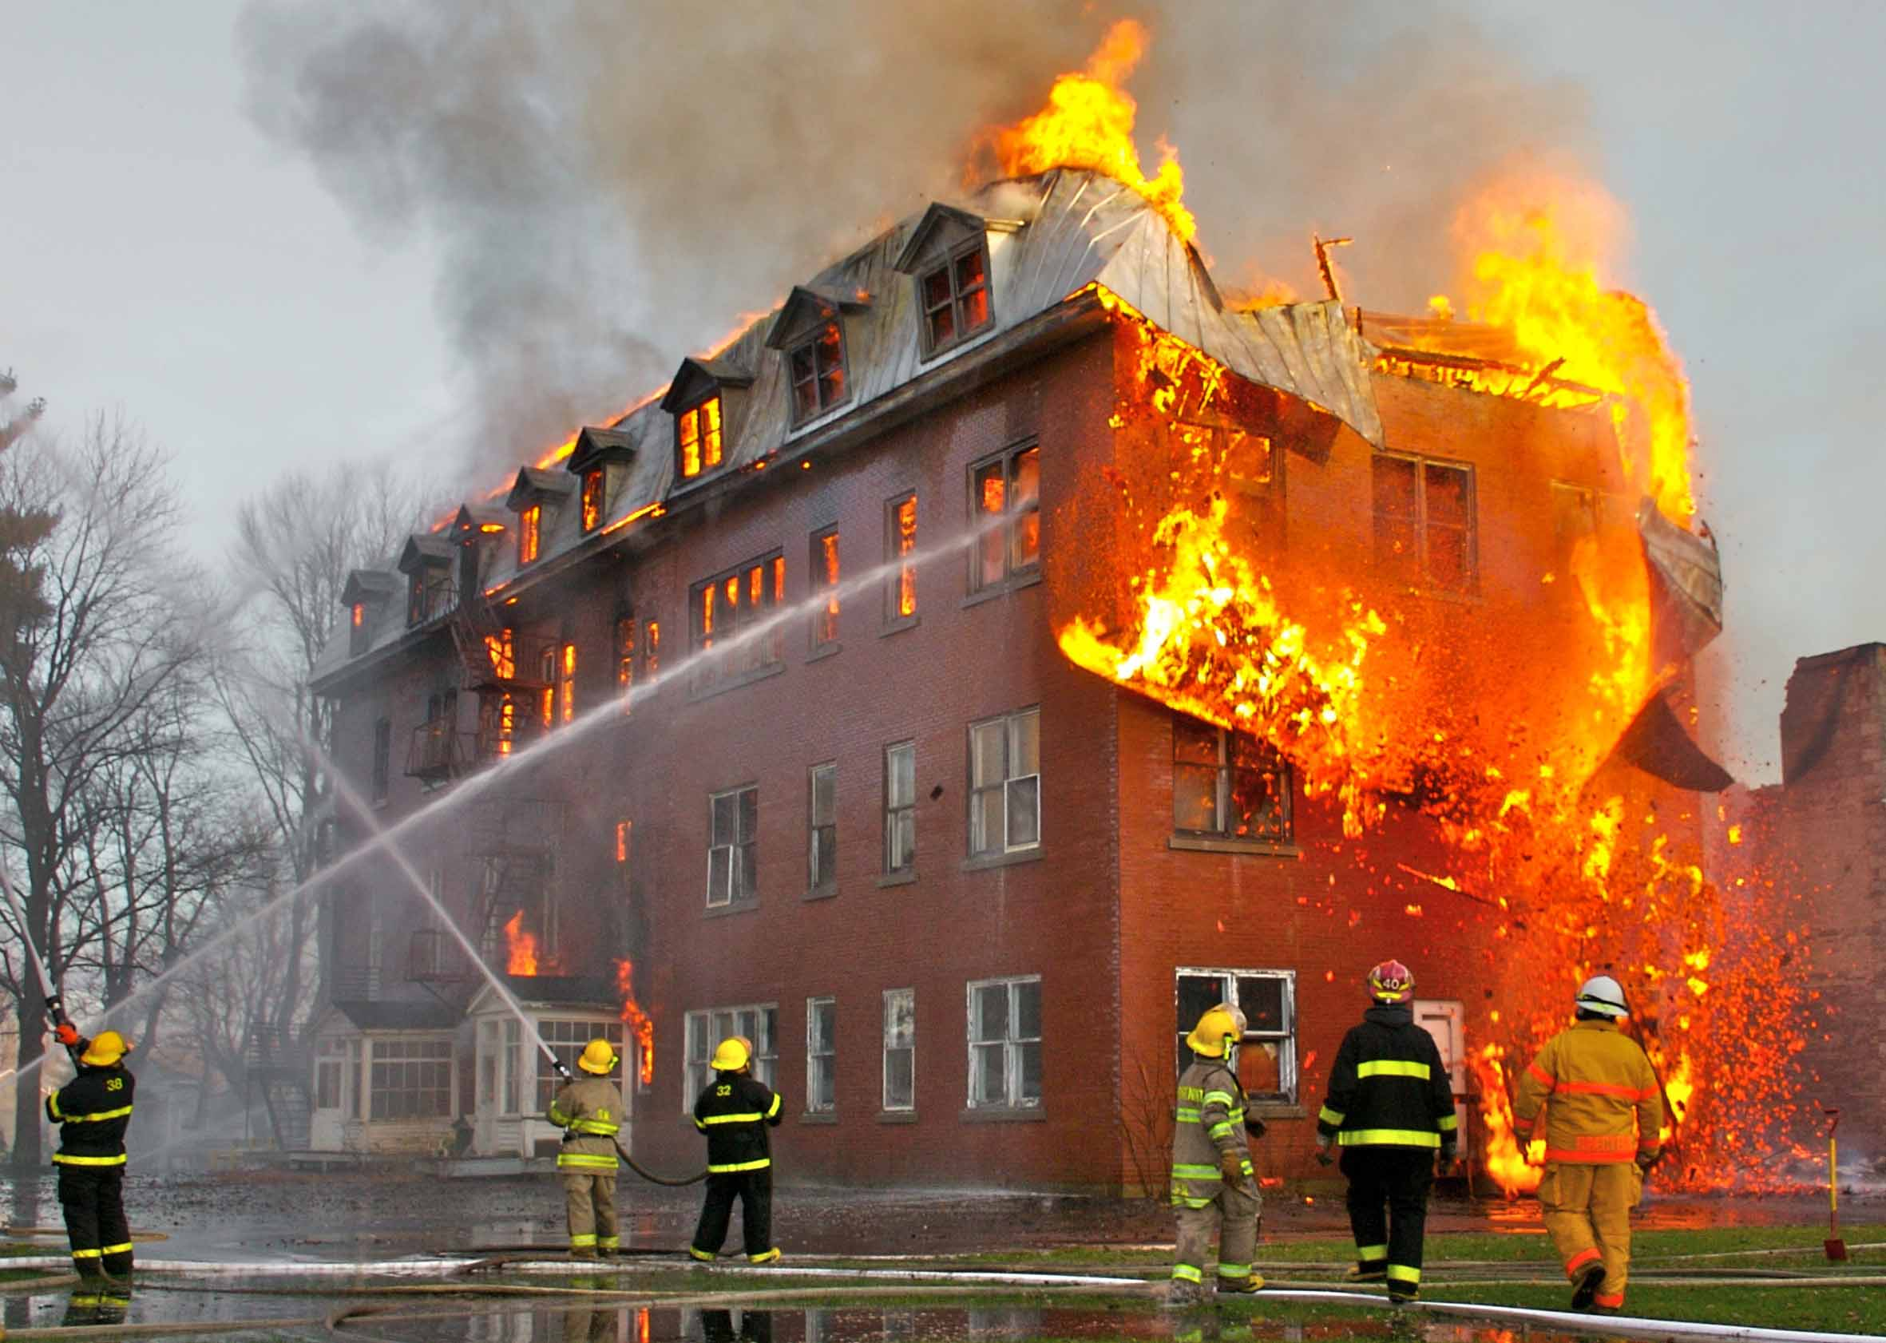
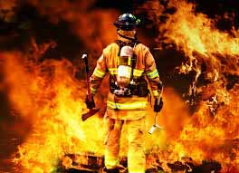
Today’s Lesson
Who put out the fire?
A firefighter.

Slide 6
Learning outcomes
Students will be able to-
Listening:1.3.1 recognize which words in a sentences are stressed.
Speaking: 1.1.1 say words, phrases and sentences with proper sounds and stress.
Reading: 1.5.1 read words, phrases and sentences in the text,with proper sound, pronunciation, stress and intonation. 1.6.1 recognize and read statements, commands, greeting, questions and answer.

Slide 7
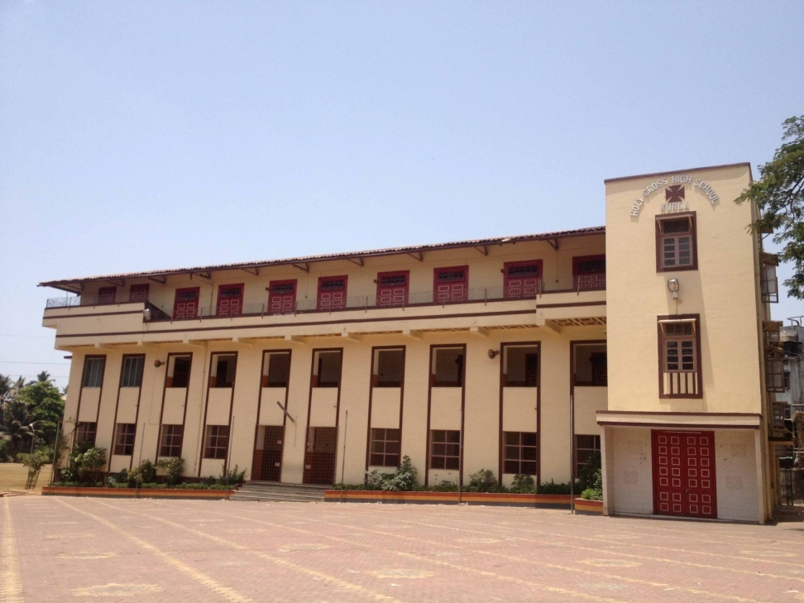
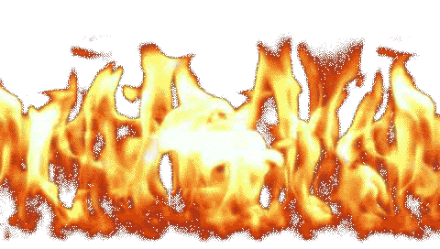
Discuss by picture:
Look at the punctuation mark and capital letters.
,
,
Long time ago,
L
R
when Raju was in class 5,
.
there was a fire in his school building.

Slide 8
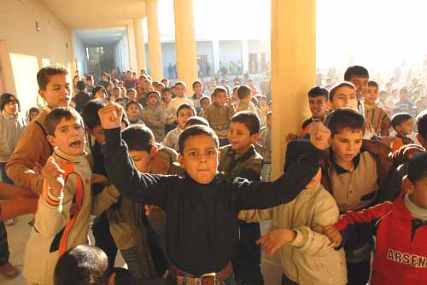
Look at the punctuation mark and capital letter
Discuss by picture:
,
.
Everyone was very afraid, but no one panicked.
E

Slide 9
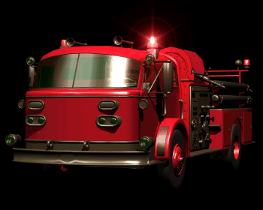
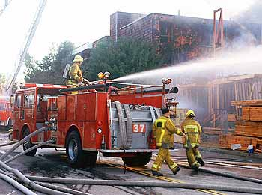
Look at the punctuation mark and capital letter
Discuss by picture:
.
Soon the firefighter came and put out the fire.
S

Slide 10
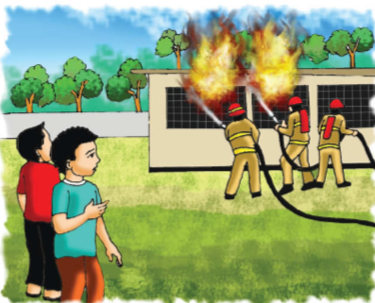
Look at the punctuation mark and capital letter
Discuss by picture:
R
Raju watched the firefighters from the school yard.
.

Slide 11
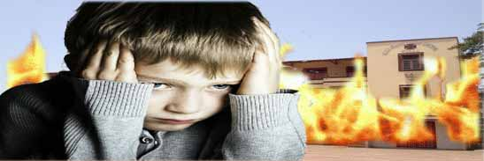
Look at the punctuation mark and capital letter
Discuss by picture:
Raju thought about the fire and the firefighters for a long time.
R
.

Slide 12
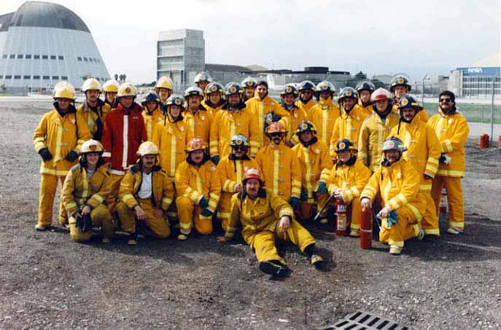
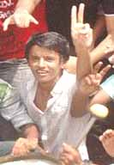
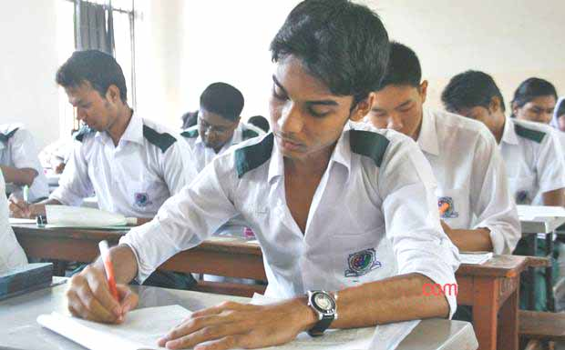
Look at the punctuation mark and capital letter.
Discuss by picture:
,
.
A
R
After college, Raju joined a volunteer fire department.

Slide 13
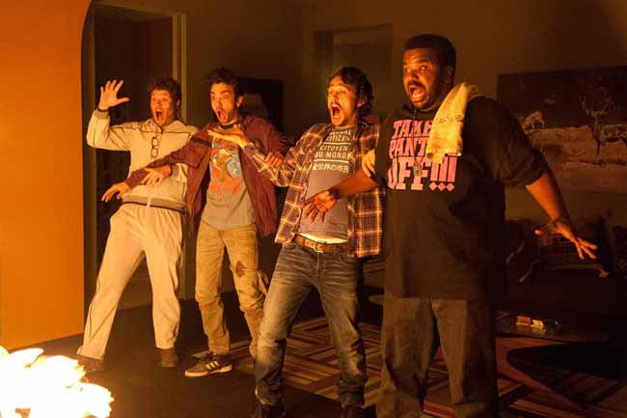
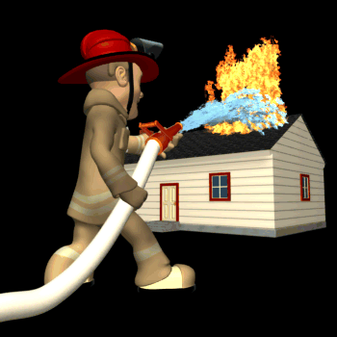
Vocabulary
Pronunciation
Meaning
A sudden feeling of great fear that can not be controlled.
To stop something from burning.
A person whose job is to put out the fire.
Firefighter
Panicked
Put out

Slide 14
Work in pair
Say true or false.
Listen the text and compare with your book page no.34
Raju is a sportsman.
Everyone was very afraid, but no one panicked.
Soon theRaju came and put out the fire.
Raju’s school got a fire, when he was in class 2
False.
True.
False.
False.

Slide 15
Group work
Firefighter group
Answer the following questions:
(a)What happened in Raju’s school?
(b)Who help the
students?
(c) Who put out the fire?
Volunteer group
Answer the following questions:
(a)Who joined a volunteer?
(b)What did Raju do after college?
(c)When was there a fire in Raju’s school ?

Slide 16
Individual Work
Fill in the gaps the best word from the box.
job | student | firefighter | Safe
yard | safety | put out | happy
student
Raju was a ................ when there was a fire in his school.
Raju wached the firefighter from the school ......... .
The firefighter came to Raju’s school to ............... the fire.
Raju feels .................. for working as a volunteer.
Raju is a ..................... .
yard
put out
happy
firefighter

Slide 17
Evaluation
Rewrite the sentence(s) using punctuation and capital letters where necessary
(a) raju is a firefighter
(b) long time ago when raju was in class 5 there was a fire in his school building
(c) everyone got panic
(d) but soon a fire brigade came and put out the fire
(e) raju could not forgot this for many days

Slide 18
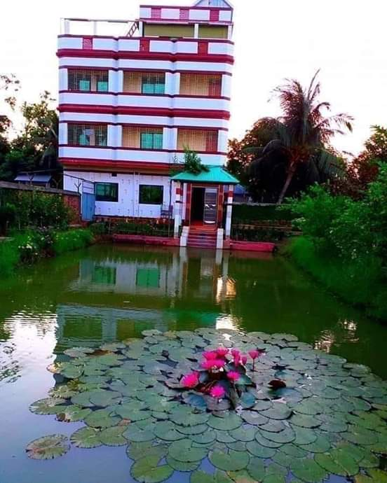
Home work
Write five sentences about “A Firefighter”.

Slide 19
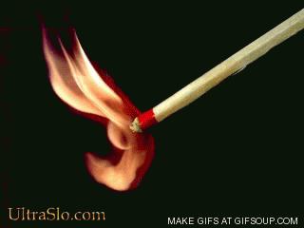
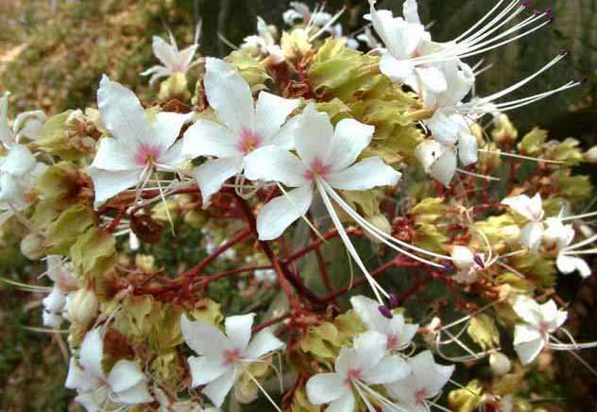
Closing of the Class
Stay Fine
Don’t play with match stick.
Thanks

