Slide 1
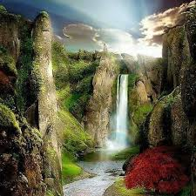
Welcome

Slide 2
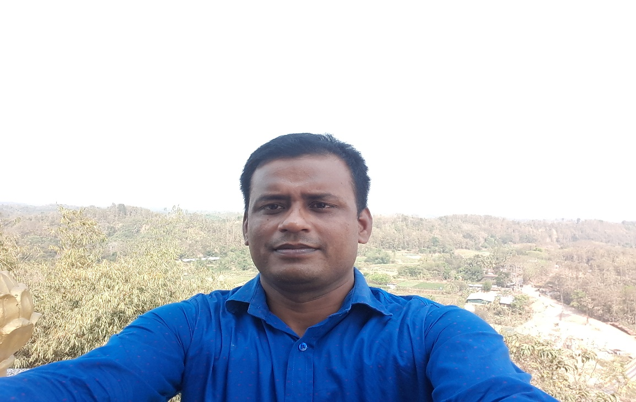
Presented by
Md. Sorfuddin Mridah
Assestent teacher
Laxmipur Govt. Primary School
Matlab south, Chandpur.

Slide 3
Class-Four
Subject-English
Unit-14, lesson 3-4
My day.

Slide 4
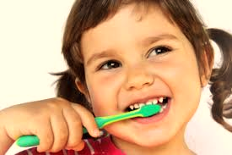
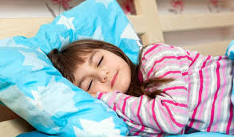
Look at the picture

Slide 5
Todays lesson
My day

Slide 6
Learning outcomes
By the end of the lesson ss will be able to……
Reading:
1.5.1 Read words, phrases and sentences in the text with proper
pronunciation, stress and intonation.
Writing:
3.1.1 Write words, phrases and sentences using non cursive
capital and small letters.
7.2.1 write the time ( hours only) and mention a.m/p.m

Slide 7
Look at the cards
Mita is in class 4.

Slide 8
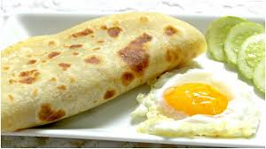
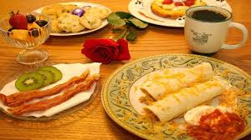
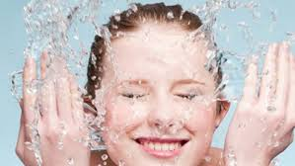
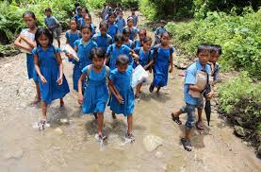
Look at the picture

Slide 9
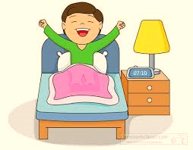
She gets up at 6 o`clock.

Slide 10
What time do you get up?
I get up at 6 o`clock.
Practice it in pairs.

Slide 11
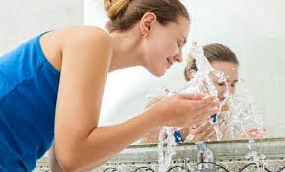
She washes her face.

Slide 12
She has breakfast at 7 o`clock.

Slide 13
When do you have breakfast?
I eat breakfast at seven o`clock.

Slide 14
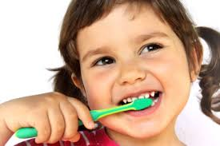
Then she brushes her teeth.

Slide 15
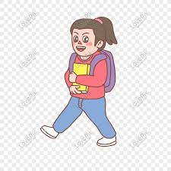
She goes to school at 9 o`clock.

Slide 16
What time do you go to school?
I go to school at nine o`clock.

Slide 17
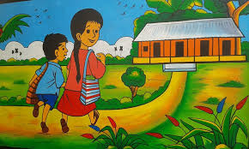
She walks to her school

Slide 18
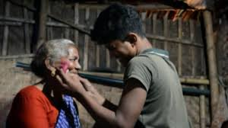
After school,at three o`clock,she visits her grandmother.

Slide 19
Then,Mita returns home at five o` clock.

Slide 20
When do you return home?
I return home at five o`clock.

Slide 21
What time do you go to bed?
I go to bed at ten o`clock.

Slide 22
Practice W/H questions in pairs.

Slide 23
Group work
Wh questions and answers.
One group ask
Another group answer.

Slide 24
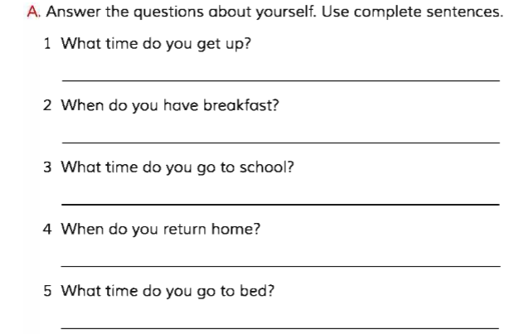
Pair work

Slide 25
Home work
Write five sentences about your day.

Slide 26
G O O D B Y E

