Slide 1
welcome

Slide 2
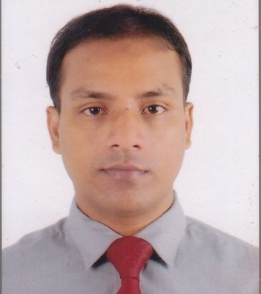
Introduction
Class: IX & X English 1st paper
Unit: 3 Lesson: 3
MD.AHSAN HABIB
Assistant Teacher(English)
SPPM High School
Chhatak,Sunamganj.

Slide 3
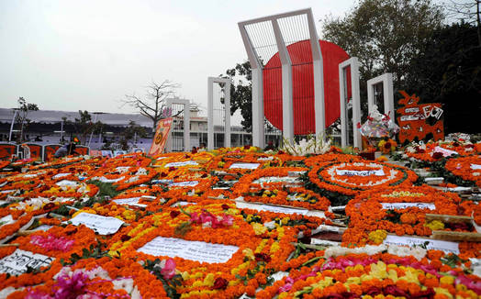
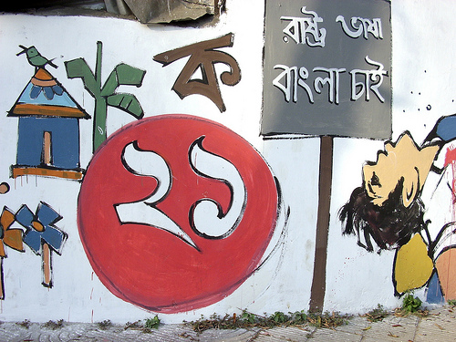
Let’s WATCH The Pictures

Slide 4
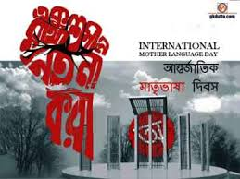
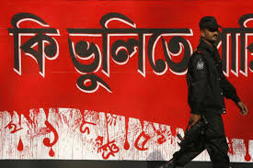
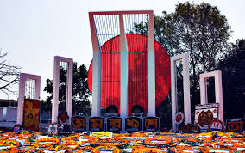
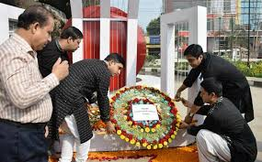
We observe the day every year as International Mother Language Day.

Slide 5
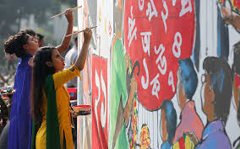
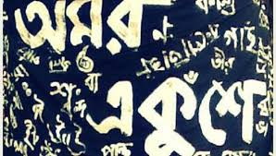
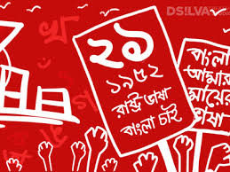

Slide 6
Topic: International Mother Language Day

Slide 7
Learning outcomes
After ending this lessons:
We will be able to know the history of mother language .
We will be able to know how to pay tribute to the martyrs.
We will be able to know how to celebration of the day.

Slide 8
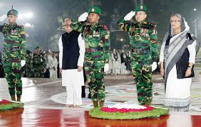
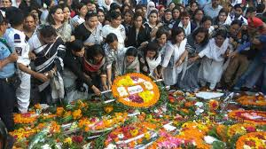
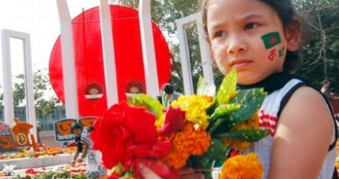
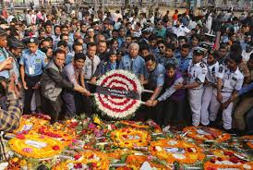
New Words
:Tribute
On this day, We pay tribute to the martyrs of language.

Slide 9
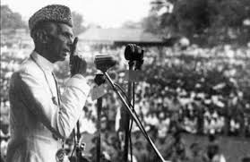
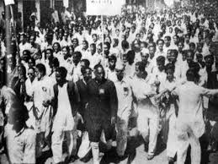
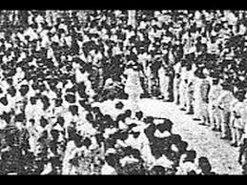
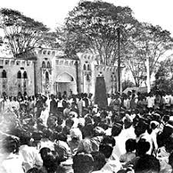
21 march 1948 when Muhammad Ali Jinnah declared Urdu is only state language then protest in the present student in the meeting.

Slide 10
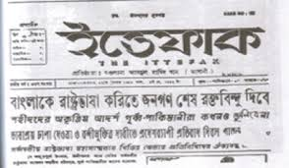
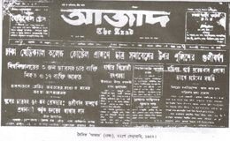
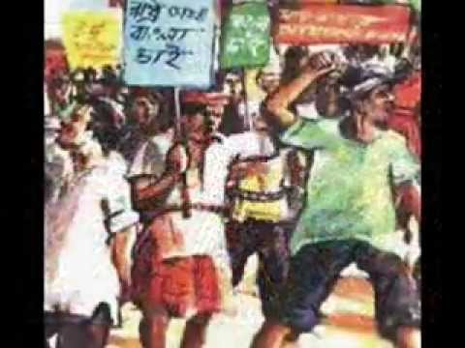
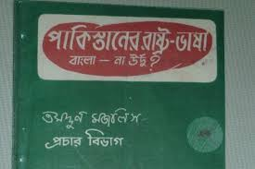
News On Language movement of 1952

Slide 11
Our national Language Hero: Shahid Salam,Rafiq,Barkat,Safiur and Jabbar.

Slide 12
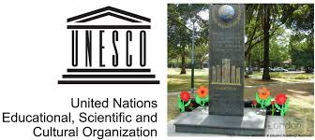
UNESCO has announced 21st February is International Mother language day.

Slide 13
Read the text in your book and complete the following chart.
Time | What happened
1947
1948
1952

Slide 14
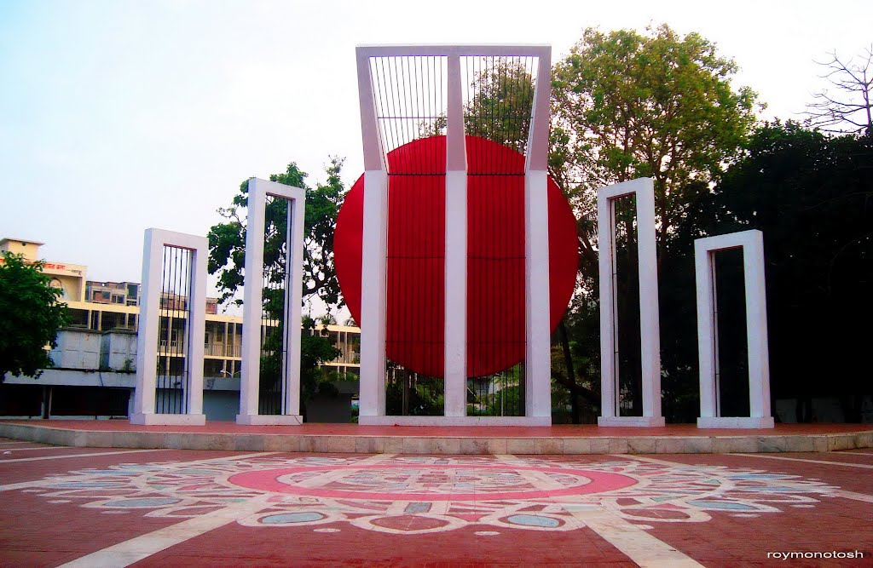
Talk about the picture.
What is the picture about?
Where do you think it is?
Why was it built?

Slide 15
Group work
Match the following words with their meaning
Words | Meaning
Tribute | A number of people moving in an orderly way
Climax | To refuse to obey
Outlaw | To ban
defy | An act of showing respect
procession | The most exciting point of time

Slide 16
Evaluation
Why do we observe 21 February as the International Mother Language Day?
What happened when Urdu was declared as the only official language of Pakistan?
What happened on 21 February 1952?

Slide 17
Home work
# Write a paragraph on how you Observed “The International Mother Language Day” in your school this year.

Slide 18
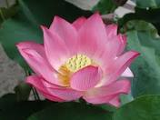
Thanks

