Slide 2
WELL COME

Slide 3
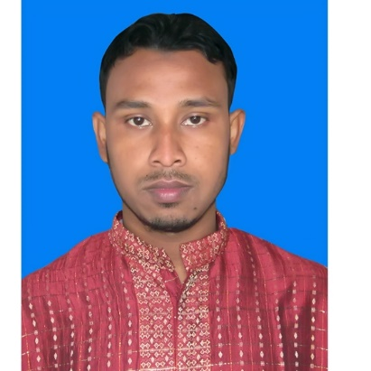
TEACHER,S IDINTITY
NURULLAH
ASS. TECHER ( ICT )
SHAITUTA HOSSAINIA DHAKIL MADRASHA
KARIMGANJ-KISHOREGANJ

Slide 4
LESSON IDINTITY
c
CLASS : SIX
SUBJECT : English For Today
Lesson : One
Going to at new madrasah
CLASS : SIX
SUBJECT : ENGLISH FOR TODAY
LESSON : 1

Slide 7
Lesson Declaration
Going To a new madrasah

Slide 8
By the end of the lesson as will be…………
Lesson outcomes

Slide 11
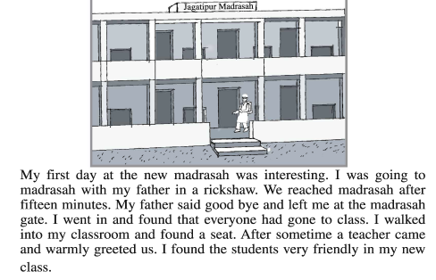

Slide 12
vocabulary
Interest
Reached
Said
Everyone
walked
Friend

Slide 13
Home work
Write a paragraph on how you felt on your first day at madrasah and why you felt so

Slide 14
Thank you

