Slide 1
WELCOME
HOW ARE YOU ?

Slide 2
Introduction
Name: Nurul Amin Azad Assistant teacher: (English) Jahangirpur T,Amin Govt.
Pilot High School Madan,Netrakona
CLASS: Eight
SUBJECT: ENGLISH SECOND PAPER
UNIT: six
LESSON: one
TOPIC : Infinitive

Slide 3
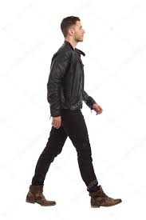
Read these sentences :
I like to read.
They like to play.
To walk is good exercise.
In above sentences what are to read, to play and To walk ?
They are INFINITIVEs

Slide 4
What is the structure of
Infinitive .?
Infinitive =
to +
Present form of verb
As :I want to drink.
Mina likes to sing
They want to play.

Slide 5
Our today’s
Topic is
Infinitives

Slide 6
Learning objectives
After completing the lesson students will able to ..
learnt what Infinitive is.
learnt the uses of infinitive.
learnt finding out infinitive from a sentence.
learnt filling the gaps using infinitives.

Slide 7
Definition of Infinitive
The infinitive is the base of a verb, often preceded by to and never change according to person, number or tense.
Kinds of Infinitives :
Infinitive
There are two kinds of Infinitives
Simple / Noun Infinitive
Gerundial / Qualifying Infinitive

Slide 8
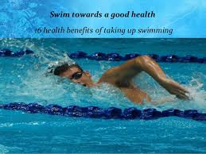
Definition of Simple or Noun Infinitive
When an infinitive does the function of a Noun, it is called Simple or Noun Infinitive.
To swim is good for health.
Girls like to music.
To respect our elders is our duty.

Slide 9
Simple or Noun Infinitive is used as :
Subject of a verb :
To speak the truth is beauty. To swim is good for health.
Object of a verb :
He likes to play. I taught him to write.
c) Object of a Preposition :
He is about to fall.
He is about to sleep.

Slide 10
Simple or Noun Infinitive is used as :
d) Complement to verb :
She seems to be a pious woman.
He appears to be a poor man.
e) Objective Complement :
We take him to be a smart.
She seems to be a lucky.
f) With too/enough.
He is too small to work.
I have enough money to run a business.

Slide 11
Definition of Gerundial or Qualifying Infinitive.
When an infinitive qualify or Modify another parts of Speech or sentences, it is called Gerundial or qualifying Infinitive.
I ran fast to win the prize.
To speak the truth, he is a strong boy.
He walked speedy to catch the train.

Slide 12
Gerundial or qualifying Infinitive is used to :
Modify an adjective :
The old woman is too weak to move.
I am happy to meet you.
She is ready to start.
b) Modify a verb :
The cricketers went to play.
We play to win.

Slide 13
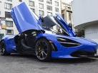
Gerundial or qualifying Infinitive is used to :
c) Modify a noun :
It is a shirt to put on.
This is a car to let.
d) Modify an adverb :
They went to the market, to buy daily necessaries.
I walked fast to catch the train.

Slide 14
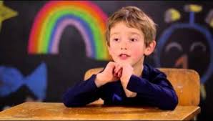
Gerundial or qualifying Infinitive is used to :
e) Qualify a sentence :
To speak the truth, he is an
honest boy.
To be brief, I am ruined.
Omissions of Infinitive
After certain verbs the infinitive is ommitted :
They are let, make, need, hear, watch, see, dare, watch, feel, had better, had rather, would rather, sooner than, rather than.

Slide 15
Perfect Infinitive
Perfect infinitive is formed by using ‘to have’ before a principal verb :
I wished to have come here.
He seems to have seen nicer days.
They are reported to have written this.
Note : Perfect infinitive is used after past tense of verbs wish, desire, hope intend , command etc.

Slide 16
Individual Work
Open your English Grammar book page no. 18
Read the passage carefully :
Ask and answer with your partner :
Which sentence in the passage is without any infinitive ?
How many infinitives are there in sentence number three ? Which ‘to’ is not infinitive here ?
Which of the verbs in the passage have bare Infinitive ?

Slide 17
Group Works
Fill in the gaps using infinitives where necessary :
a. Mother advised me ……….. read regularly.
b. This is a house ……….. Live in.
c. Mohona is eager ………….. study computer.
d. I saw him ………….. go there .
e. This is a car ………. let.
f. You had better ……………. eat than go away.
g. He seems ………….. be happay today.
Answer : a) to b) to c) to d) x e) to f) x g) to.

Slide 18
HOME WORK
Write ten sentences using infinitive ‘to’.

