Slide 1
Welcome everyone
Welcome everyone

Slide 2
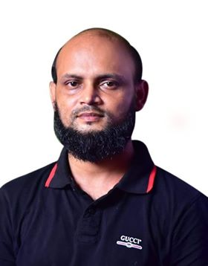
Nurul Aziz
Assistant Teacher
Krishnakumari City Corporation Girls’ High School,
Nandankanan, Chittagong
E mail : naziz13.na@gmail.com
English For Today
Class IX
Time : 45 Minutes
Date : 02/02/2020

Slide 3
Let’s watch a video…

Slide 4
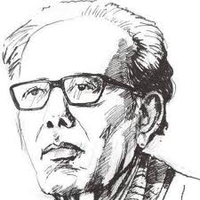
Our today’s lesson is….
Zainul Abedin, the great artist
Unit : 07
Lesson : 01 Page: 91 Period: 1st

Slide 5
Objectives of the lesson
After the end of the lesson students will be able to…
apply new vocabulary in sentences
ask and answer questions
listen to audio text for specific information
write dialogue

Slide 6
Vocabulary
Acclaim (verb)
Syn. Praise highly
Ant. Disapprove, criticize
We should acclaim someone’s contribution.

Slide 7
Vocabulary
Skeletal (Adj.)
Syn. Bony, thin, of skeleton
Ant.. Fatty, blubbery
Rahim is fatty but Karim is skeletal.

Slide 8
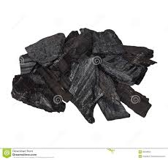
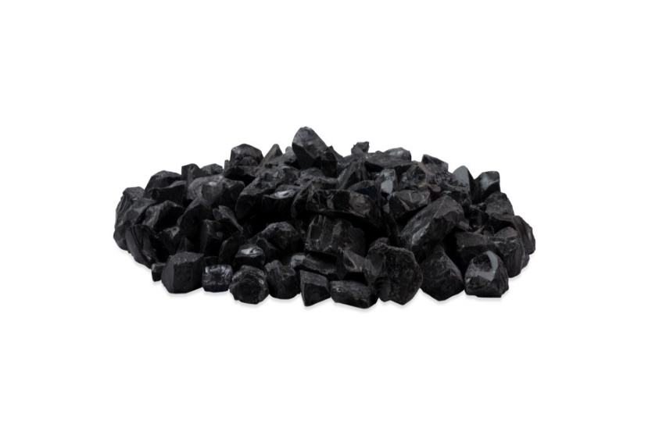
Vocabulary
Charcoal (noun)
Remains of something burnt
Charcoal is a useful thing.

Slide 9
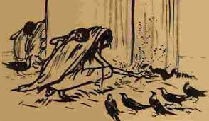
Vocabulary
Sinister (adj.) threatening or foreshadowing evil
Syn. Ominous, menacing
Ant. Reassuring, supportive
Zainul portrayed the sinister face of harsh famine.

Slide 10
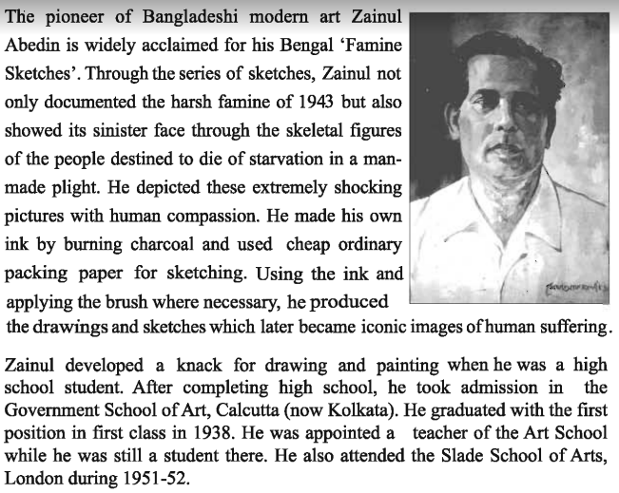
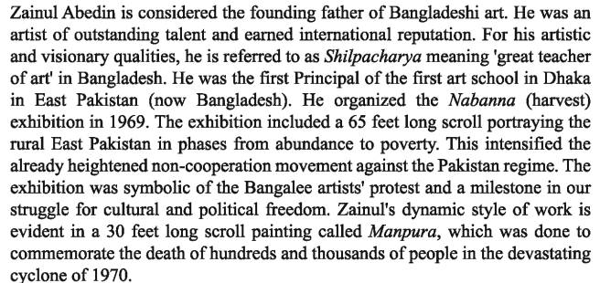
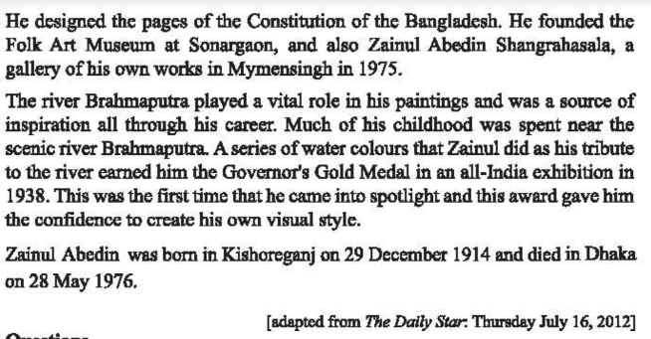
Silent Reading

Slide 11
Pair Work
Answer the following questions.
(Match the answers in the next slide.)
1. Write in detail how Zainul Abedin portrayed the sufferings of people?
2. What influence did the river Brahmaputra have on Zainul Abedin? How did he show this influence in his works?
3. What did these works earn him in his life?
4. How did his art help to intensify the noncooperation movement against the Pakistan in phases from abundance to poverty ?

Slide 12
Thei
Pair Work (Answers for matching)
1. Zainul Abedin portrayed the sufferings of people through his several paintings. For example, he documented the harsh famine of 1943 by sketching the skeletal figures of people destined to die of starvation in a man-made plight. Besides, by painting ‘Manpura’ he portrayed the death of many people in the cyclone of 1970.
2. The River Brahmaputra played a predominant role in Zainul Abedin’s paintings and inspired him all through his career because much of his childhood was spent near this scenic river. He showed this influence in his works by using water colours as a tribute to this river.
3. These works earned the Governor’s Gold Medal in a all-India exhibition in 1938.
4. His 65 feet long scroll painting portrayed the rural East Pakistan in phases from abundance to poverty. Thus it intensified the noncooperation movement.
Notes:
Here writing may vary from student to student but the basic information should be written.

Slide 13
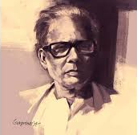
Life span of Zainul Abedin
Birth : 29 December 1914
In Kishoreganj
Death:28 May 1976
In Dhaka

Slide 14
Famous exhibitions of Zainul Abedin
Nabanna (Harvest), 65 feet long scroll painting, 1969
Intensified Non-cooperation movement against Pakistani regime
Monpura , 30 feet long scroll painting , 1970
Commemorating the death of thousands of people in the cyclone of 1970

Slide 15
Completion of high school
Government school of art ,Calcutta
Graduated with first class 1938
Appointed as a teacher of the art school
Attended Slade School of Art, London (1951-52)
Study and work of Zainul Abedin

Slide 16
Zainul
Abedin
Great teacher of art
The Pioneer of Bangladeshi modern art
Founding father of Bangladeshi art
Shilpacharya
Study and work of Zainul Abedin

Slide 17
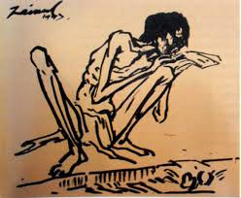
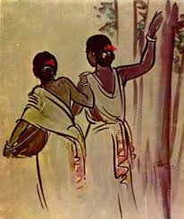
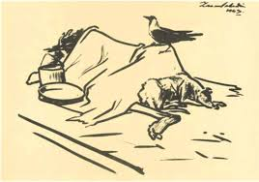
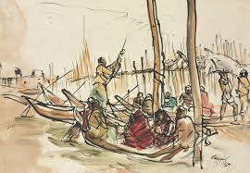
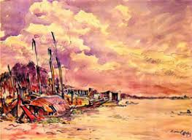
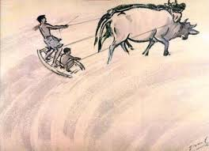
The
Group Work
Talk about the pictures below in groups and write briefly what each picture portrays.
Picture 1
Picture 2
Picture 3
Picture 4
Picture 5
Picture 6
Picture 7
Notes:
Please match the probable answers in the slide

Slide 18
Group A: Picture 1 portrays the famine of 1943.
Group B : Picture 2 portrays two santal sisters going to work.
Group C :Picture 3 portrays the pathetic scenes of 1943 famine.
Group D : Picture 4 portrays a watery place where people are loading and unloading goods in and from boats.
Group E : Picture 5 portrays the picture of a village by the side of a river.
Group F : Picture 6 portrays two famers levelling the soil by pulling the oxen by ropes to keep balance.
Group G : Picture 7 portrays two oxen and a man struggling hard to draw a cart laden with wood.
Group work answers

Slide 19
Individual Works
Listen to the Audio and tick the word/ words you hear.
Notes:
Questions of this listening test for individual works are to be practiced in the next slide.

Slide 20
The
Individual Work
1. The US Ambassador to Bangladesh considered Zainul Abedin a
a. Great painter
b. Popular painter
c. Master painter
c. Unique painter
2. Zainul’s art gallery was set up in……………………………………………..
a. 1972
a. 1973
a. 1974
a. 1975
3. Number of artworks preserved in the gallery is……………………….
a. 53
a. 62
a. 65
a. 75
4. The US Ambassador commented that the museum is a global
a. wealth
a. asset
a. gift
a. treasure
5. The US Ambassador was in the gallery for
a. 3 hours
a. 2 hours
a. 1 hour
a. ½ hour

Slide 21
Evaluation
Listen to the Audio again in slide 19 and answer the following questions in the next slide.
Notes:
Questions of this listening test for individual works are to be practiced in the next slide.

Slide 22
Evaluation
1. Where is Zainul’s art gallery situated?
In Mymensingh
2. When did the Ambassador visit the gallery?
On Tuesday
3. Which artworks of Zainul Abedin did the Ambassador specially mention?
The famine series
4. Who else were with the Ambassador during his visit?
The DC, Police Sup. And the keeper of the gallery.
5. How did the Ambassador feel after visiting the gallery?
He felt honoured visiting the gallery.

Slide 23
Home Work
Write a dialogue with your friend about the contribution of Zainul Abedin as a pioneer of Bangladeshi modern art.

Slide 24
Thank you.

