Slide 1
wellcome

Slide 2
Introduction of the Teacher
Name: Shorifa Khatun {Head Teacher )
Kamardanga GPS .Mirpur.Kushtia

Slide 3
Introduction of the lesson
Class:one
Unit:5
Lesson:Alphabet
Today`Lesson:Commands
Total time:35 minutes

Slide 4
Learning outcomes
By the end of the lesson the student will able to-
1.1.2.Give simple commands and instructions .
2.1.1.Repeat after the teacher simple words .

Slide 6
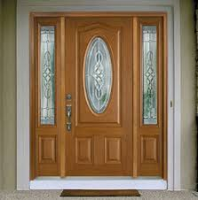
Window
door

Slide 7
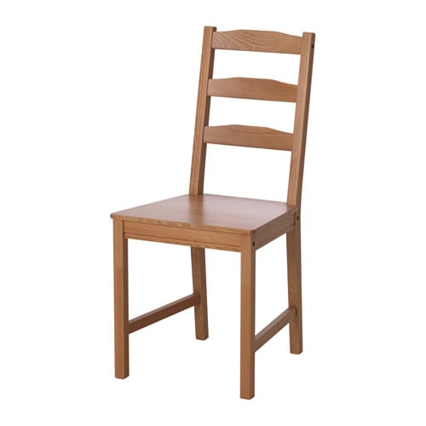
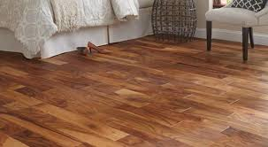
Chair
Floor

Slide 8
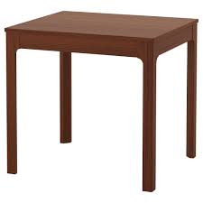
Table
Book

Slide 9
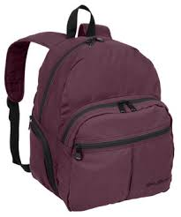
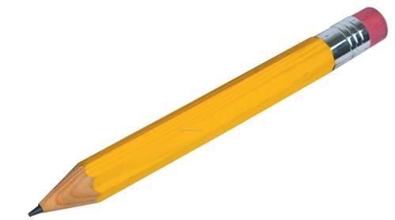
Pencil
Bag

Slide 10
Group- Rose

Slide 11
Group- Belly

Slide 12
Group- Belly
Table
Pencil
Book
Bag

Slide 13
Group- Rose
Window
Door
Chair
Floor

Slide 14
pair work
Word practice

Slide 15
Game

Slide 16
Read the word from your text book
Page at 10

Slide 17
Individual Work

Slide 18
Individual Work

Slide 19
Evaluation
Window
door
Book
Chair

Slide 20
Evaluation
Pencil
Table
Bag
Floor

Slide 21
Home Task
Write some word in your room .

Slide 22
Good bye

