Slide 1
MULTIMEDIA CLASS

Slide 3
TEACHER’S IDENTITY
NAHIDA AKHTER
ASSISTANT TEACHER
KALIKACCHA NORTH GOVT. PRIMARY SCHOOL
SARAIL, BRAHMANBARIA

Slide 4
LEASSON
CLASS:ONE
UNIT : 2 LESSON :4-6
LESSON’S TITLE:ALPHABET
TODAYS LESSON:A

Slide 5
LEARNING OUTCOMES
Listening: 1.1.1.become familiar with English sounds by listening to common English words.
Speaking:
1.1.1. repeat after the teacher simple words and phrases.
Reading:
1.2.1recognize and read the alphabet both small and capital(non-cursive).
Writing:
1.1.1.to practice letter shapes/simple writing patterns,etc.

Slide 6
Let’s watch a video

Slide 7
Apple
A
Ant
A

Slide 8
apple
a
ant
a

Slide 9
Ant
Apple

Slide 10
Apple
A
ant
a

Slide 11
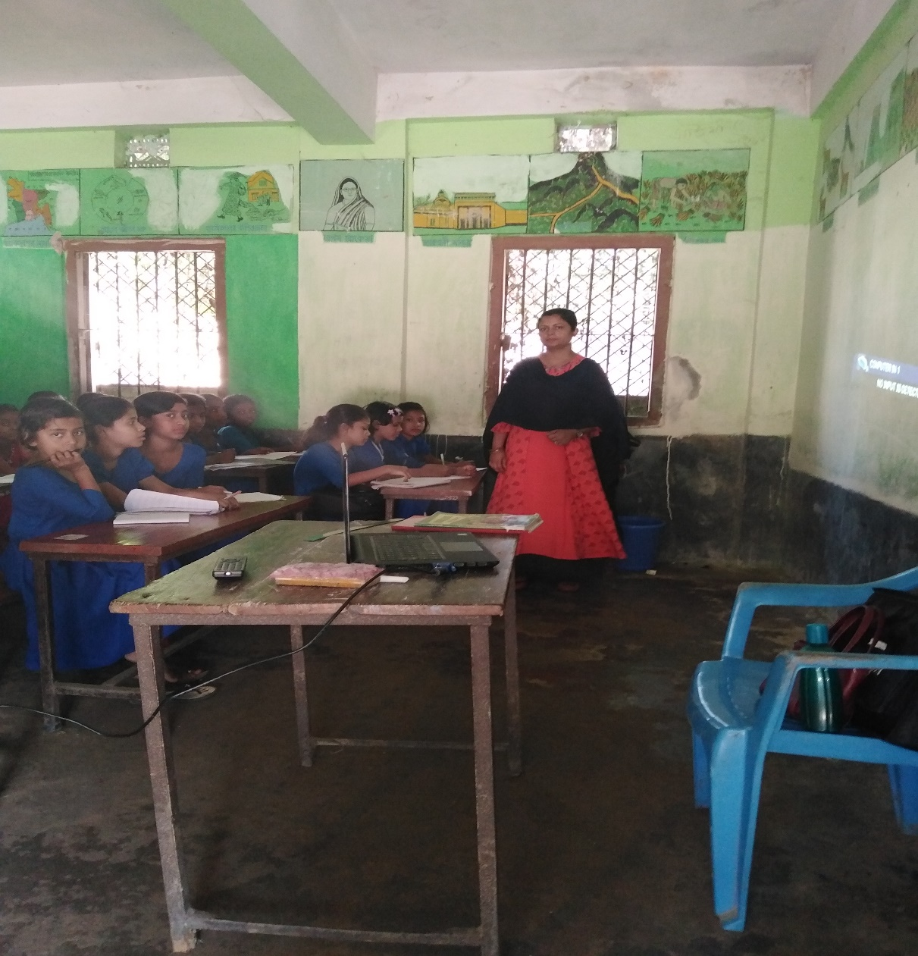
Teachers reading

Slide 12
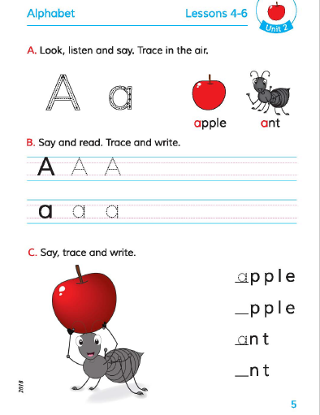
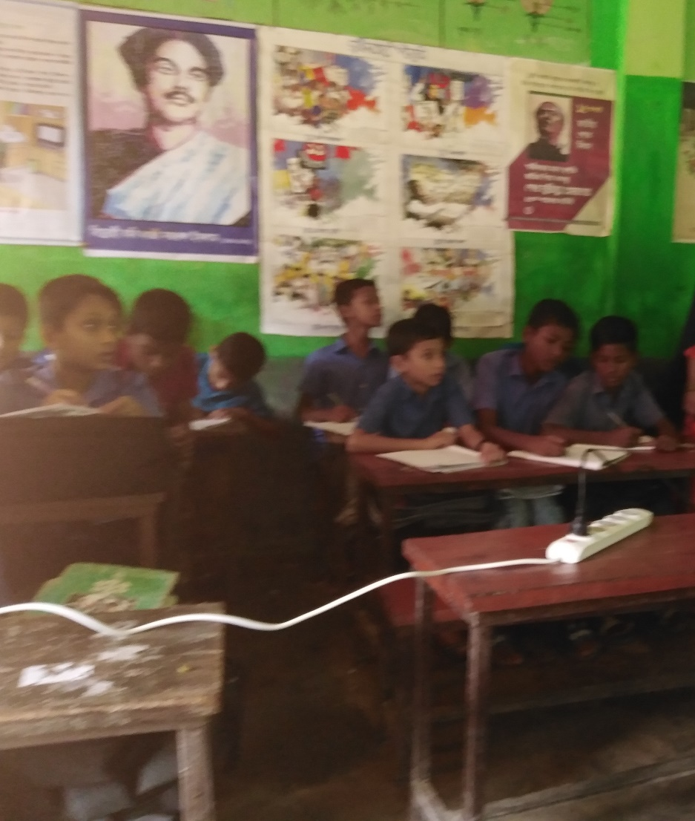
Open at the page no 5

Slide 13
Make another word with the alphabet A.

