Slide 2
Welcome

Slide 3
Introduction
NURULLA
Ass: teacher ( ICT )
Shaituta Hossainia Dhakil Madrasha
Karimganj-Kishoreganj
Class : Six
Subject: English 1st Paper
Lesson : 5

Slide 4
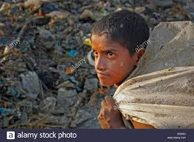
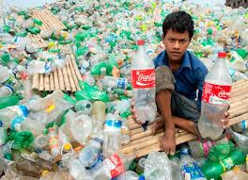
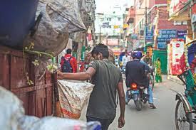
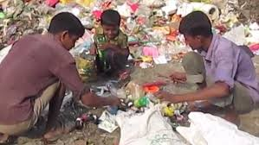
Let’s see some picture
What are you see in this picture?

Slide 5
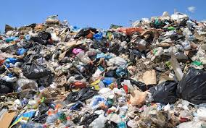
Rubbish
Notes:
Title of the lesson: Nakshi Kantha

Slide 6
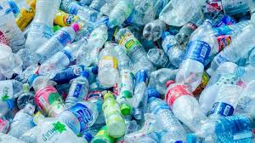
Plastic
A plastic is a material that can change its shape.
Notes:
Title of the lesson: Nakshi Kantha

Slide 7
Lesson Title
Thanks for your work
Notes:
Title of the lesson: Nakshi Kantha

Slide 8
Learning Outcomes
After completing the lesson students will be able to……
1.what time does bulbul wake up?
2. where do the people of Sankar put their rubbish?
3.why does bulbul think that all jobs are important ?
4.what happened when bulbul became sick ?
5.what will you say to bulbul . if you meet him?

Slide 9
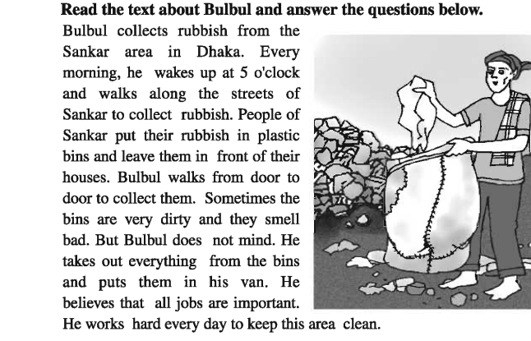
Notes:
Title of the lesson: Nakshi Kantha

Slide 10
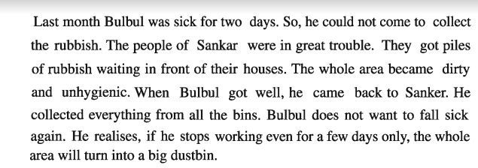
Notes:
Title of the lesson: Nakshi Kantha

Slide 11
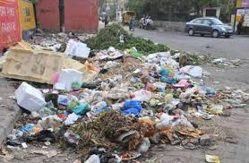
unhygienic
not clean or sanitary.
Notes:
Title of the lesson: Nakshi Kantha

Slide 12
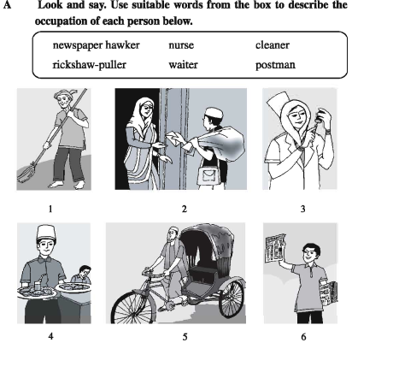

Slide 13
Individual Work
Complete the following sentences with the clues given.
their
jobs
dirty
rubbish
important
two
plastic
1 Bulbul collect ----------------
2 People of Sankar area put ---------- rubbish in ---------bins.-
3 Bulbul believes that all -------- are--------
4 Last month bulbul was sick for ---------- days.
5 The hole area become -------
Notes:
Title of the lesson: Nakshi Kantha

Slide 14
Home Work
Write 5 sentence “How can you keep yours surroundings clean”.
Notes:
Title of the lesson: Nakshi Kantha

Slide 15
Thank you
Notes:
Title of the lesson: Nakshi Kantha

