Slide 1
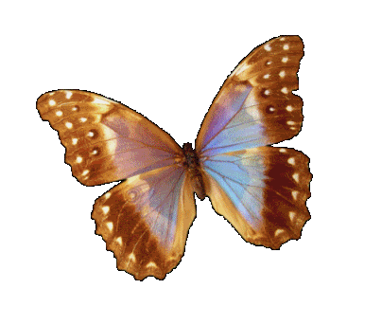
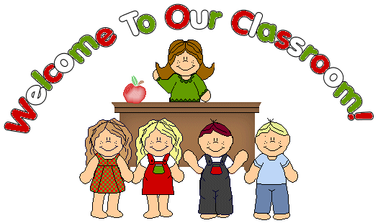

Slide 2
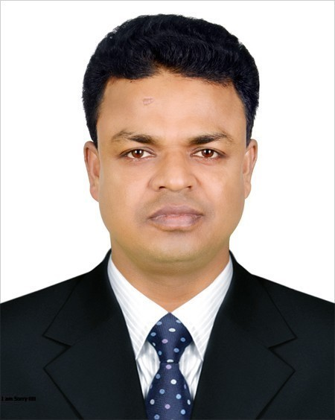
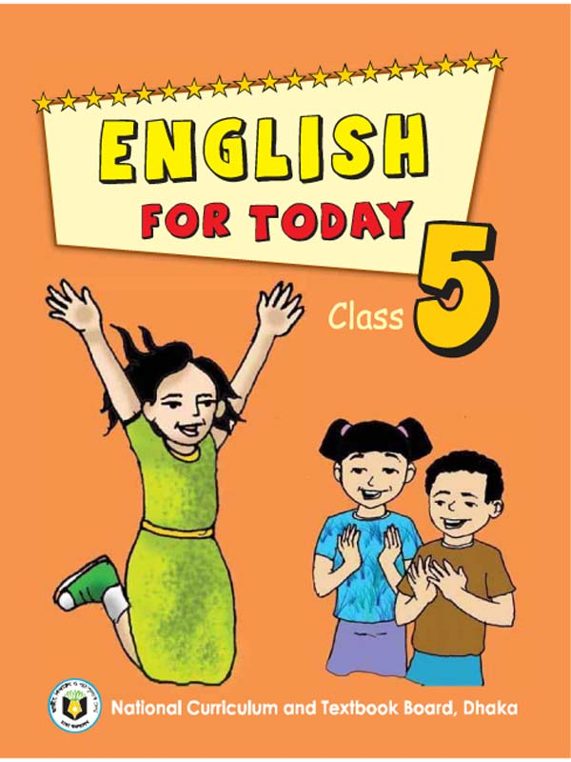
INTRODUCING
Md. Shakhawat Hossen
Assistant Teacher
Pakuria Government Primary School,
Singra - Natore.
E-mail: shakhawathossengps@gmail.com
Mobile: 01724025641
Class: Five
Subject: English for Today
Unit: 15
Lesson: Happy birthday
Parts Of the lesson: A person’s...family.

Slide 3
Learning out comes:
Students will be able to….
read and understand the text & enrich their vocabulary.
answer structured question from the text.
speak English to talk about their own birthday.

Slide 4
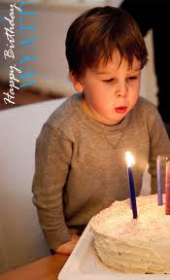
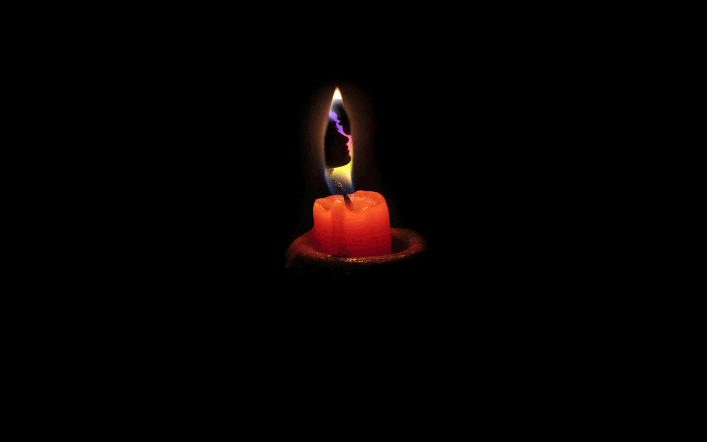
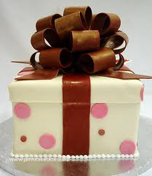
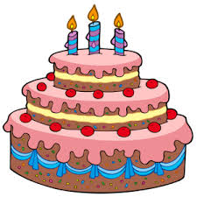
What do we see in the picture?
Let’s we will read today- Happy Birthday.
Birthday Cake
Puting out fire
Cake box
Candle

Slide 5
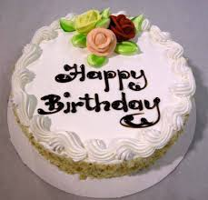
Discuss by picture:
Birthday cake.
There is usually a birthday cake.

Slide 6
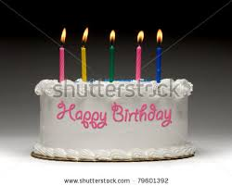
Discuss by picture:
Candles are lit on it..

Slide 7
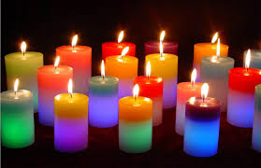
Discuss by picture:
The number of candles depends on how old a child is.

Slide 8
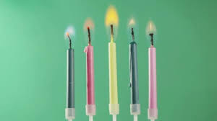
Discuss by picture:
In the picture there are five candles.

Slide 9
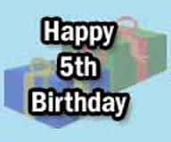
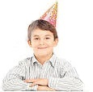
Discuss by picture:
It means that the boy is five years old.

Slide 10
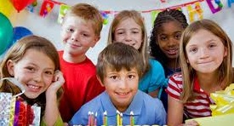
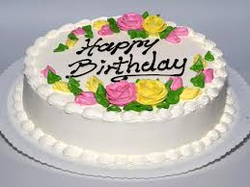
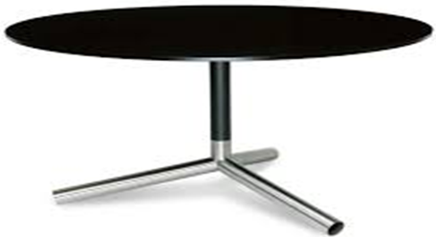
Let’s sing a birthday song. Happy Birthday to you, Happy Birthday to you Happy Birthday Dear……., Happy Birthday to you.

Slide 11
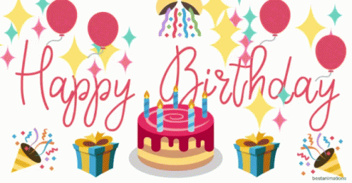
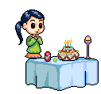
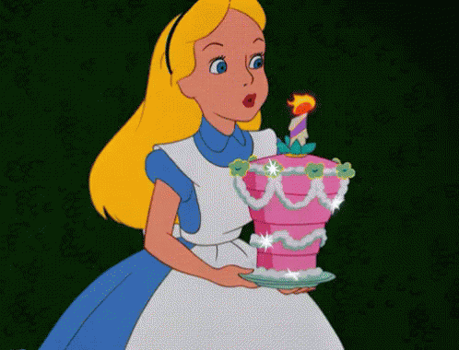

Slide 12
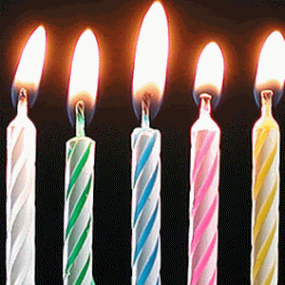
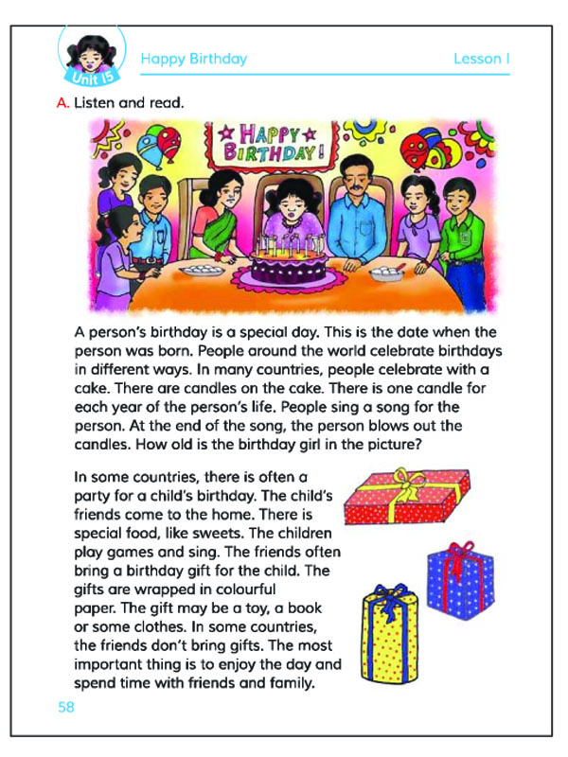
Text book connections

Slide 13
Let’s look and see the video attentively.

Slide 14
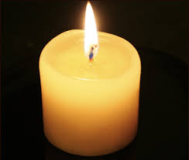
New words with sentences by using picture:
A stick of wax with a string through the middle.
Candle
Please give me some candles.

Slide 15
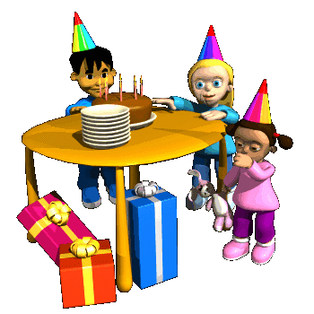
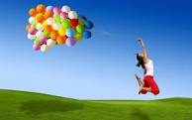
New words with sentences by using picture:
To get pleasure from something.
Enjoy
Enjoy your day.

Slide 16
Answer the following questions:
1. What is birthday?
Answer: A Birthday is a memorable day in one’s
life. It is the day when he was born.
2. Why are five candles kept on the cake?
Answer: Five candles are kept on the cake because
it is the fifth birthday of the boy.

Slide 17
Choose the best answer:
1. What is the cake made from?
a. candle
b. Strawberry
c. orange
d. fire
2. A birthday is a memorable day. Here ‘memorable’ is a/an---
a. noun
b. adjective
c. verb
d. adverb

Slide 18
Choose the best answer:
3. Let’s sing a birthday song. Here ‘Birthday’ is-
a. noun
b. adjective
c. verb
d. adverb
4. ‘Parents’ means--
a. father
b. mother
c. Father and mother
d. adverb
5. The number of the birthday cake is usually
a. one
b. two
c. Same as the child’s age
d. three

Slide 19
Rearrange the sentences to make a meaningful story. SGW
Parents ask other children to come and have a party.
This is the day when you were born.
They wear new clothes, sing songs, play games and enjoy the day in different ways.
A birthday is a memorable day in one’s life.
Children around the world have fun on this day.

Slide 20
This is the story
A birthday is a memorable day in one’s life. This is the day when you were born. Children around the world have fun on this day. Parents ask other children to come and have a party. They wear new clothes, sing songs, play games and enjoy the day in different ways.

Slide 21
Write 3 sentences about your
Birthday.

Slide 22
