Slide 1
Power Bank Distributions
In sylhet division.

Slide 2
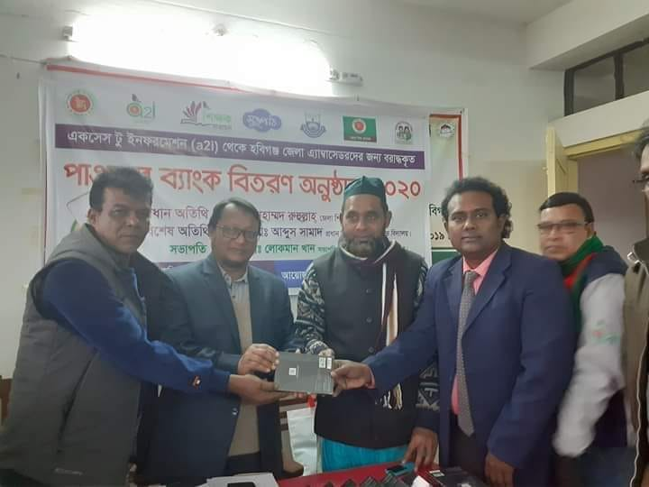

Slide 3
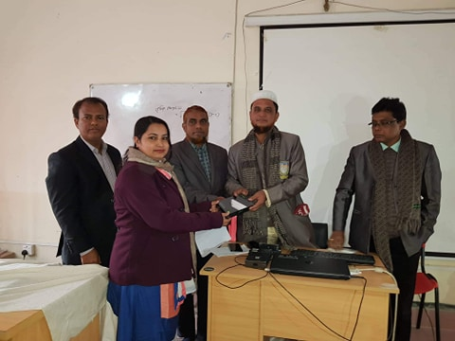

Slide 4
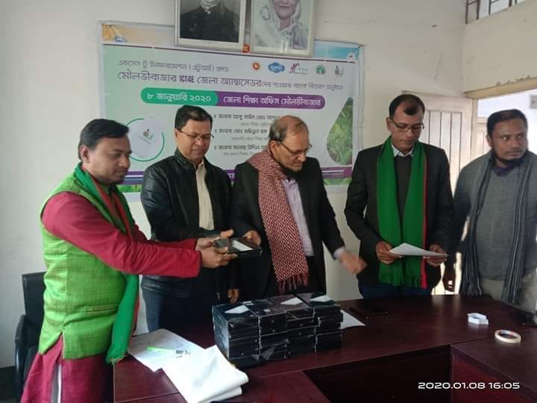

Slide 5
