Slide 1
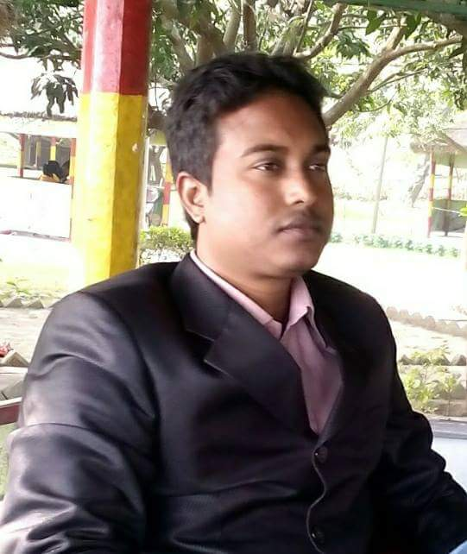
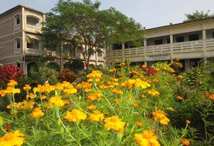
Md. Anowar Hossain Pramaik
Lecturer: Finance & Banking,
Madhnagar Degree College,
Naldanga, Natore
Cell: 01784075097
E-mail : anuaub7pk@gmail.com

Slide 2
WELCOME

Slide 3
Todays Presentation Topic’s
SHARE

Slide 4
TYPE OF SHATE;
Primary
Seondary

Slide 5
Primary Share
The Share purchase by IPO

Slide 6
SECENDARY SHARE
When Primary share are trade again is secondary share

Slide 7
Any Question ?

Slide 8
Thank You Everybody

