Slide 1
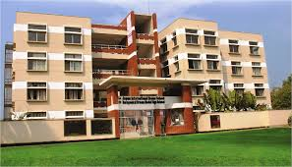

Slide 2
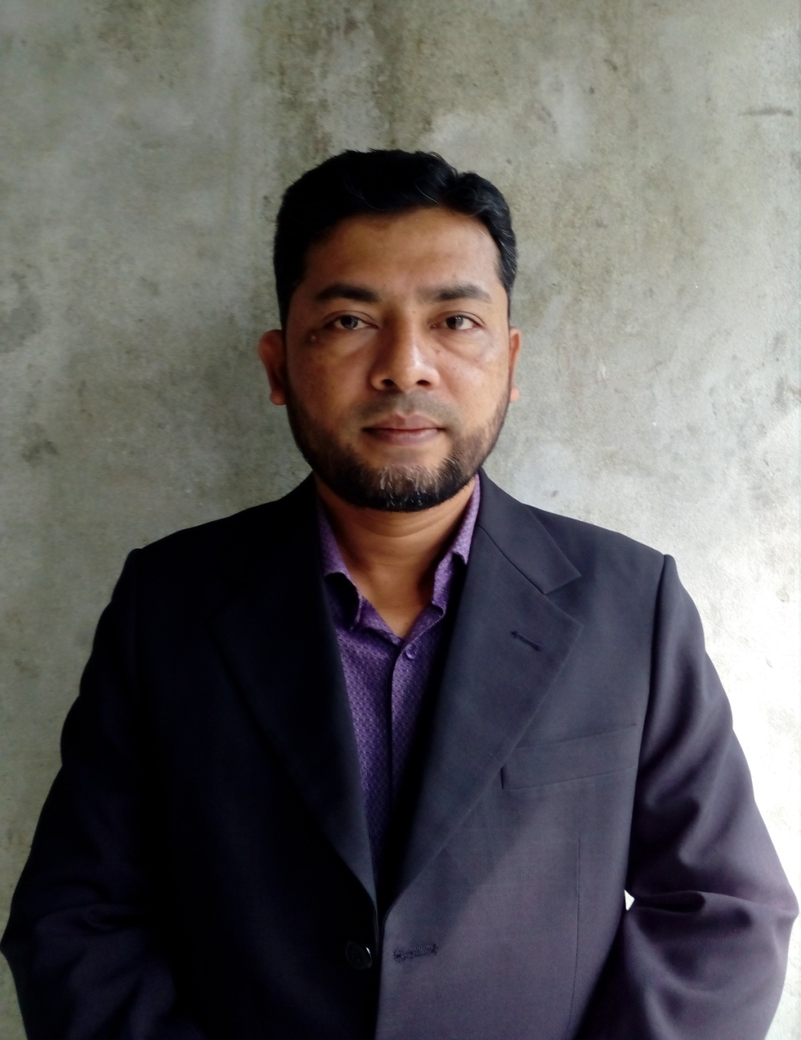
PRESENTED BY
NAME:SHAMSUDDIN.
SENIOR ASST. TEACHER
VEDURIA SERAJIA FAZIL MADRASAH.
LALMOHAN,BHOLA.

Slide 3
LESSON IDENTITY
CLASS: SEVEN.
SUBJECT:ENGLISH FOR TODAY.
UNIT:3
LESSON:2
TIME:45 MINUTES

Slide 4
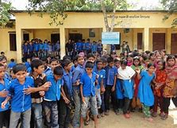

Slide 5
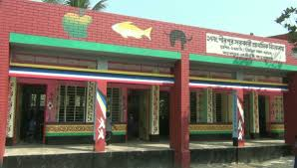

Slide 6
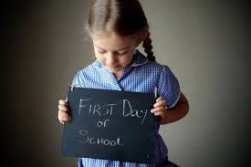
TODAY’S LESSON

Slide 7
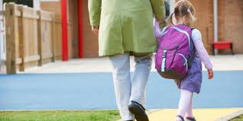
My father took me to the Headmaster.

Slide 8
HALF AN HOUR

Slide 9
SCHOOL CAMPUS

Slide 10
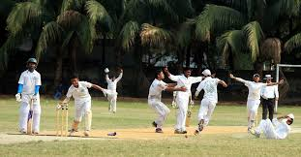
Some were playing.

Slide 11
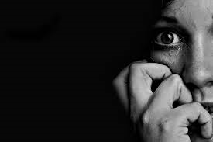
Afraid

Slide 12
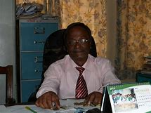
Headmaster

Slide 13
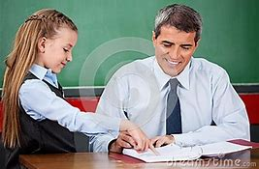
He asked me some questions and I answered them intelligently.

Slide 14
Remember

Slide 15
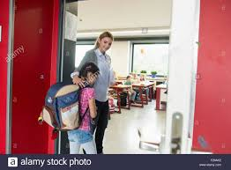
Ms Laila took me to the class.

Slide 16
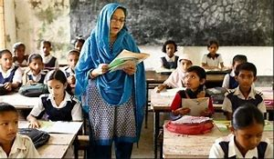
OPEN AT THE PAGE NO 20 AND READ THE TEXT CAREFULLY.

Slide 17
ANSWER THE FOLLOWING QUESTIONS-
1.How long did it take Flora to reach the school?
a.An hour b.half an hour c.less than half an hour d.one and a half hour.
2.Flora was a little afraid when she reached the school campus-
a.The campus was full of students b.it was first she went there.c.all the people were there unknown d.the school was a long way from there home.
3.The headmaster was pleased with Flora because she-
a.Loooked very innocent.b.had a sweet voice.c.could answer the Headmaster’s questions.d.was very smart.

Slide 18
Make sentences from this table
Flora’s mother Ms Laila The Headmaster The students in the class Flora | Asked Made Started took | at Flora. Friends with few students. Her to the Headmaster. Flora some questions. her to the class.

Slide 19
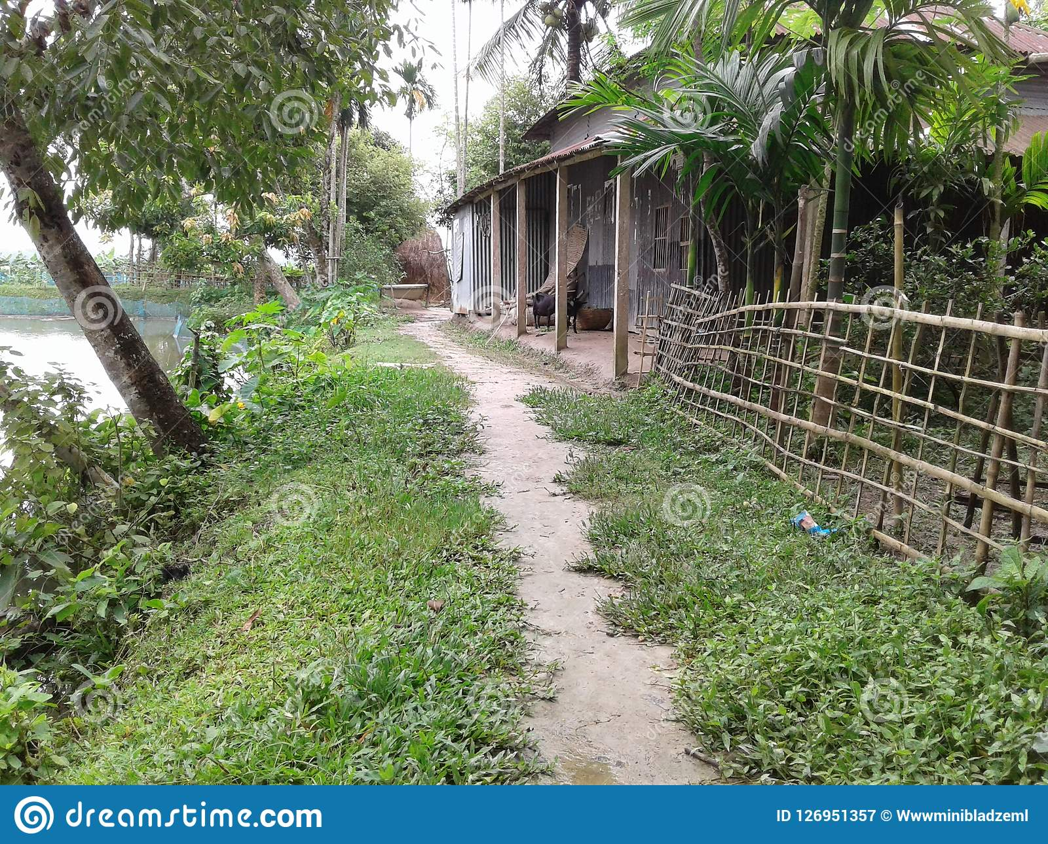
Homework
Write a paragarph about your first day at school.

