Slide 1
Well-come.

Slide 2
Teacher’s Introduce
Lesson Introuduce
Class:Five
Subject:English
Unit: 3
Lesson:1-2
Time:40 minutes
Laily Akter
Assistant Teacher
Fulgaon Govt. primary School,
Laksam, Comilla.

Slide 3
Lets go watch a video
“Twinkle Twinkle Little Star”

Slide 4
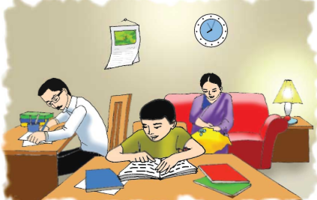
What do you see in the picture?
A family

Slide 5
Lesson Declaration
Saikat’s family
(Saikat Islam………tigers and lions.)

Slide 6
Learning outcomes
Students will be able to:
Listening: 3.2.1 understand question about family and friends of students.
Speaking: 6.1.2 say what others are doing. Reading: 1.7.1 read paragraph, dialogues, stories, letters and other texts.
Writing: 10.2.1 write a short paragraph by answering a set of questions.

Slide 7
Who is he?
He lives in Bogura.
He is Saikat.

Slide 8
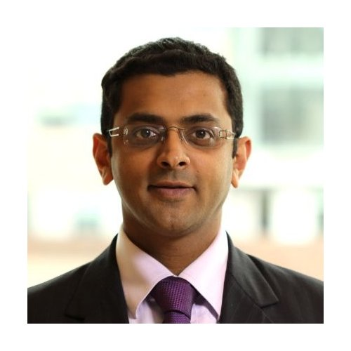
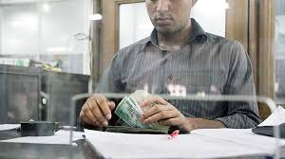
Who is he?
He is Saikat’s father.
His name is Mr.Rashidul Islam.
He is a banker.

Slide 9
Saikat’s father.
In his free time,he writes stories and listens to music .

Slide 10
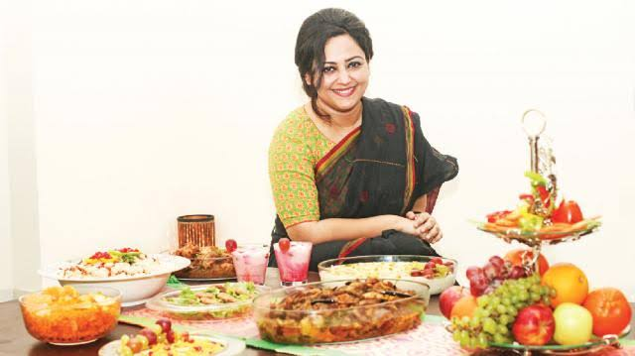
Who is she?
She is Saikat’s mother.
Her name is Monwara Islam.

Slide 11
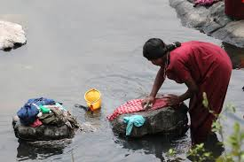
Saikat’s mother is a housewife.

Slide 12
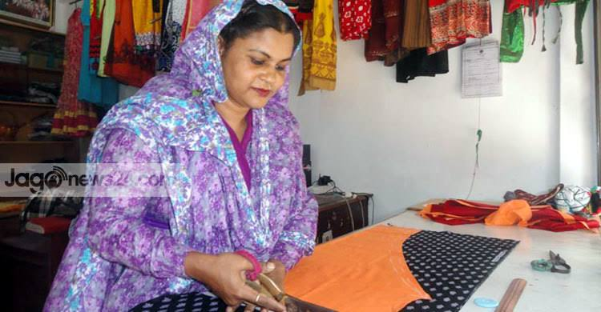
In her free time, she enjoys sewing.
Saikat’s mother.

Slide 13
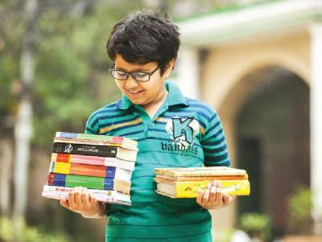
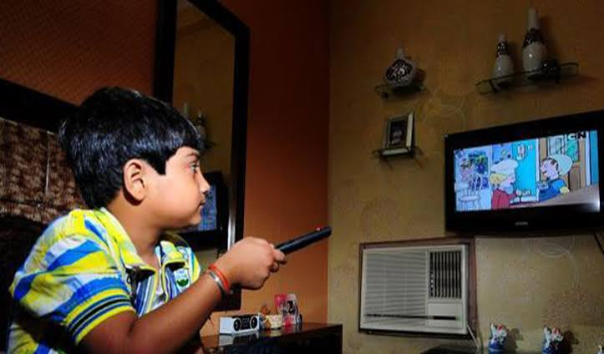
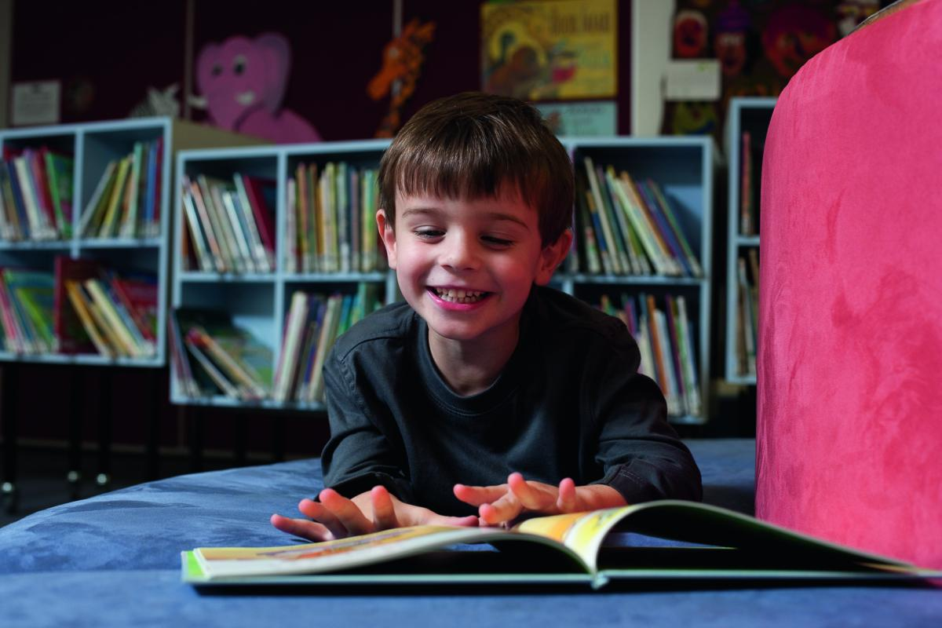
Saikat is a good student.
He wants to improve his English. So he watches cartoons on TV everyday.
He also reads English books.

Slide 14
What is this?
Saikat’s family tree.

Slide 15
Saikat’s Family
Saikat
Saikat’s father
Saikat’s mother

Slide 16
New words
Flat
Apartment
Live
To reside
Parents
Father and mother
Neighbour
Not far from
Household
Housewife

Slide 17
Now open your English book at page number 10. Listen to me attentively and put your finger under the line.
Read the text silently.

Slide 18
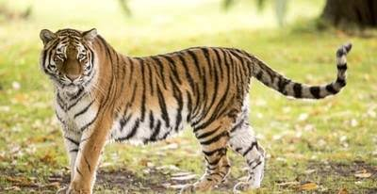
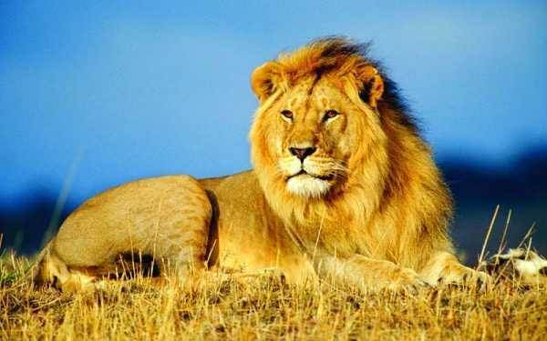
Group work
Tiger group
1.What is Saikat’s father’s name?
2.What does Saikat’s father do?
3.What does Saikat do in his free time?
Lion group
1.What is Saikat’s mother’s name?
2.What does Saikat’s mother do?
3.What kind of books does Saikat like?

Slide 19
Evaluation
Write a short paragraph in 5 sentences about “Your family” by answering the following questions:
1 What is your name?
2.What is your father?
3.What is your mother?
4.How many member’s are there in your family?
5.What is your brother’s/sister’s name?

Slide 20
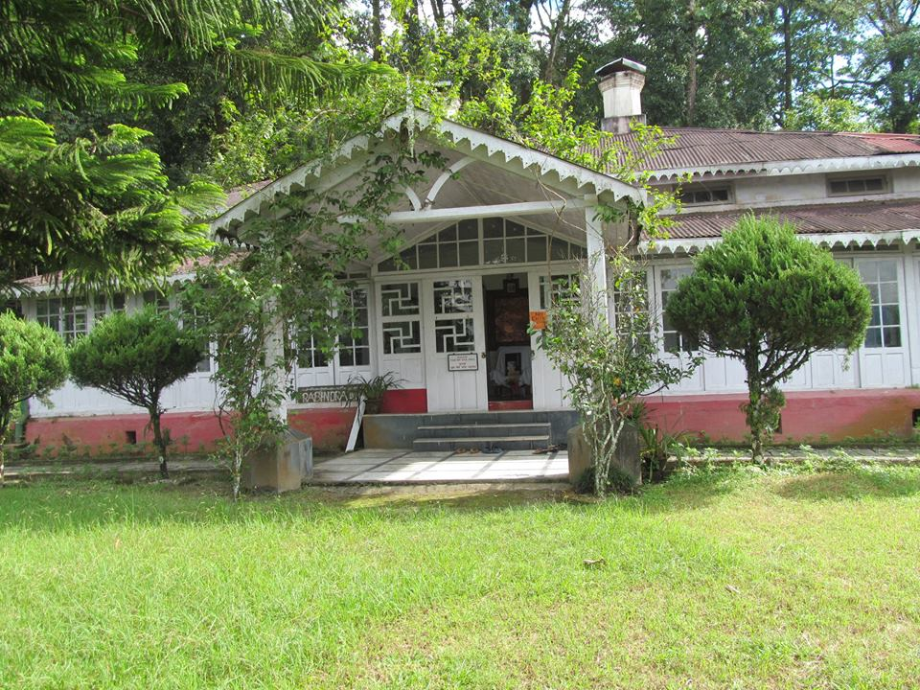
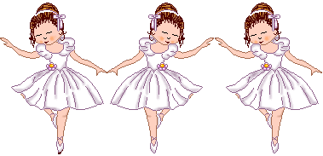
Home work
Write five sentences about “Your self”.

Slide 21
Thanks to all
Goodbye.

