Slide 1
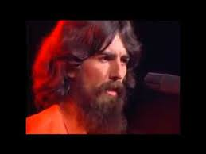

Slide 2
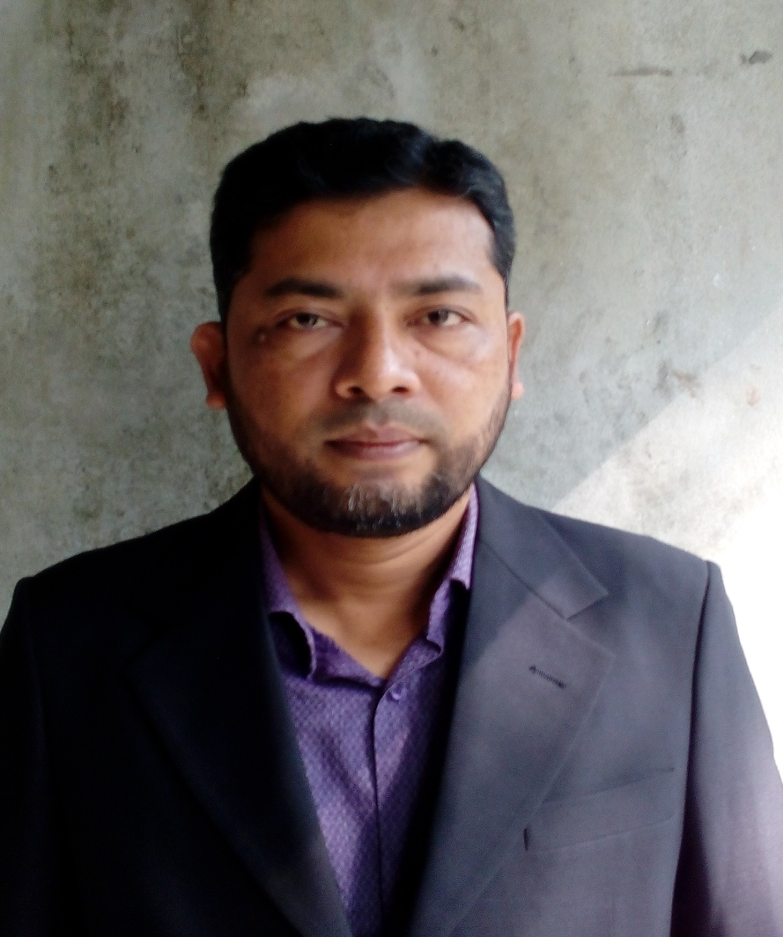
PRESENTED BY
NAME:SHAMSUDDIN.
TEACHER OF ENGLISH.
VEDURIA SERAJIA FAZIL MADRASAH.
LALMOHAN, BHOLA.

Slide 3
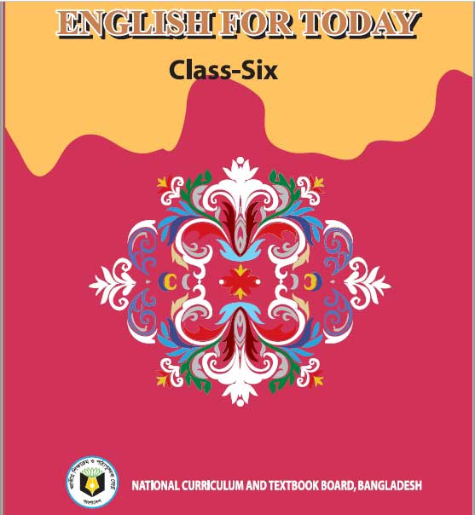
LESSON IDENTITY
CLASS:SIX
SUBJECT:ENGLISH FOR TODAY.
LESSON:27
TIME:45 MINUTES.

Slide 4
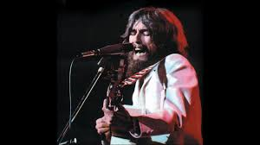

Slide 5
Let’s watch the video

Slide 6
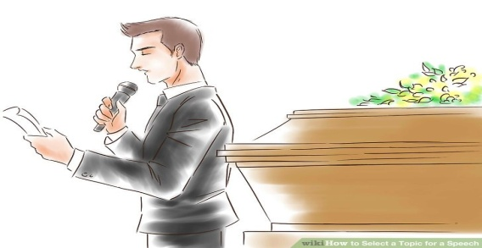
TODAY’S LESSON
‘THE CONCERT FOR BANGLADESH’
LEARNING OUTCOME
By the end of the lesson students will be able to-
1.Read and understand text.
2.Ask and answer questions.
3.Participate in short dialogues.

Slide 7
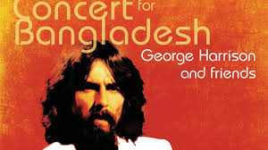
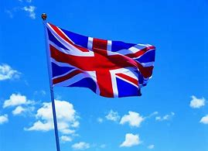
George Harrison was born in England.

Slide 8
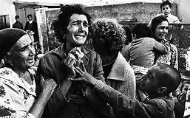
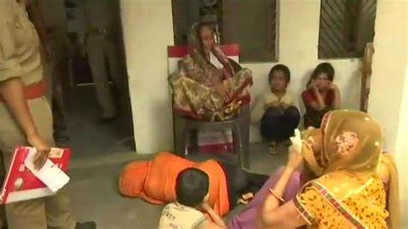
Suffering-----something bad or unpleasant.
Grateful--thankful
Victim--sufferer

Slide 9
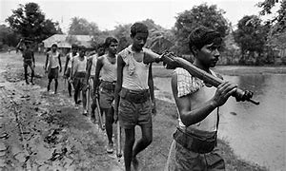
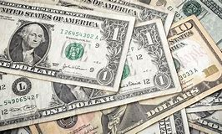
Liberation war—the act of setting free from slavery
Dollar—currency of some countries.
U-united, N—nation ,I-international, C—children, E-emergency,
F—Fund.

Slide 10
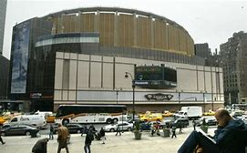
Madison Square Garden,New york.
In front of—in a position just ahead.

Slide 11
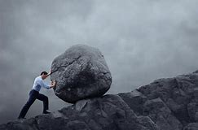
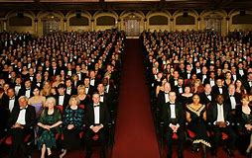
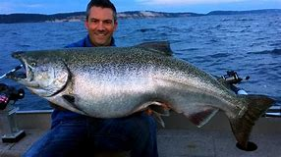
Struggle—Make forceful efforts.
Audience-The people present in the meeting.
Huge—Very big.

Slide 12
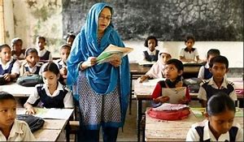
Open at the page 82 and read the text silently.

Slide 13
Write or false.If false, give the correct answer.
1.George Harrison was from the united States.
2.In 1971,George Harrison visited Bangladesh to take part in the Liberation war.
3.A huge audience attended the concert for Bangladesh.
4.George Harrison was the only well-known musician to take part in the concert for Bangladesh.
5.The people of the world became aware of the crisis in Bangladesh following the concert for Bangladesh.

Slide 14
Write a dialogue between you and your friend about the concert for Bangladesh.

