Slide 1
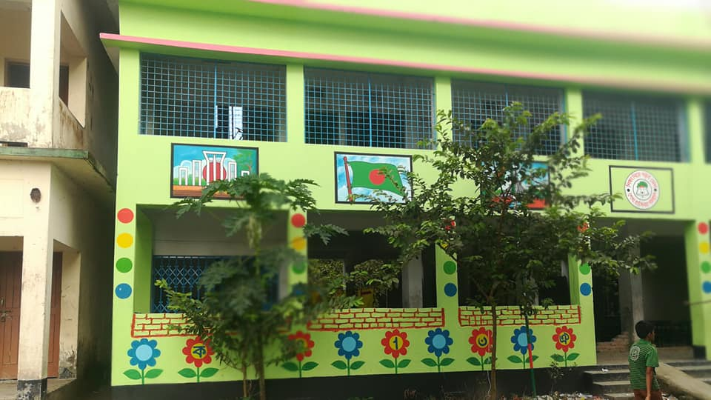

Slide 2
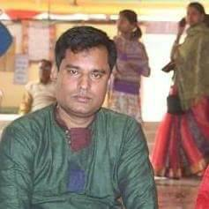
Presented by
Uttam chandra samadder
Head teacher
Kachipara Govt. Primary School

Slide 3
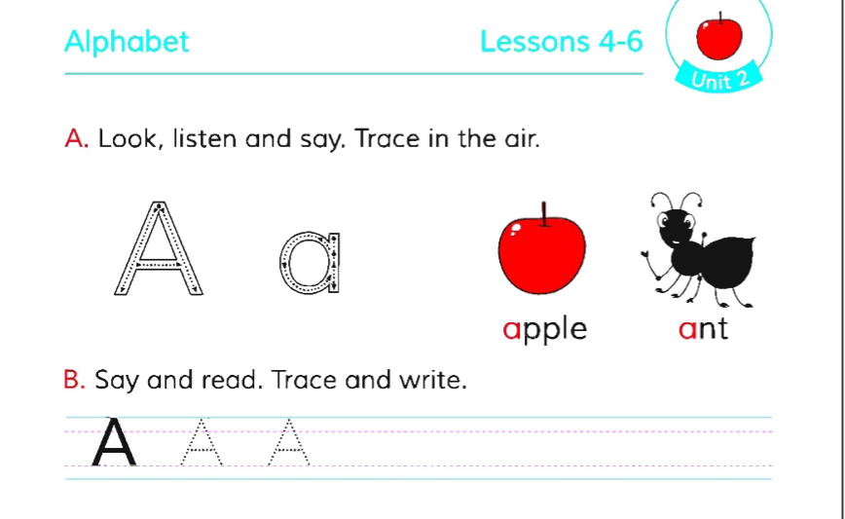
Class:One
Sub :English
Alphabet
Lessons 4-6
Unit 2

Slide 4
Learning Outcomes
By the end of the lesson the students will be able
1.1.2 To recognize names of objects having same initial sounds.

Slide 5
LOOK AT THE PICTURES

Slide 6
Aa

Slide 7
Bb
ball

Slide 8
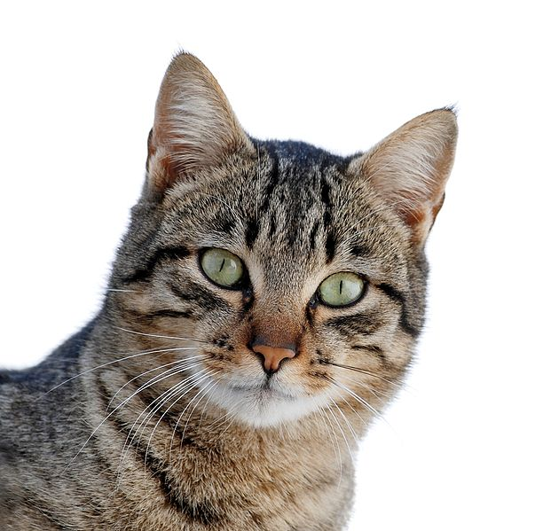
C c
Cat

Slide 9
Playing silent mouthing
Apple,ball,cat.

Slide 10
Write the meaning of the words
Ball Cat

Slide 11
Group work
With letter cards
Match the letter to make word
In 4 groups.

Slide 12
Single work
Match capital and small
A,B,C,
a,b.c,

