Slide 1
Good Morning

Slide 2
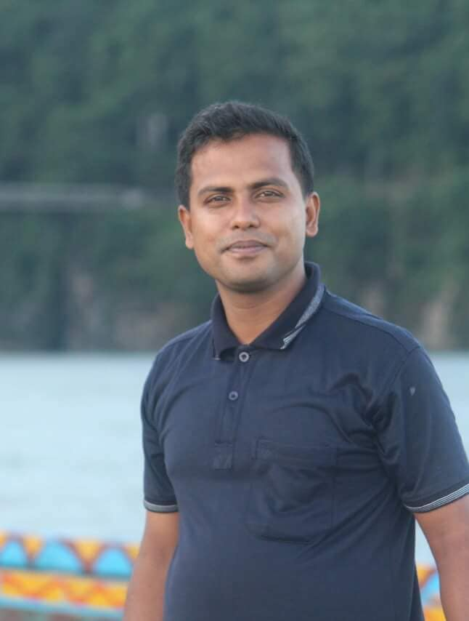
TEACHER IDENTIFICATION
Md.Golam Rabbani
BSc(Hons) Zoology
MSc (Fisheries)
BEd
Teacher at Bamunia Fajil Degree Madrasah,Shajahanpur, Bogura
Md.Golam Rabbani Mobile 01737009637 01772216190 01811887724 01811886963

Slide 3
Class: Five
Subject: English
Unit: 3
Lesson: 1-2

Slide 4
Learning outcomes
Students will be able to:
Understand questions about family and friends of students.
Say words, phrases and sentences with proper sounds and stress.
Say sentences with proper intonation.
Read words, phrases and sentences in the text with proper pronunciation, stress and intonation.
Make sentences using words, phrases given in the text.

Slide 5
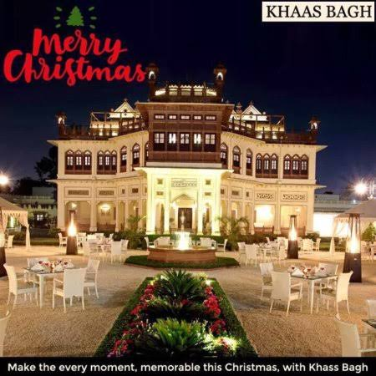
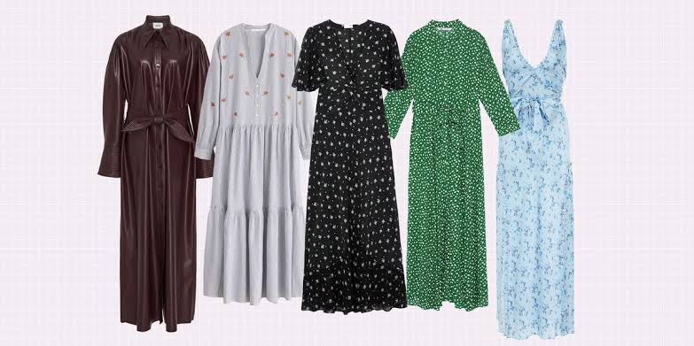
Apartment
Dresses

Slide 6
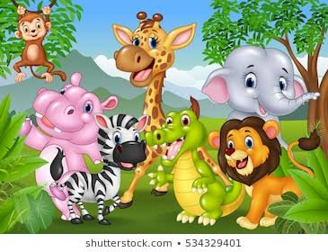
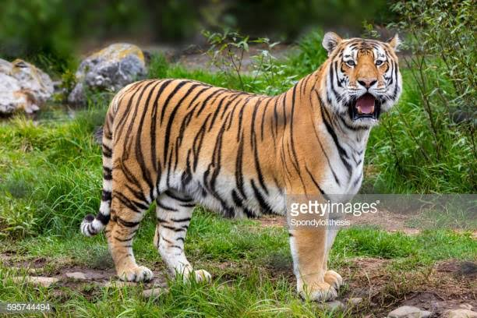
Cartoons
Tiger

Slide 7
Today’s lesson
About Saikot’s family

Slide 8
New words and meaning.
Parents = father and mother
Banker = the person who works in bank Student = learne Flat = apartment
Make = prepare
Improve = develop
Tiger = one of the animals who lives in forest
Listen = hear

Slide 9
He lives with his parents in a flat in Bogra .He is in class 5.He is a good student. He wants to improve his English, so he watches cartoons on TV everyday. He also reads English books. He likes books about animals, especially tigers and lions.
This is Saikat.

Slide 10
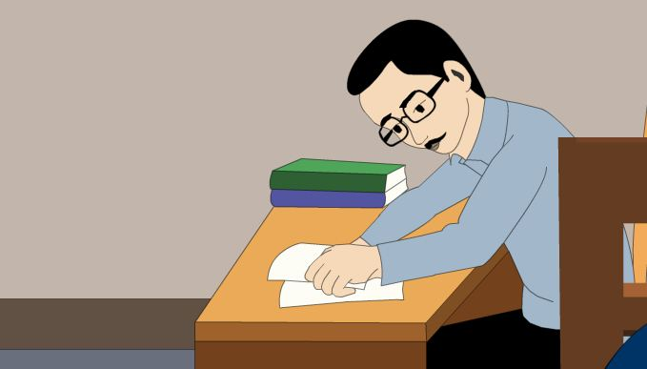
Mr.Rashidul Islam is a banker. But in his free time Mr.Islam writes stories and listens to music.
This is Saikat’s father.

Slide 11
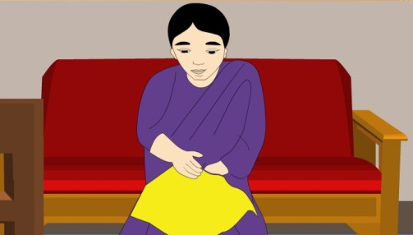
Saikat’s mother is Mrs.Monwara Islam .She is a housewife. In her free time she enjoys sewing. She makes dresses. She often gets orders from her friends and neighbours.
This is Saikat’s mother.

Slide 12
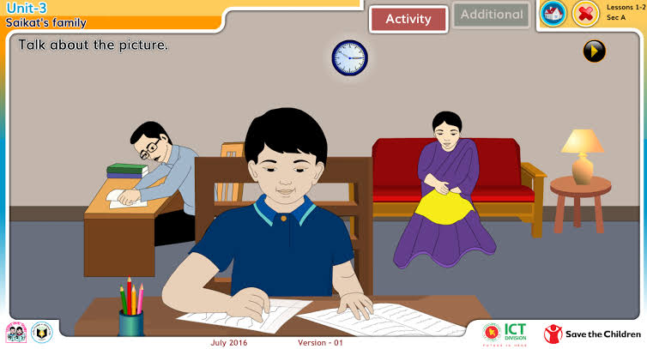
Teacher’s Reading
Dear students, open your book .
Listent and read.
Saikat Islam lives with his parents in a flat in Bogra. His father Mr. Rashidul Islam is a banker. But in his free time Mr. Islam writes stories and listents to music. Saikats mother is Mrs. Monwara Islam. She is a housewife. In her free time she enjoys sewing. She makes dresses. She often gets orders from her friends and neighbours.
Saikat is in class 5. He is a good student. He wants to improve his English. So,he watches cartoons on TV everyday. He also reads English books. He likes books about animals, especially tigers and Lions.

Slide 13
1. Match similar words or phrases in column A with column B.
Column A | Column B
a. Parents | 1.a school pupil.
b. apartment | 2.put on one’s clothes.
c. cartoons | 3.a flat.
d. dresses | 4.a drawing usually humorous.
e.student | 5.Father and Mother.

Slide 14
GW
Group-1
Where does Saikat live?
What class Saikat read in ?
Group-2
What is the name of Saikats Father?
What does he do in his free time?
Group-3
What is Maleka Begum?
What does she do in his free time?

Slide 15
IW
Read the passage about ‘Saikot’s family’ from the text book and write the answer of the following questions.
1. What is Saikat?
Ans: Saikat is a student.
2. What is Saikat’s mother’s name?
Ans: Saikats mothers name is Monowara Begum.
3. What is Saikats Father?
Ans: Saikats father is a Banker.
Notes:
The teacher can ask SS to go to the textbook. After reading the passage student will find out the answer from the passage. 10 minutes can be given for the task. Then the teacher can elicit answer from 4/5 students. Then the teacher can show the answer.

Slide 16
Write true or false.
1. Saikat lives in Chittagong.
False
2. Saikat’s mother is a housewife.
True
3. Saikat read in class 3.
False
3. Saikat reads English story book everyday.
True

Slide 17
Fill in the gaps.
1.Sakat islam wants to improve …………
2. He is in class …………...
3. Saikat Isalm is a ………….students.
4. He likes book about………

Slide 18
Make sentence
Home work
1.Housewife
2.Music
3.
Cartoons

Slide 19
Home Work
Write Ten Sentences About Your Family

Slide 20
Thank you

