Slide 1
Welcome to my class

Slide 2
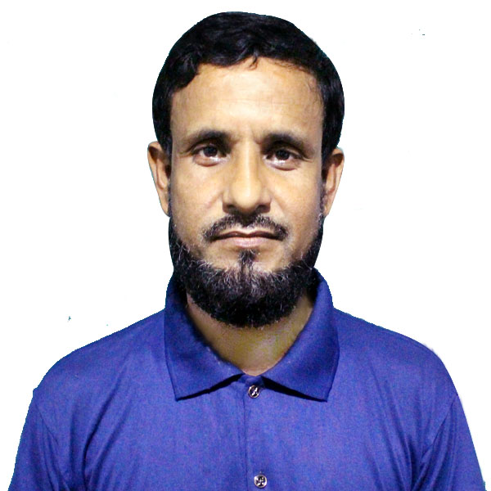
Presented by
Md. Nazrul Islam
Head Teacher
Purbo Ramjebon Govt Primary School
Sundargonj, Gaibandha.

Slide 3
Lesson Details
Class : Four
Subject : English
Unit : 3
Lesson : 1
Date; 11-01-2020

Slide 4
Learning outcomes
Student will able to-
Reading-
1.4.1- read words, phrases and sentences in the text.
1.5.1-read words, phrases and sentences in the text with proper pronunciation, stress and intonation
1.7.1-read short paragraphs, dialogues and simple letters.
5.1.1- read silently with understanding paragraphs, stories and other texts.

Slide 5
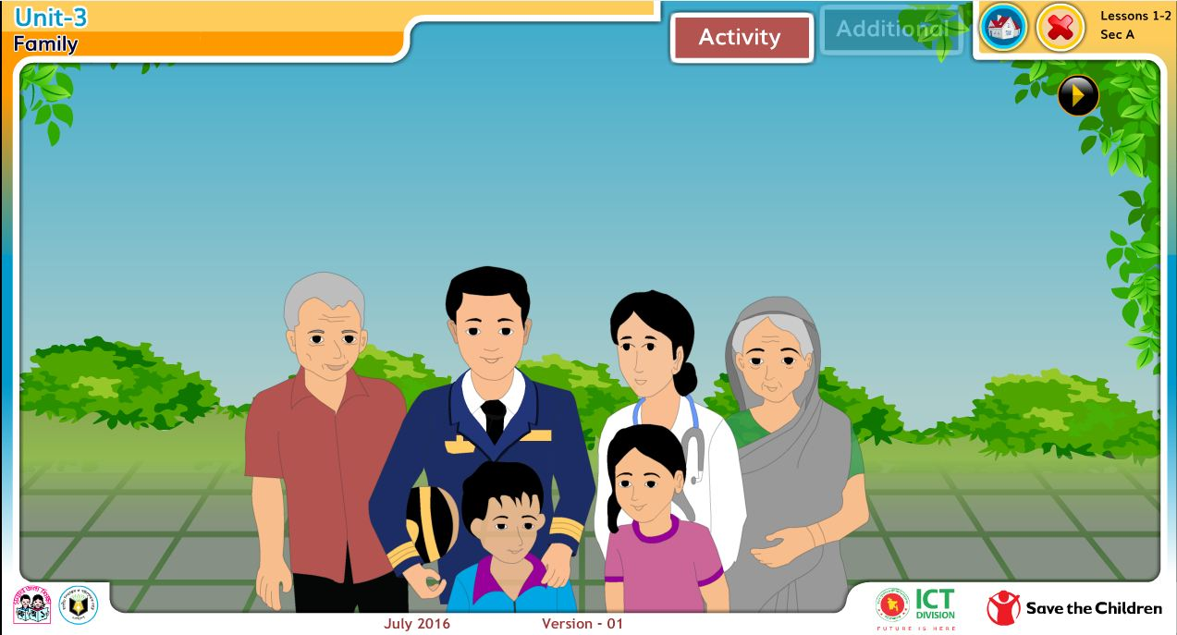
1.How many people are in the Picture ?
2.Do you know them ?
3.Have you any brother or sister ?
To day we are going to read-
‘Family’

Slide 6
One day one word
like
Choose

Slide 7
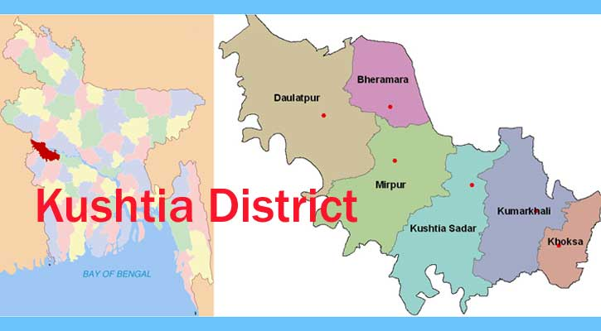
Farzana and Jamil are from Kushtia.
They go to Chachua Government Primary School.

Slide 8
Farzana is nine years old. She is in class 4.
Jamil is seven years old. He is in class two.
They like school and they are good students.

Slide 9
Teacher’s Model Reading
Farzana and Jamil are from Kushtia . They go to Chachua Government Primary School . Farzana is nine years old . She is in class 4 . Jamil is seven years old . He is in class 2 . They like school and they are good students .

Slide 10
Pair Work

Slide 11
Individual reading

Slide 12
Silent Reading

Slide 13
Group work
Group
A
1. What type of student are Farzana and Jamil?
2. What is the name of their school ?
Group
B
1. How old is Farzana?
2. What is Farzana ?
Group
C
1. How old is Jamil ?
2. What is Jamil?

Slide 14
Evaluation
Say True or False.
1. Chachua is a Non-Government Primary School.
2. Farzana is nine years old.
3. Farzana and Jamil likes school?
4. Only Jamil is a good students.
False
True
True
False

Slide 15
Home work
Write five sentences about
“Your Family”.

Slide 16
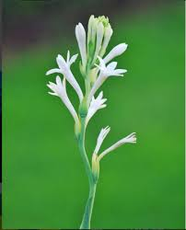
Thanks For All

