Slide 1
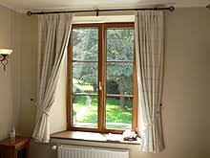

Slide 2
WELCOME

Slide 3
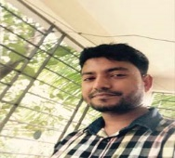
INTRODUCING
MD. AL AMIN
Assistant Teacher
Kaitkuna Govt. primary school
Chhatak, sunamgonj
01716184734
Class- THREE
Sub: English for today
Unit: 33
Lesson : 1-2
Time : 40 min.
Date: 12.01.2020

Slide 4
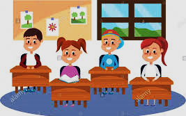
Teacher
Students
Good morning, students.
Good morning! teacher
How are you today?
Fine. and you?
Fine, thank you.
You are welcome sir.

Slide 5
Creating Emotion
Dear Students, let’s enjoy a video!

Slide 6
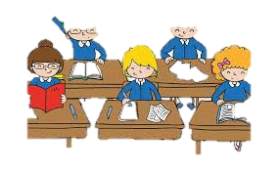
Discussion about video
What do you see in the video?
The boys & the frogs
What are they doing?
Playing in the pond

Slide 7
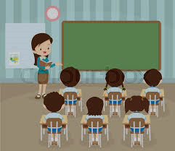
Lesson announcement
Today’s Class is about -
The boys & the Frogs

Slide 8
Learning Outcome
By the end of the lesson students will be able to…
Listening:
4.3.1 enjoy and understand simple stories.
Speaking:
1.1.1 Repeat after the teacher and say words, phrases and sentences with proper sounds, stress and intonation.
Reading:
5.1.2- read simple stories

Slide 9
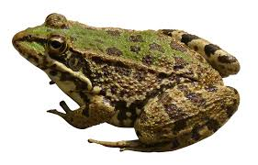
Let’s learn New Words
Word Meaning
Frog
ব্যাঙ

Slide 10
Let’s learn New Words
Word Meaning
Listen
শোনা

Slide 11
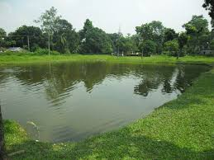
Let’s learn New Words
Word Meaning
Pond
পুকুর

Slide 12
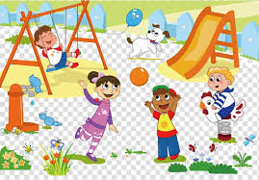
Let’s learn New Words
Word Meaning
Play
খেলা করা

Slide 13
Let’s learn New Words
Word Meaning
Happy
সুখি

Slide 14
Let’s learn New Words
Word Meaning
See
দেখা

Slide 15
Individual Work
Tell the word meaning
Happy
Frog
See
Play
Listen
Pond

Slide 16
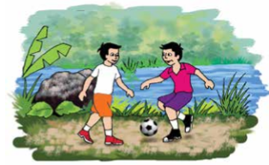
Listening
What do you see in the picture?
Fazle and Saiful are playing
near the pond

Slide 17
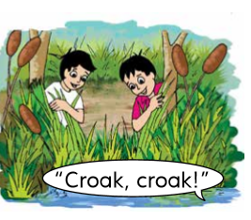
Listening
What do you see in the picture?
Fazle says, “Listen, Saiful.
There are frogs here!

Slide 18
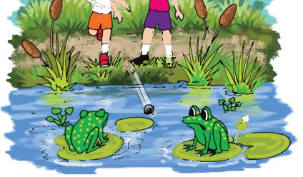
Listening
What do you see in the picture?
Let’s see them!”
Fazle is happy.

Slide 19
Connection with book
Now open your English Book at page 66

Slide 20
Listening
Listen and say after me.
Fazle and Saiful are playing near the pond. Fazle says, “Listen, Saiful. There are frogs here! Let’s see them!”
Fazle is happy.

Slide 21
Reading
Student’s read silently
Fazle and Saiful are playing near the pond. Fazle says, “Listen, Saiful. There are frogs here! Let’s see them!”
Fazle is happy.

Slide 22
Pair Work
One student read the text and other student will listen.
Fazle and Saiful are playing near the pond. Fazle says, “Listen, Saiful. There are frogs here! Let’s see them!”
Fazle is happy.

Slide 23
Evaluation
1. Where does a frog live?
2. What are the boys doing?
3. Why Fazle is happy?
4. What sound does a frog make

Slide 24
Home Work
Write three sentences about the frog.

Slide 25
Goodbye
Let’s enjoy a Goodbye song!

