Slide 1
Welcome everyboy to my session

Slide 2
Introduction
Md.Asaduzzaman
Head Teacher
Charnewaji Govt Primary School
Mohonganj,Rajibpur, Kurigram.

Slide 3
m
Lesson Introduction
Subject: English
Class:Five
Lesson:One
Unite:15
Topic:Happy Birthday(A person---- in the picture.)
Time:45 minutes.

Slide 4
Learning Outcomes
At the end of the lesson ss will be able to—
1.1.1.read the text with understandable pronunciation.
4.2.1.know the vocabulary (birthday,special,celebrate)
5.1.1.understand the text.
10.1.1.write four/five sentences about him/her birthday.

Slide 5
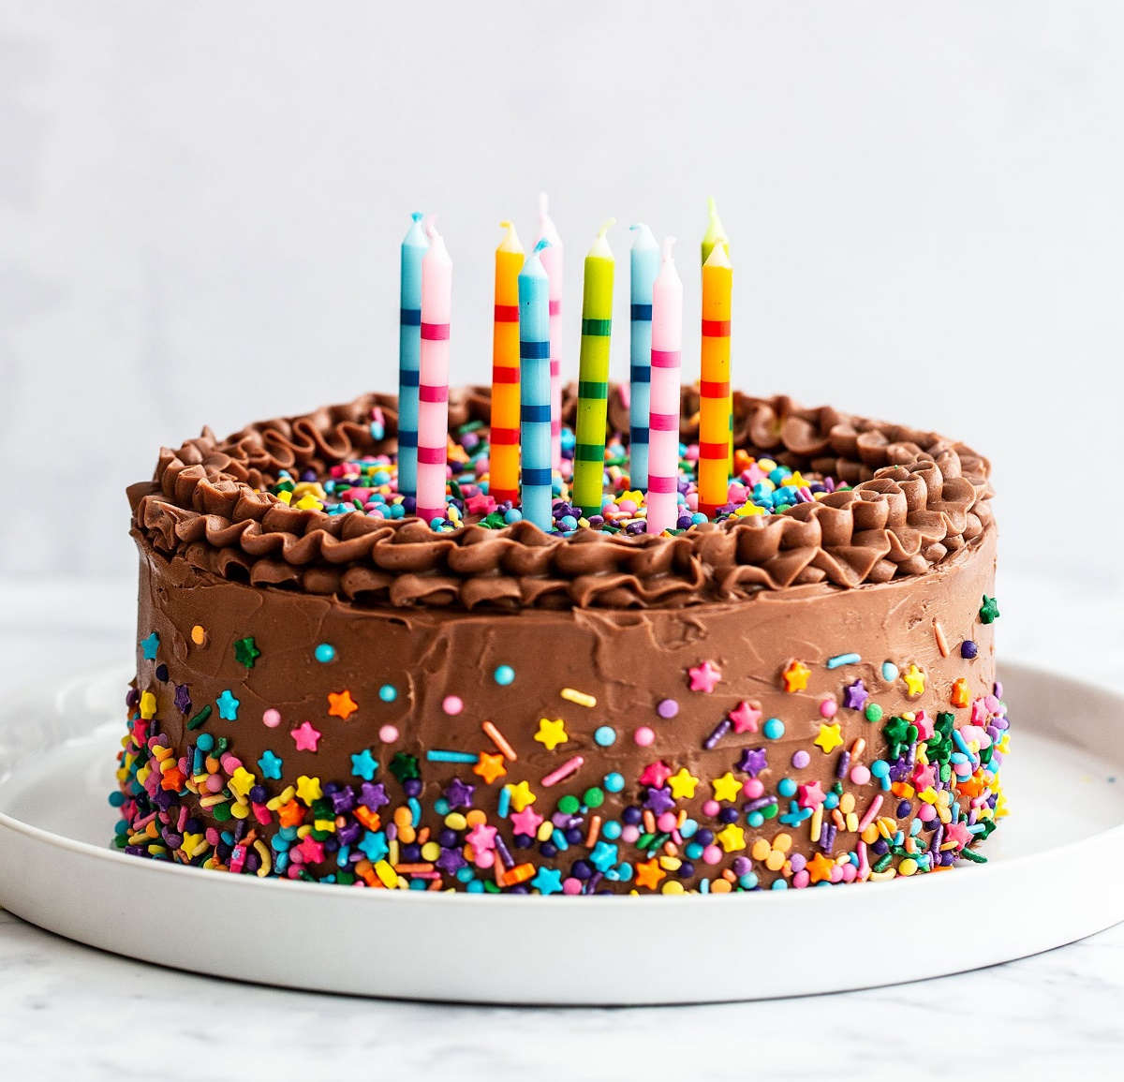
Look at the picture. Think alone and share with your pair

Slide 6
Pronunciation , spelling and meaning of the new words
Birthday,
Special,
Celebrate,
Different

Slide 7
Special ----not usual or general.
Celebrate ----to observe something happily.
Birthday ----the day when a person was born.
Different ----not the same.

Slide 8
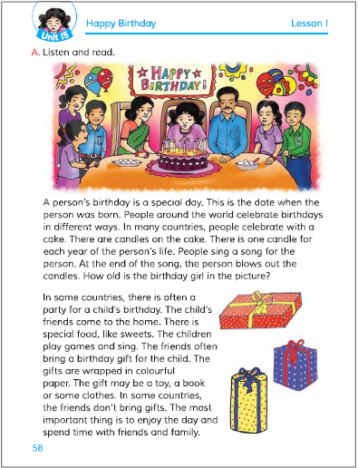
I will read the text with correct pronunciation

Slide 9
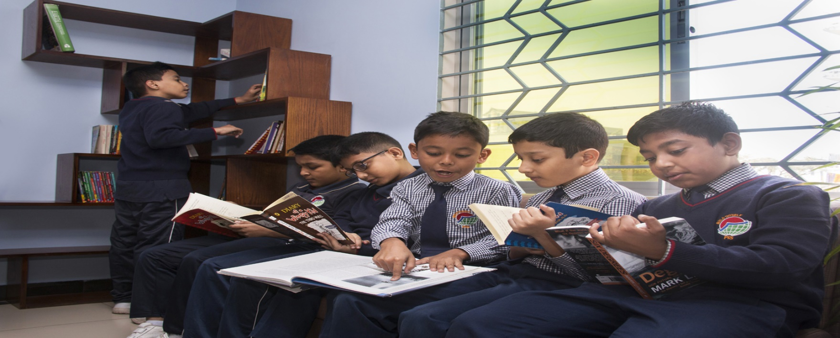
Group reading

Slide 10
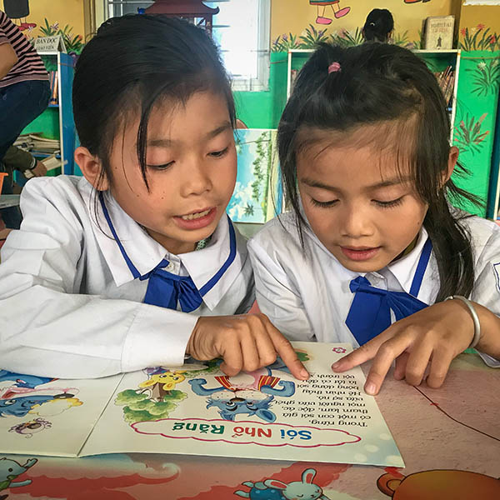
Pair reading

Slide 11
Write true or false
1. People around the world celebrate birthdays in same ways.
2. There is one candle for each year of the person’s life.

Slide 12
Fill in the blanks in pair.
1.A persons birthday is a --------- day.
2.There are --------- on the cake.
special
candles
Answer the following questions in group.
1.What is birthday ?
2.How is birthday?
3.How do you celebrate your birthday?

Slide 13
Write three sentences about your last birthday

Slide 14
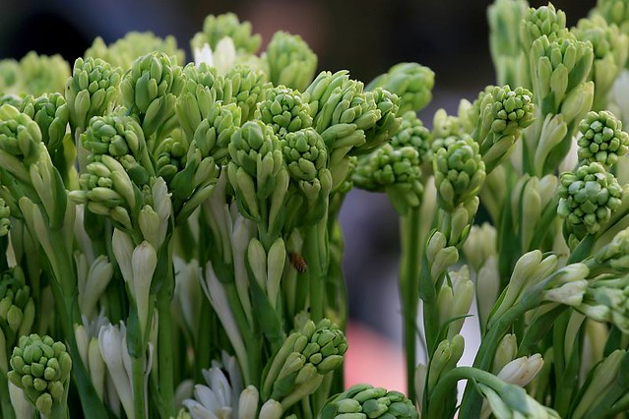
tt
THANK YOU

