Slide 1
Good Morning
Every body

Slide 2
Teacher Name : Kalyan Kumar Dev
A.T : Sukdeb Govt Primary School Rajarhat .

Slide 3
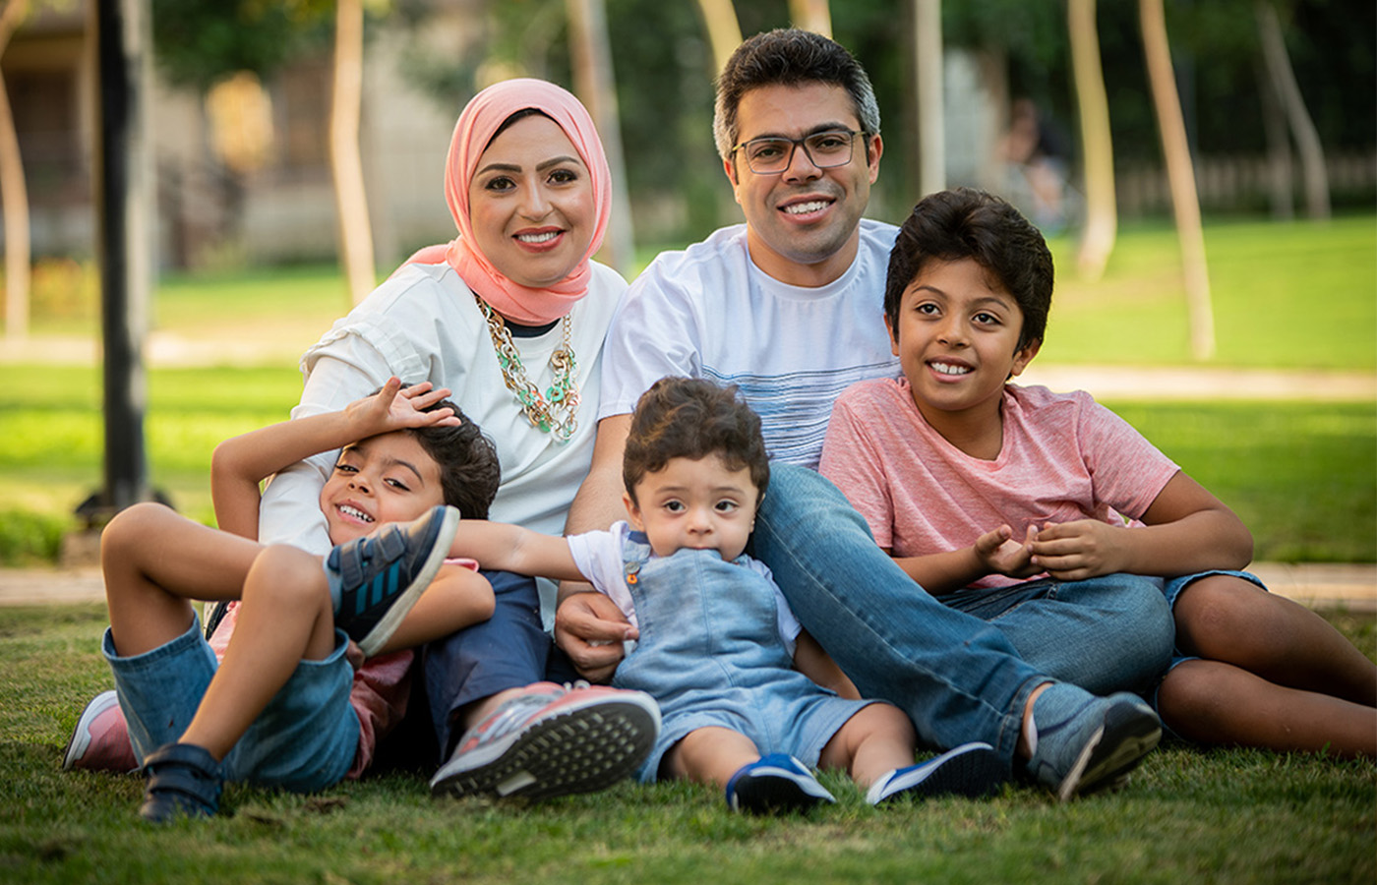
Family

Slide 4
Subject: English
Class: Five
Lesson: 1-2
Unit: 3 Saikat’s family
Page:10
Time: 45 minutes
Date: 12-01-2020

Slide 5
Learning Outcomes
To understand questions about family,friends and community of the students.
3.2.1

Slide 6
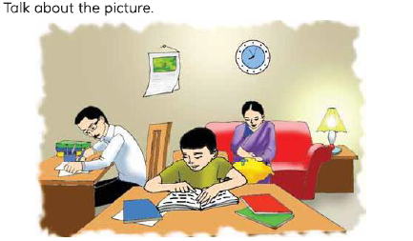

Slide 7
New word in the liston
Flat
Parent
Banker
Dresses
Housewife
Neghbours

Slide 8
I will read the liston correct Pronunciation

Slide 9
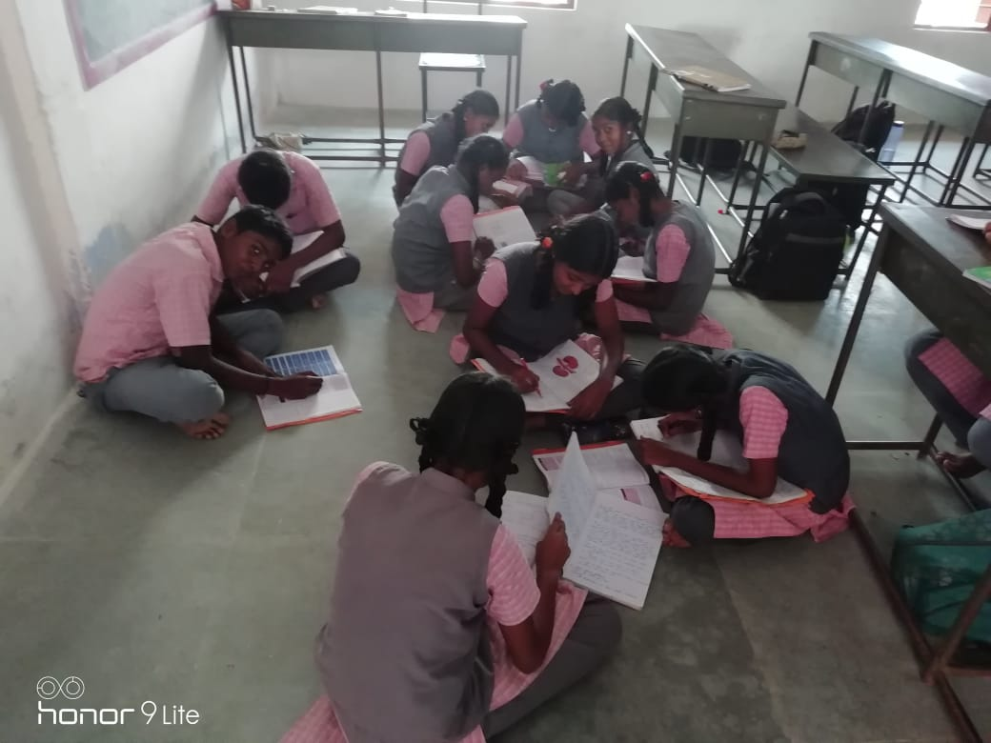
Group Reading

Slide 10
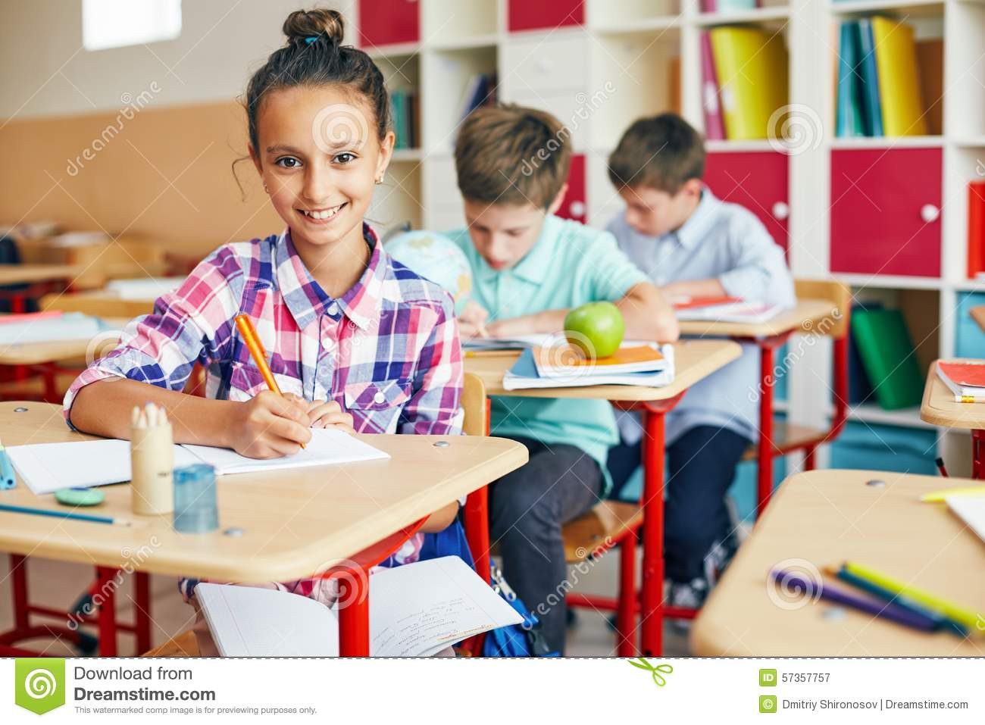
Individul Reading

Slide 11
Read agin. Say True or False
1.Saikat lives in Bogra.
True
2.His father is a Teacher.
False
3.His mother is housewife
True

Slide 12
Complete Sentences
lives
1.Saikat Islam……… with his parents.
2. His Father Mr.Rashidul Islam Is a…….
banker
dresses
3.She makes …..........

Slide 13
Ask and answer the question
1.What is saikat’s father name
2.What do his parents do in their free time
3.What is saikat’s mother’name

Slide 14
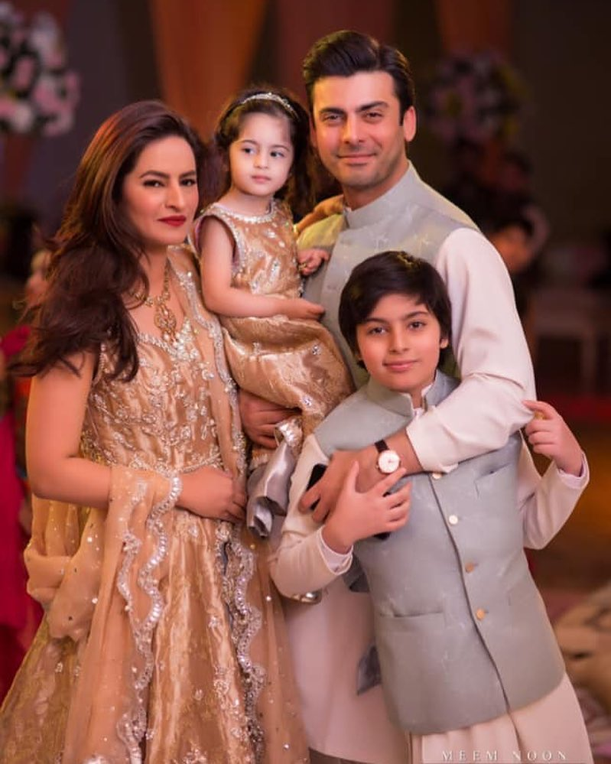
Your Father
Your mother
Your sister
You

Slide 15
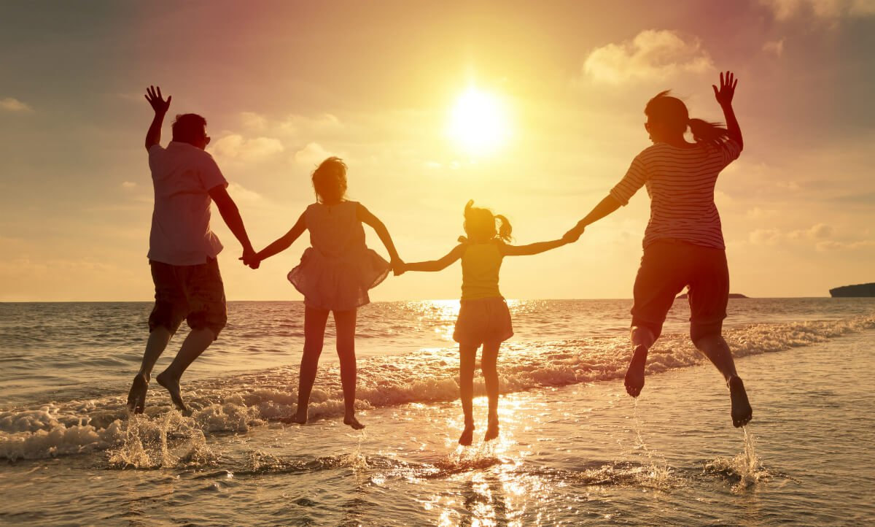
Thank you

