Slide 1
Welcome

Slide 2
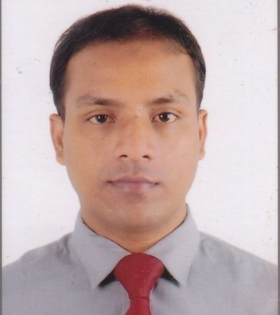
Introduction
Class- Nine
Subject-English paper 1
Unit-03. Lesson: 02.
Md.AhsanHabib
Asst.Teacher
Sylhet Pulp & Paper Mills high School
Chhatak,Sunamganj

Slide 3
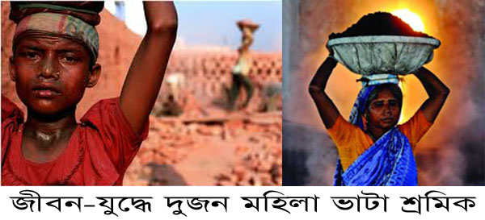
Let’s see some pictures
Two labours work in a brick field.

Slide 4
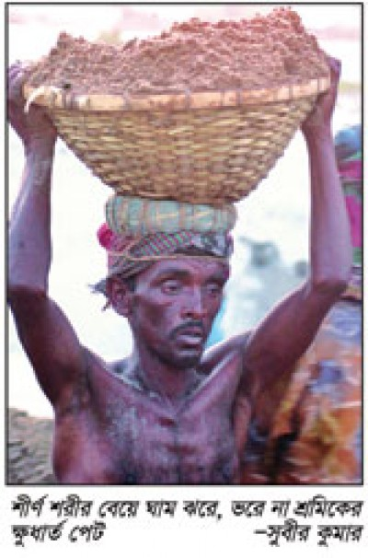
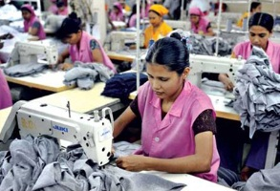
A day labour working hard
Some garment workers working

Slide 5
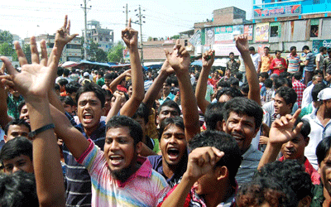
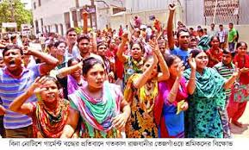
Is their salary sufficient?
Movement
Movement

Slide 6
Look At the picture and talk about it.
What do you see in the picture?
Can you relate any historical event in this picture?
What happened on this day?

Slide 7
Lesson:02
Topic:
May day

Slide 8
Objectives:
Ss will learn about the importance of may day.
Ss will able to identify the reasons of industrial revolution.
Ss will know the meaning of new words.
Ss will able to develop four skills.

Slide 9
B. Read the text for 8 minutes and answer the questions that follow.
1.What does May Day refer to?
2. How long did the workers have to work a day before the May 1 strike?
3.How many workers were victimised for taking part in the strike?
4.How did the workers in Chicago go on astrikes?

Slide 10
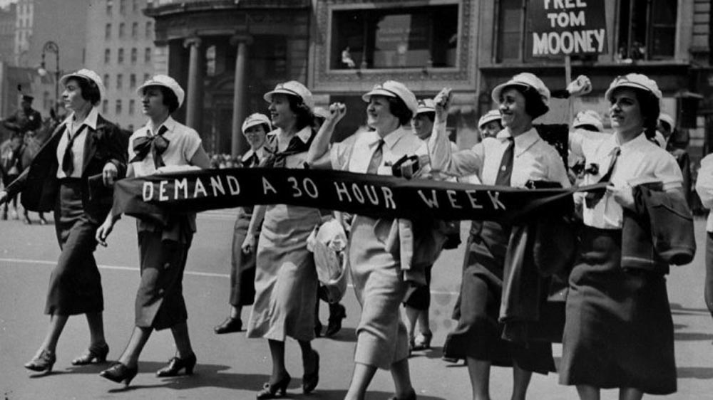
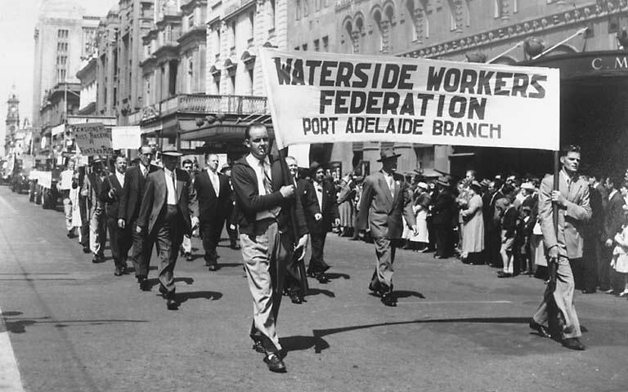
ss
Movement: Demand on 8 hours works.
Movement on workers.

Slide 11
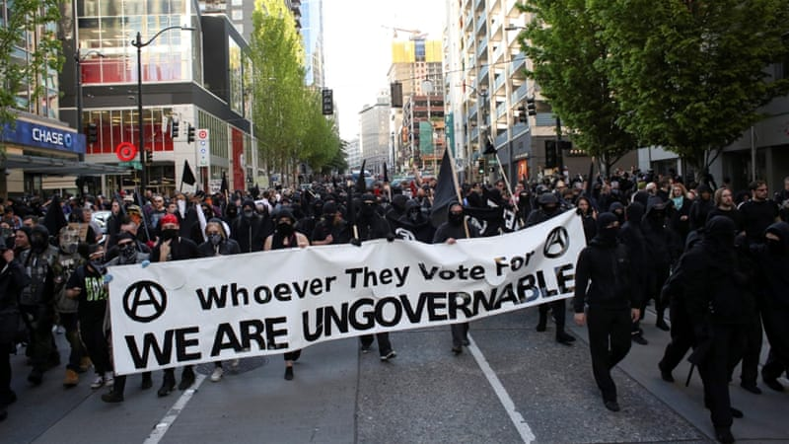
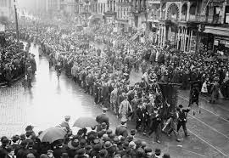
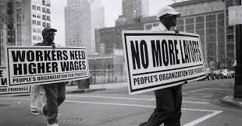
ss
Company’s movement for demand wages.

Slide 12
Estalished: International workers day.

Slide 13
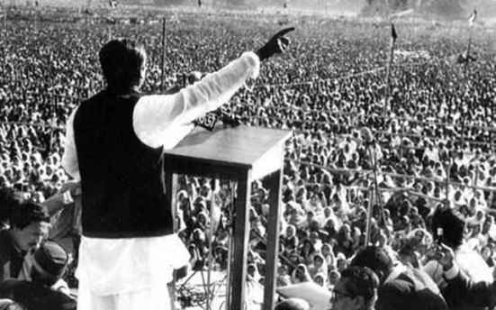
Word meaning
connected with history or past events
Historical
Sheikh Mujib made a historical speech.

Slide 14
Commemorate
Recall and show respect for someone or something
Struggle --- a forceful effort to get free.
Demand---- to ask for something forcefully.
Instantly --- at once.

Slide 15
Fill in the blank with the verbs given in the box.
Live, work, send, add, support , do
Tania is a poor garment worker. She_____ in a big garment factory in Gazipur. She ____ in a slum with a few fellow workers. She works eight hours a day on a monthly salary of TK.3000/- .She does overtime to ____ some more money to her income.
If she can save something, she ____ it to her father to _______ the family.

Slide 16
Group Work
Write five points about May Day.

Slide 17
Evaluation
1.Do you think Tania’s monthly salary is enough for her work?
2.How many time does Tania work?
3.Does Tania live in a hygienic place?

Slide 18
Home Task
Write a paragraph about May Day.

Slide 19
Thanks

