Slide 2
Introduce of teacher
Md:Shahjahan
Assist:teacher
Condipasha purvo para G P S
Pakundia kishoreganj

Slide 3
Introduction of lesson: unit 6 lesson 1
Time:4o minute

Slide 4
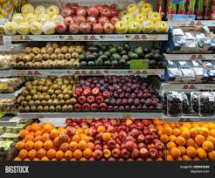

Slide 5
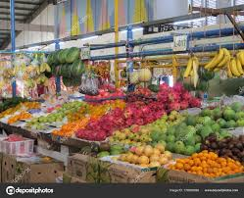
Look and say
What are you watching here?

Slide 6
Today lesson: Eat healthy
Page no 22

Slide 7
Learning outcomes
3.3.1 Understand question about object around them
3.4.1 Understand statemeants made by the teacher and
Students .s
1.1.1Say wards phrases and sentence with proper sound
And stress.
1.5.1Read words phrases and sentence in the text with
Proper pronunciation stress and intonation.

Slide 8
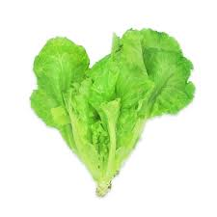
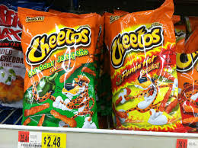
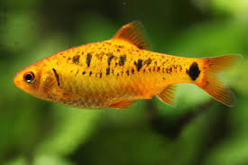
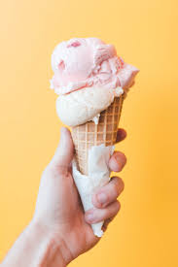
Look Listen and say
chips
lettuce
Ice cream
Fish

Slide 9
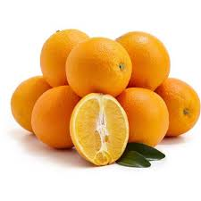
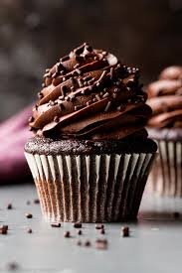
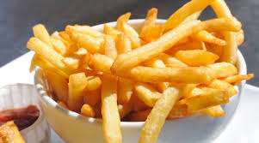
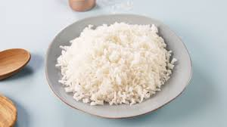
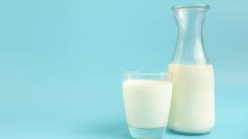
Orange
Chocolate
Fries
Rice
milk

Slide 10
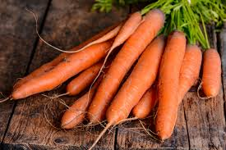
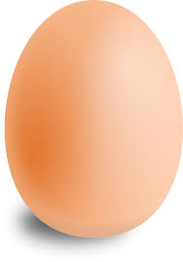
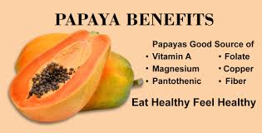
Egg
papaya
Carrots

Slide 11
I read the text loudly with proper sound ,stress and intonation

Slide 12
Then students will read with me correctly

Slide 13
I ask the students do you like fruits and vegetables? And what do usually
Have for breakfast?what food you like most?
Students will ans the question by help me.

Slide 14
What food you like most?underline it

Slide 15
What food you like most?underline it.

Slide 16
New words
Lettuce Fries Carrots

Slide 17
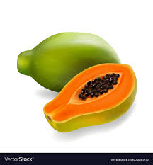
Match the name of the picture
orange
carrots
rice
Fish
milk
lettuce
egg
papaya

Slide 18
Healthy food
Fish Rice Orange Milk Carrots Egg
Papaya Lettuce
Unhealthy food
Ice cream Chips Fries Chocolate

Slide 19
Talk about your response to
Underline healthy food.

Slide 20
Conversation in pair/group
/I/W
And say
1.What are healthy food?
2.Which are unhealthy food?

Slide 21
Checking learning
Circle the healthy food

