Slide 1
Welcome

Slide 2
Lesson Plan
Date: 11-01-2020
Class : 3
Subject:English
Duration: 45 min

Slide 3
https://www.youtube.com/watch?v=KnOefgPqbrQ

Slide 4
Where is it ?

Slide 5
Learning outcomes:
Students will be able to :
.
6.2.1 talk about people and objects.
.
8.1.3 write sentences textbook or model.

Slide 6
Box
Football

Slide 7
behind
under
in
on
between
In front of

Slide 8
New words
Between
In front of

Slide 9
Group Work
Group
A
Group
B
Group
C

Slide 10
Pair Work

Slide 11
Individual Work

Slide 12
Silent Reading

Slide 13
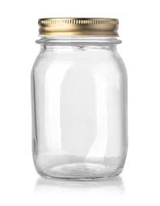
Evaluation
Write a sentence use of the word / preposition “ under”.
The pen -------the jar.
Fill in blank . Use of the clue “picture

Slide 14
Home Work
Write three sentences about your classroom.

Slide 15
Thanks to everybody

