Slide 1
Welcome to English class.

Slide 2
Teacher Identity
Md. Rabiul Hasan
Assistant Teacher of Mongolbari GPS
Dhamoirhat, Naogaon.

Slide 3
Lesson Identity
Class: Five
Sub: English
Lesson: 7
Topics: Eat Healthy Live Healthy
Time: 40 minutes

Slide 4
Learning Outcomes
Students will be able to
Listening: 3.4.1 Understand statements made by teacher and students.
Speaking: 1.1.1 Say words, phrases, and sentences with proper sounds and stress.
Reading: 1.5.1 Read words, phrases, and sentences with proper pronunciation, stress and intonation.

Slide 5
Good Morning
Students

Slide 6
Lets watch a video

Slide 7
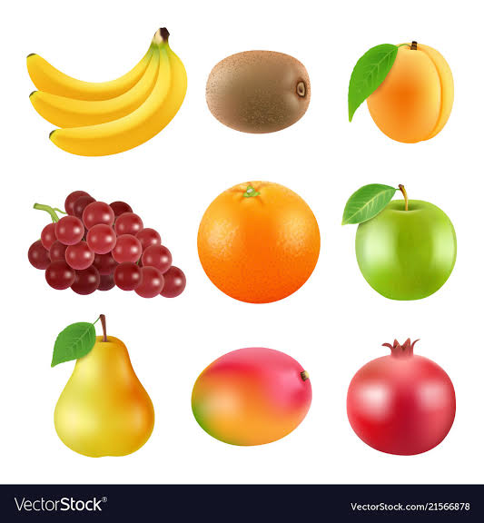
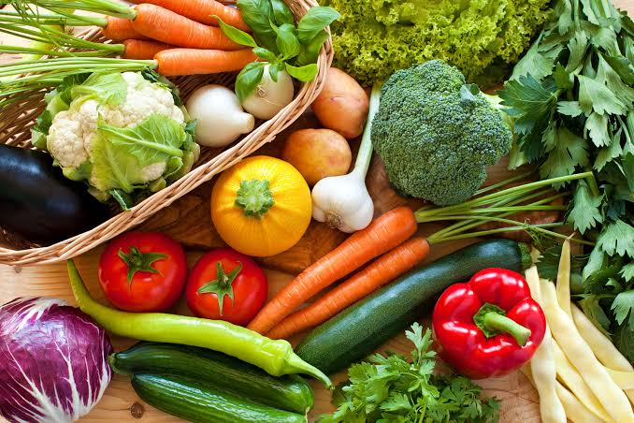
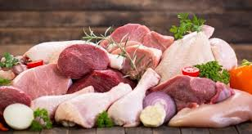
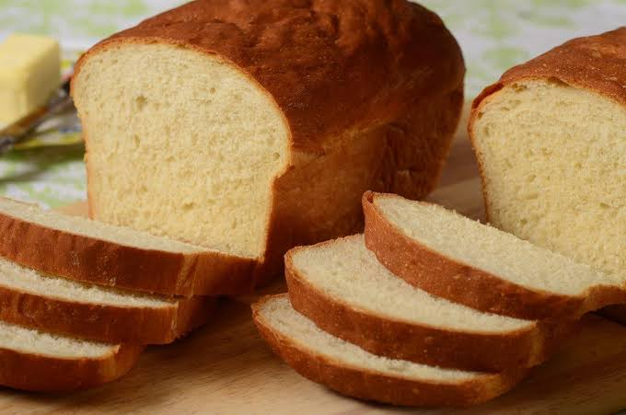
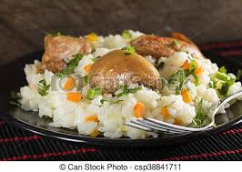
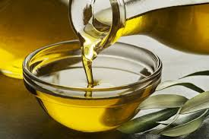
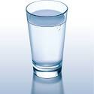
Lets see some pictures

Slide 8
Lesson declaration
Today we’ll read
‘’Eat Healthy Live Healthy”

Slide 9
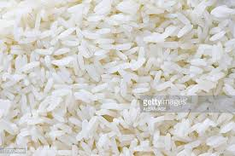
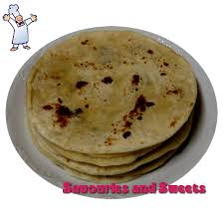
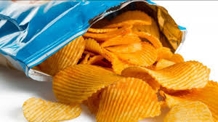
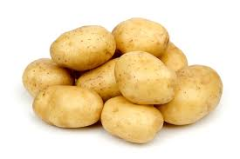
Bread
Rice
Potato
Chips
These convey carbohydrates. Which are essential for our body to grow.

Slide 10
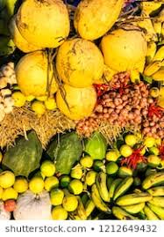
Fruits
Vegetables
These contain vitamin. Which protect our body from diseases.

Slide 11
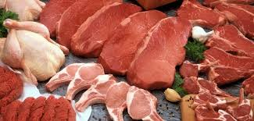
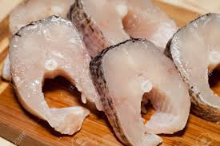
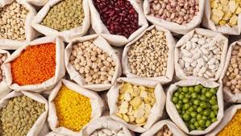
Meet
Fishes
Dales
These convey protein.

Slide 12
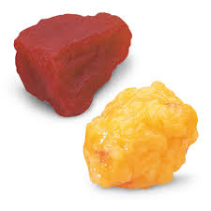
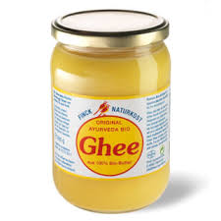
Fat
Oil
Ghee
These convey fat. Our body needs a little amount of fat.

Slide 13
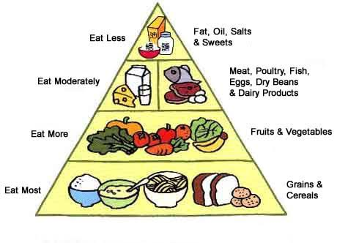

Slide 14
New words
Healthy
- স্বাস্থ্যবান
Nothing
- কিছু না
Mix
- মিশ্রণ
Protein
-আমিষ

Slide 15
Teacher’s reading (Loudly)
Student’s reading (silently)

Slide 16
Group work
Group Rose: Identify the foods-
1. What foods are there in the bottom level of the food pyramid?
Group Lilly: Identify the foods-
1. What foods are there in the level before bottom of the food pyramid?

Slide 17
Assessment
What food is good food?
2. Which food gives us energy?
3. Which foods help our eyes and health?
4. What type of foods convey vitamins?
5. What does the food pyramid help us to understand?

Slide 18
Good Bye

