Slide 1
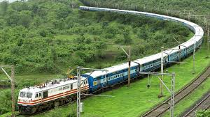

Slide 2
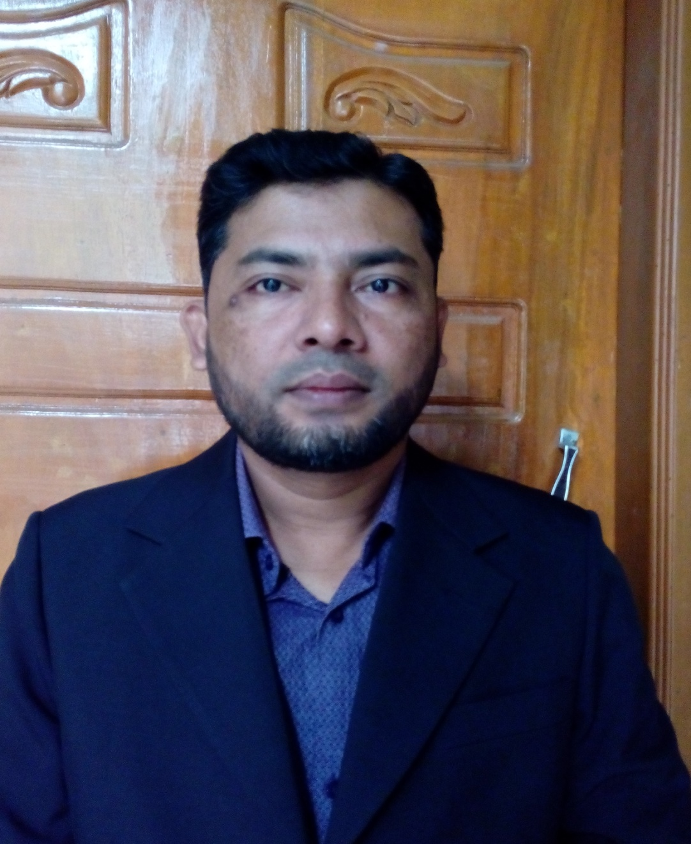
Presented by
NAME:SHAMSUDDIN.
TEACHER OF ENGLISH.
VEDURIA SERAJIA FAZIL MADRASAH.
LALMOHAN,BHOLA.

Slide 3
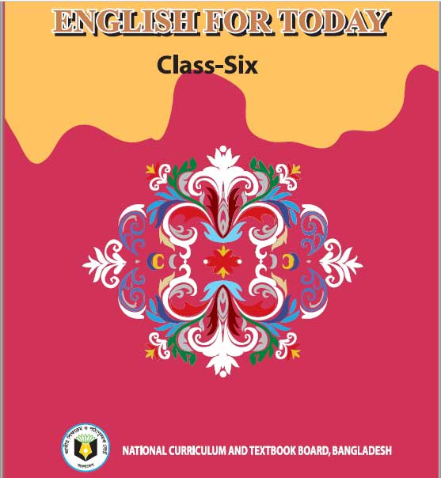
ABOUT LESSON
CLASS:SIX.
SUBJECT:ENGLISH FOR TODAY.
LESSON:03
TIME:45 MINUTES.

Slide 4
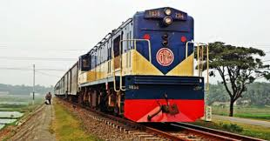

Slide 5
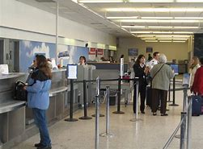

Slide 6
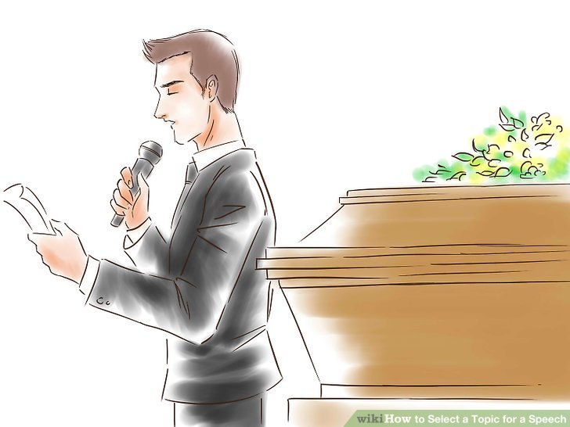
TODAY’S LESSON “AT A RAILWAY STATION”
LEARNING OUTCOME
BY THE OF THE LESSON STUDENTS WILL BE ABLE TO—
1.Talk about people , places and familiar objects in short and simple sentences.
2.Read and understand texts.

Slide 7
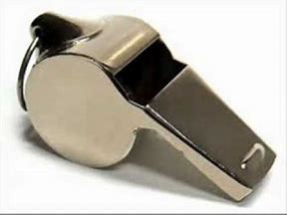
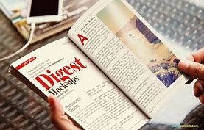
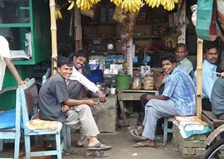
whistle
Magazine=journal
A tea stall=a small shop where prepared tea and a few snacks are sold.

Slide 8
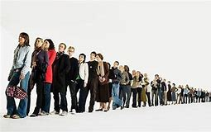
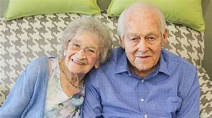
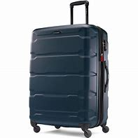
Queue= line
Couple=husband and wife
Suitcase= travelling bag

Slide 9
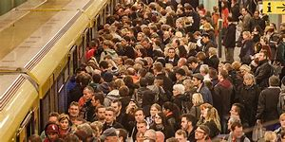
See off
Crowd=a large number of people gathered in a place.

Slide 10
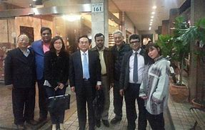
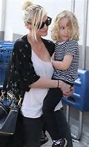
See off
Tightly=with very firm

Slide 11
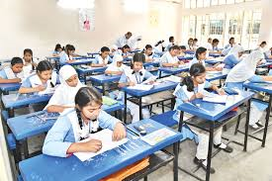
Open at the page 7 and read the passage silently---

Slide 12
Match a word from column A with a word column B that has a opposite meaning--
Column A | Column B
See off | Light
long | busy
quiet | receive
Heavy | drop
Pick up | short

Slide 13
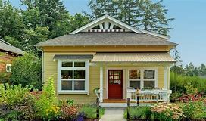
Describe a place you went there.

