Slide 1
WEL COME TO ALL

Slide 2
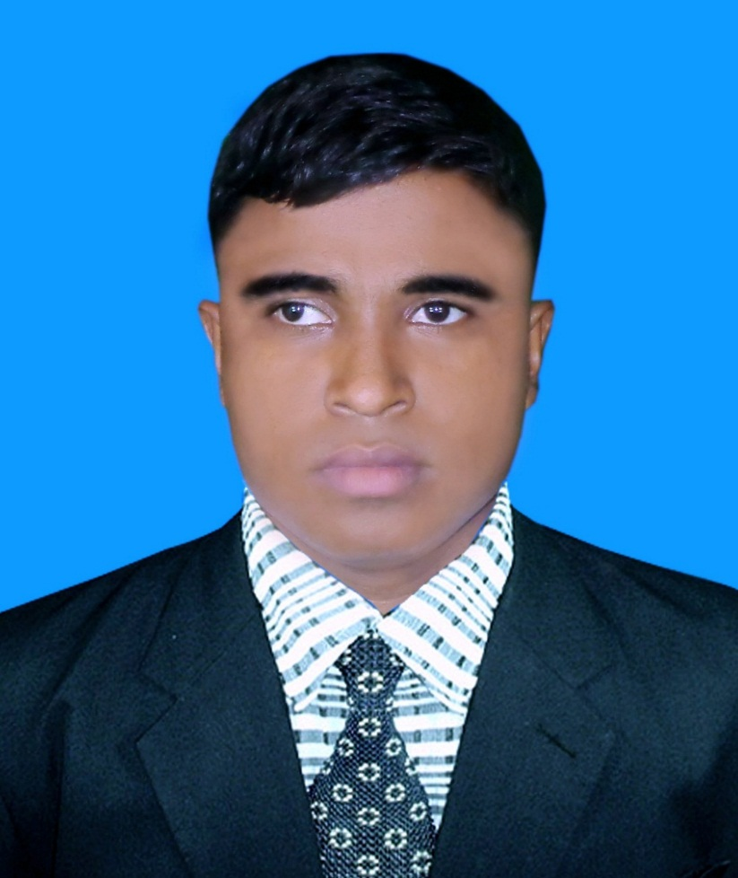
Identity
A. Sukur Ali Khan B.A hons.M.A In English Assistant Teacher(English)
Naldha Secondary School
Naldha,Fakirhat,Bagerhat.
Class-Ten
Sub:English 1st paper
Unit-Seven; Lesson-6
Duration-50mn.

Slide 3
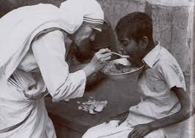
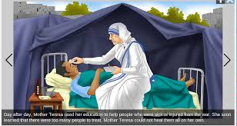
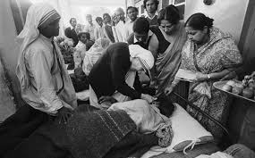
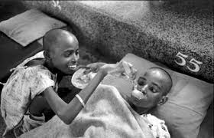
Look at the pictures
What do you see in these pictures?
They are serving the people

Slide 4
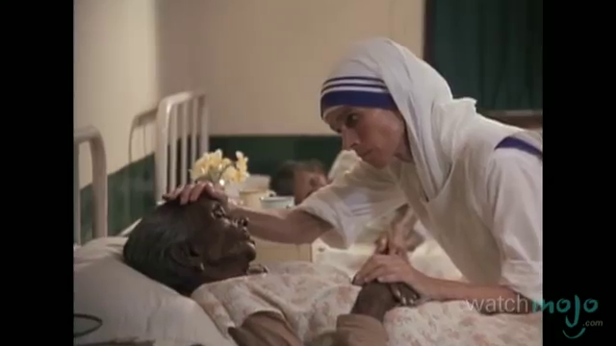

Slide 5
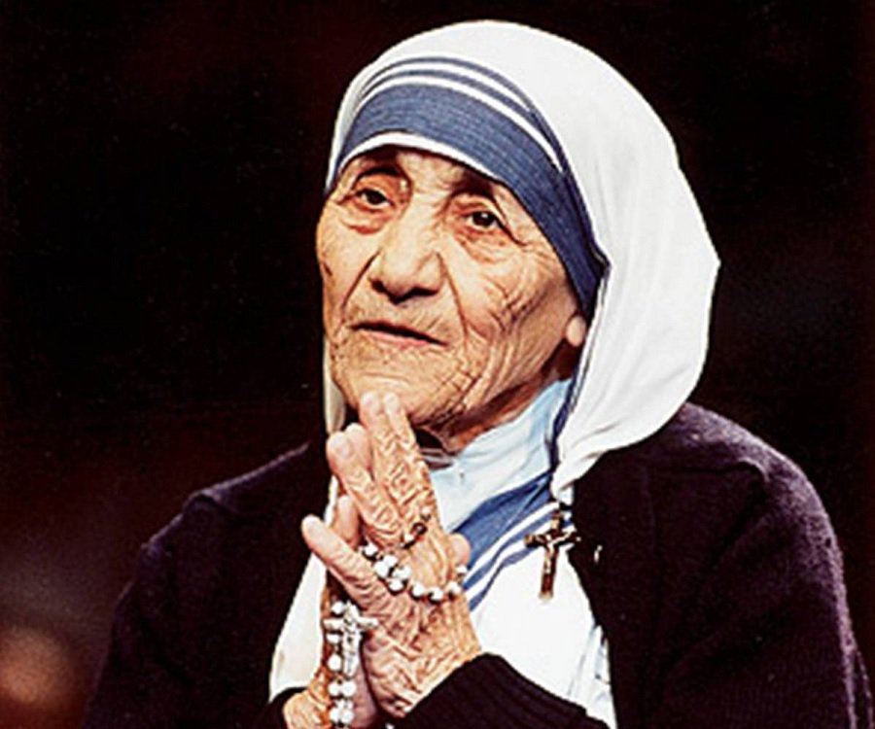

Slide 6
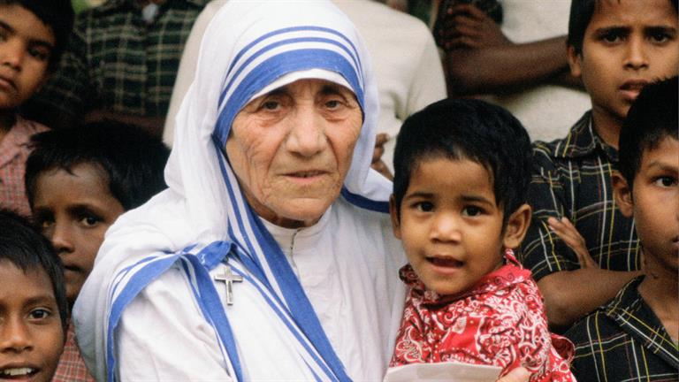

Slide 7
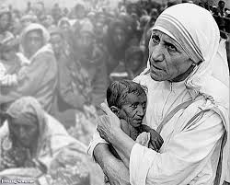
Yes,Our topic is :
Love for humanity

Slide 8
By the end of the lesson students will be able to…
(a)Read the text.
(b) Learn some new words
(c) Describe Mother Teresa’s humanitarian work for the sick and dying people
(d) Explain about her teachings for us.
(e) Ask and answer questions.

Slide 9
Silent reading
Open at page 100

Slide 10
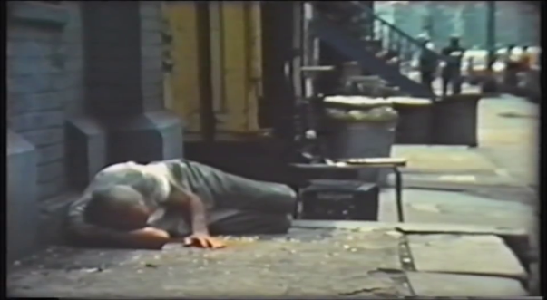
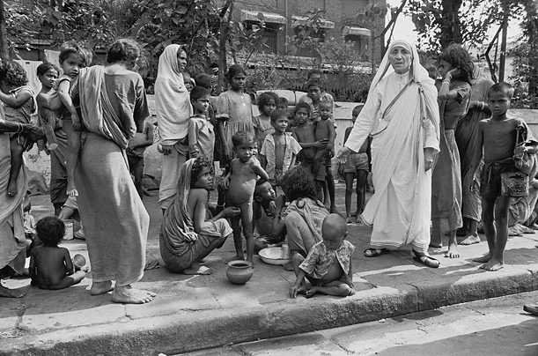
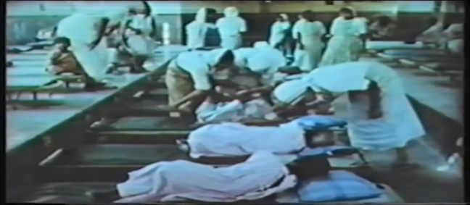
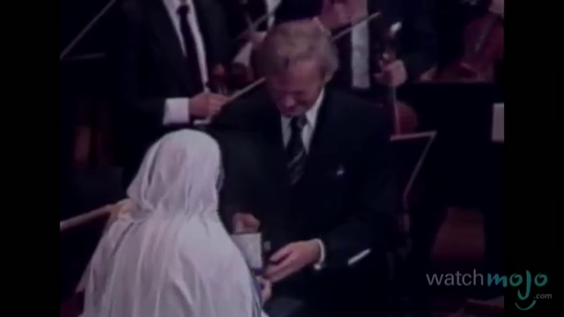
vocabs
Uncared
Deprived
Destitute
impoverished
Nirmol Hridoy
Pure heart (home for the dying destitute)
recognised
Acceptance as valid

Slide 11
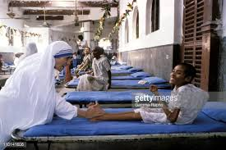
Mother Teresa was moved by the presence of the sick and dying.

Slide 12
Women and children have been taken from the streets and carried to Nirmol Hridoy.

Slide 13
The dying and destitutes were lovingly looked after and cared for.

Slide 14
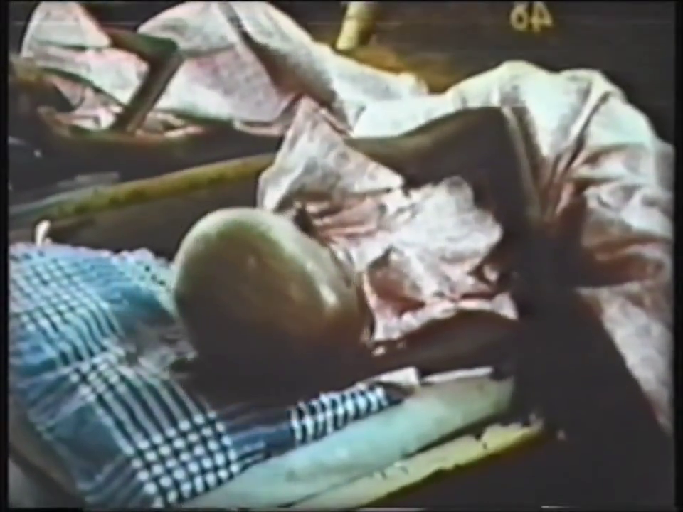
These unloved and uncared for people get an opportunity to die in an environment of kindness and love.

Slide 15
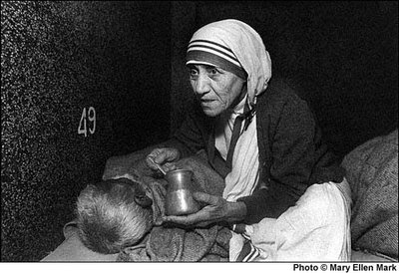
In their last hours they get human and Divine love.

Slide 16
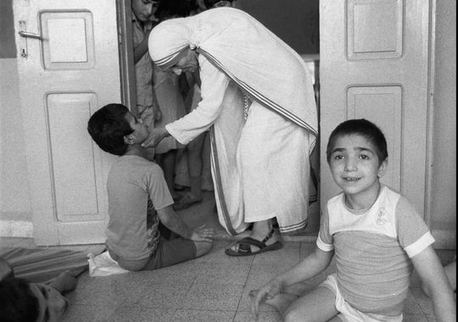
Mother Teresa thought that they should get human and Divine love, and can feel they are also children of God.

Slide 17
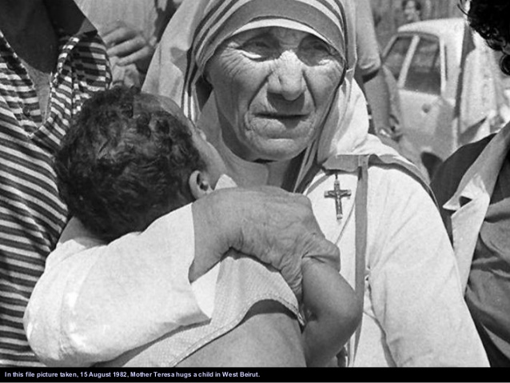
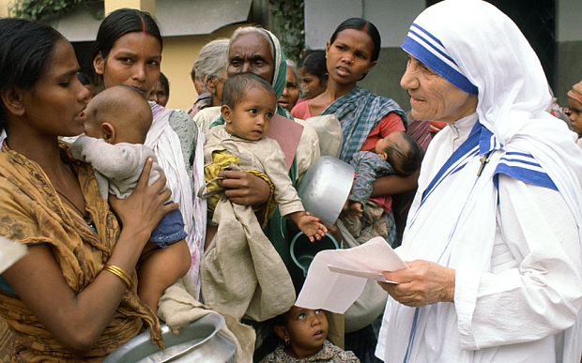
She has taught us how to extend our hand towards those who need our love and support irrespective of creed, caste and religion.

Slide 18
Group work
Discuss with your partner and circle the right answer :
Nirmol Hridoy is a – organization.
i) Charitable. Ii) philanthropic. Iii) bountiful iv) all the options.
b) – were brought to Nirmol Hridoy by Mother Teresa.
`i) affluent ii) helpless iii) cultural. Iv) all the options.
c) – were taken from the streets of Kolkata and carried to Nirmol Hridoy.
`i) men. Ii) women. Iii) children . Iv) all the options.

Slide 19
Answer
a) (I) -all the options.
b) (iii)- helpless
© (ii)- all the options.

Slide 20
a) What is nirmol Hridoy?
b) What does Nirmol Hridoy stand for?
c) What was the most prestigious prize ?
d) When did she die?
Evaluation

Slide 21
Answer
Nirmol Hridoy is a charitable organization working for the poor section of people.
Nirmol Hridoy stands for pure heart.
The noble prize was the most prestigious prize.
She died on 5 September 1997.

Slide 22
Home work
Write a paragraph about Mother Teresa not more than 100 words.

Slide 23
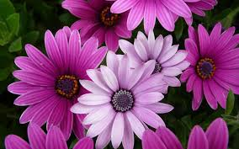
Thanks to all.

