Slide 1
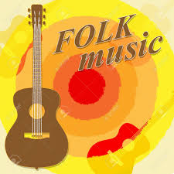
welcome

Slide 2
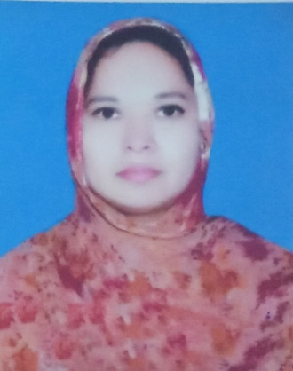
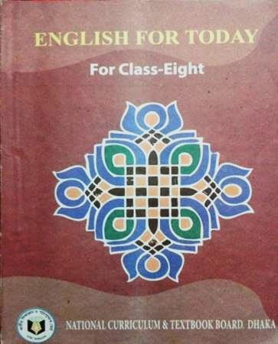
Introduction
Musa. Rahima Akther
Asst. teacher
Khulna Engineering University School
Class 8
English 1st paper

Slide 3
Look at the video:

Slide 4
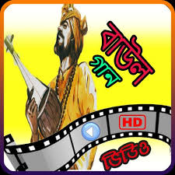
Today’s lesson is “Our folk songs”
Unit: 1
Lesson: 01
Page: 30
Time: 50 minutes
“loke bole ho bole re ghor barhi vala na amar”

Slide 5
Learning outcomes
At end the lesson, students will be able to –
Work in pairs;
Read and answer the questions;
Discuss in groups;
Write a paragraph by answering questions;

Slide 6
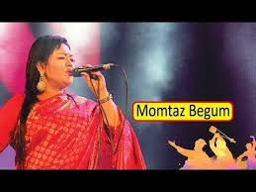
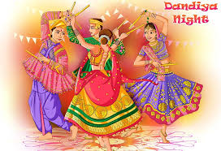
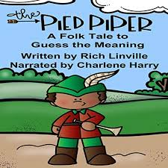
Kew words
folk
Folk song
Folk dance
Folk tale

Slide 7
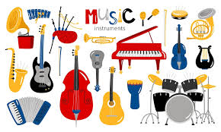
Kew word
Musical instrument
Instruments which are related to music.

Slide 8
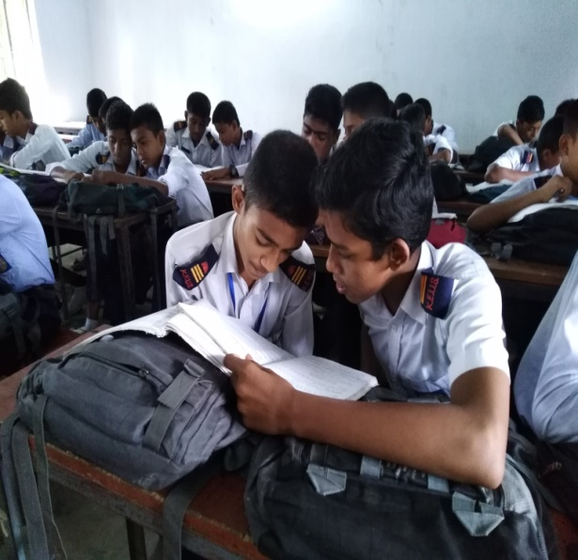
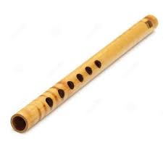
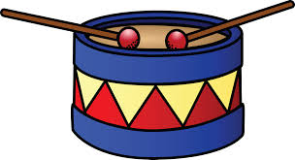
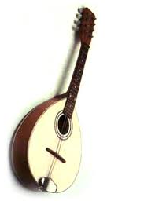
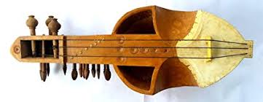
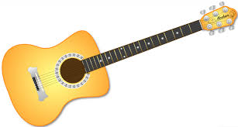
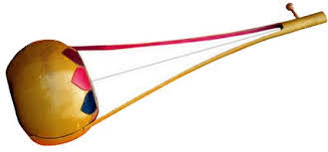
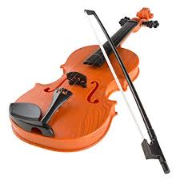
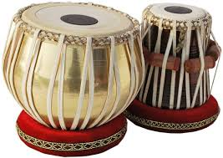
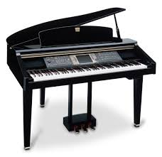
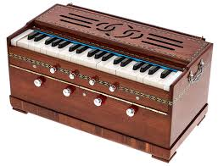
Work in pairs
Look at the musical instruments
guitar
bamboo flute
drum
dotara
sarinda
piano
harmonium
ek-tara
violin
tabla

Slide 9
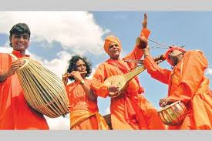
1. Can you sing a song?

Slide 10
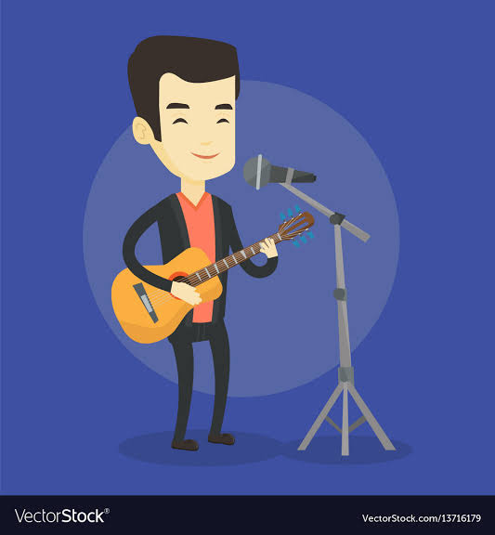
2. Can you play any of these musical instruments?

Slide 11
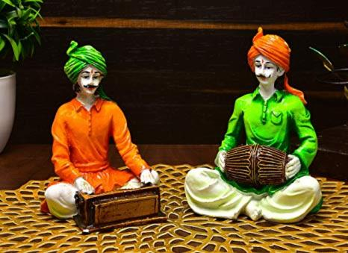
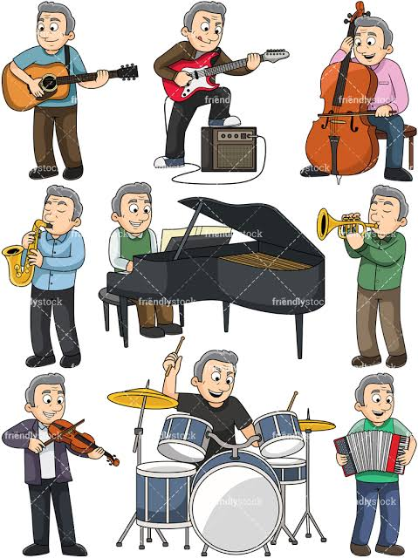
Do you know anybody who can play any of these instruments? Tell what you know about her/him.

Slide 12
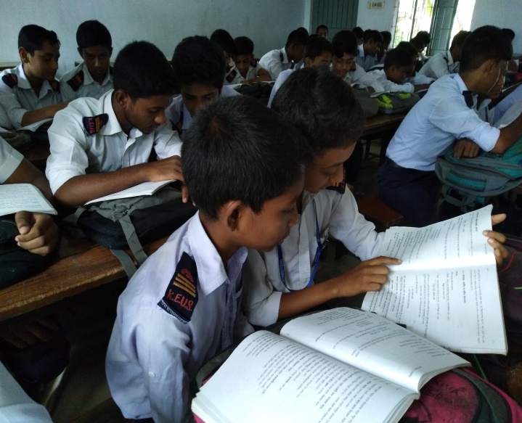
Read the text and answer the questions.
1. Who usually likes our folk songs?
2. Can you name some well known folk singers?
3. Do you like folk songs? If you do, who is your favourite folk singer? Which song or songs do you like most?
4. Look at the musical instruments in Activity A above and say which instruments go well with the folk songs.
5. Discuss in groups whether the modern instruments like guiter and the piano could be played with the folk songs?

Slide 13
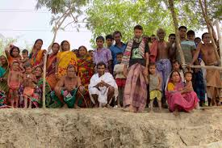
1. Who usually likes our folk songs?
Common people usually like our folk songs.

Slide 14
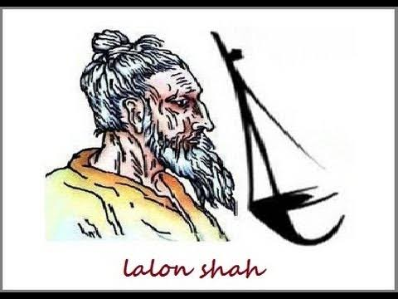
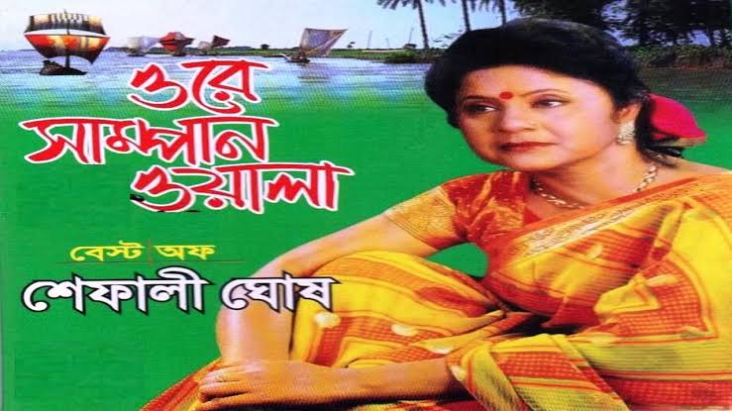
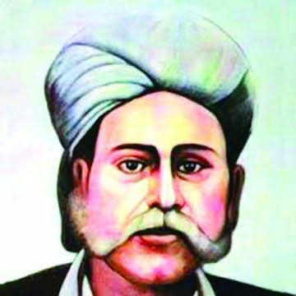
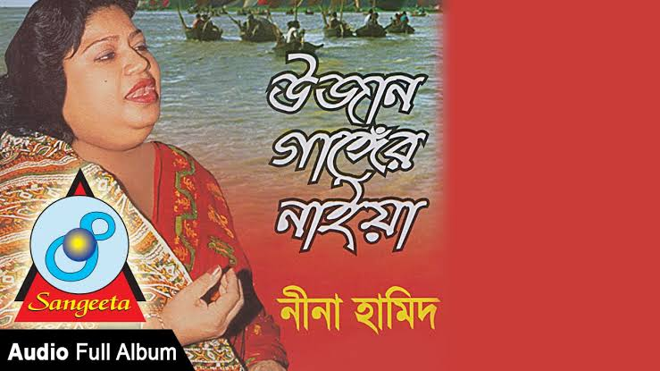
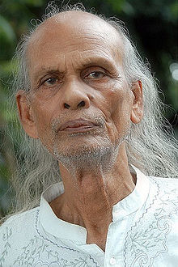
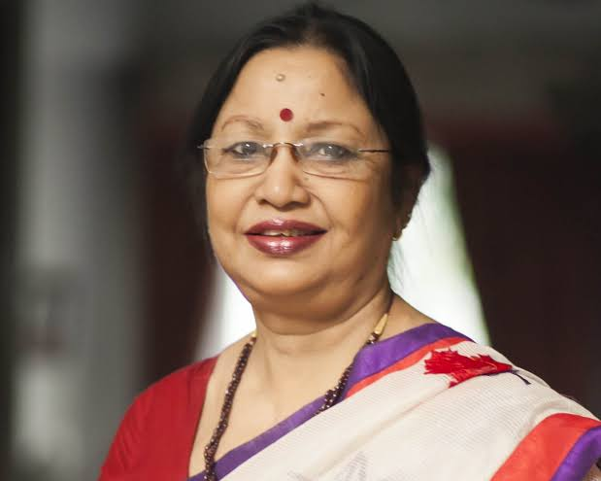
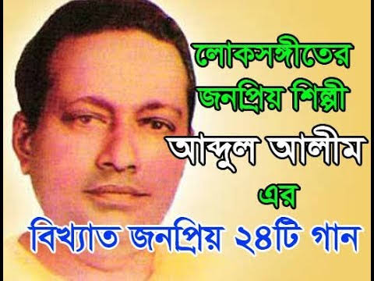
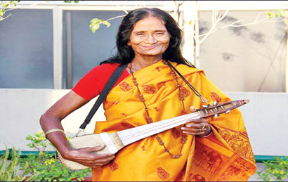
1. Can you name some well known folk singers?
Lalon Shah
Shefali Ghos
Hason Raja
Nina Hamid
Shah Abdul Karim
Ferdousi Rahman
Abdul Alim
Kangalini Sufia

Slide 15
3. Do you like folk songs? If you do, who is your favourite folksinger? Which song or songs do you like most?

Slide 16
Look at the musical instruments in Activity A above and say which instruments go well with the folk songs?
guitar
bamboo flute
drum
dotara
sarinda
piano
harmonium
ek-tara
violin
tabla

Slide 17
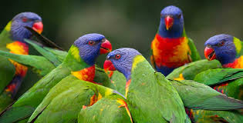
Discuss in groups:
Discuss in groups whether the modern instruments like guiter and the piano could be played with the folk songs?

Slide 18
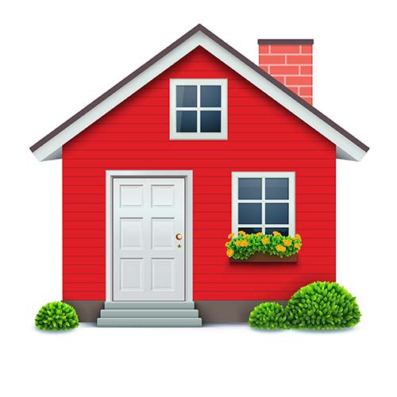
Home work
Do you want more or less programmes on folk songs on our TV channels? Why?/why not?

Slide 19
Thank you

